Slide 1
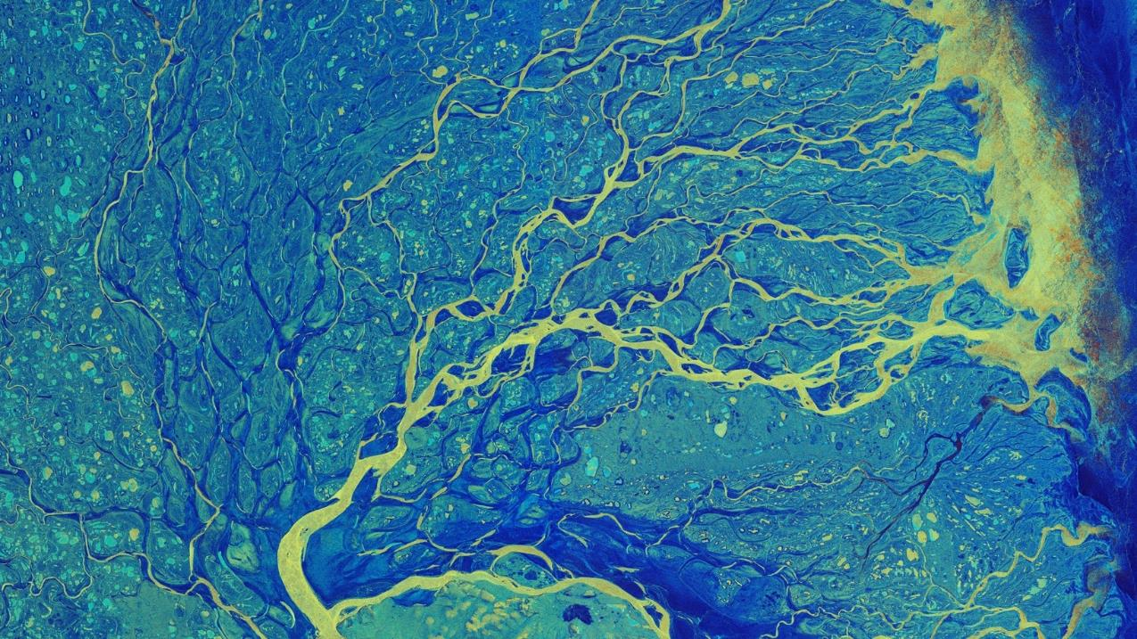
Freshwater from space
Why from space ? satellites
Cnes/Aviso
Lena Delta by Sentinel-1 (SAR) © Esa
Notes:
Except otherwise noted, “Freshwater from space. Why from space ? satellites” presentation by Cnes/Aviso is licensed under CC BY-SA 4.0. To view a copy of this license, visit https://creativecommons.org/licenses/by-sa/4.0

Slide 2
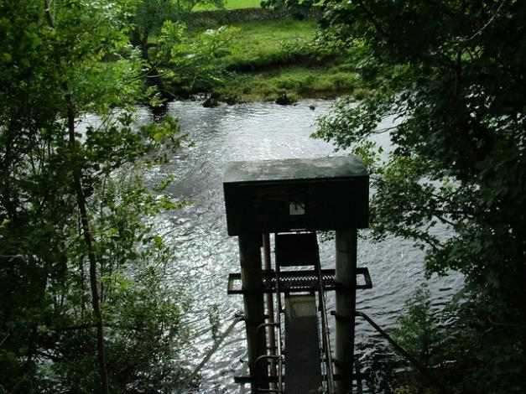
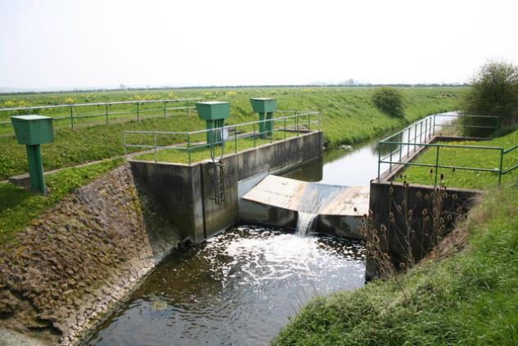
Observe water “on site”
Measurement stations are installed on water streams, lakes
© Richard Croft, CC BY-SA 2.0
© David Brown, CC BY-SA 2.0
Data are collected on site, or remotely (satellites, phone network, VHF, wires…)
Notes:
Photos :
https://www.geograph.org.uk/photo/166904
https://www.geograph.org.uk/photo/2078099
in situ: installation, maintenance and data distribution costs are a problem
70 to 80 stations closed every year in the USA.
30% of stations lost since the 1990s in what was the territory of the former USSR
very few new stations, especially in developing countries
Except otherwise noted, “Freshwater from space. Why from space ? satellites” presentation by Cnes/Aviso is licensed under CC BY-SA 4.0. To view a copy of this license, visit https://creativecommons.org/licenses/by-sa/4.0

Slide 3
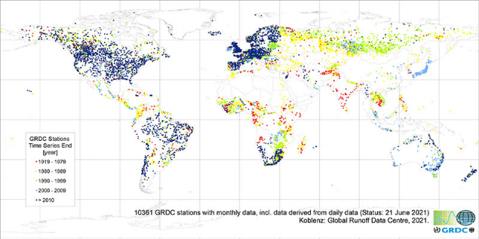
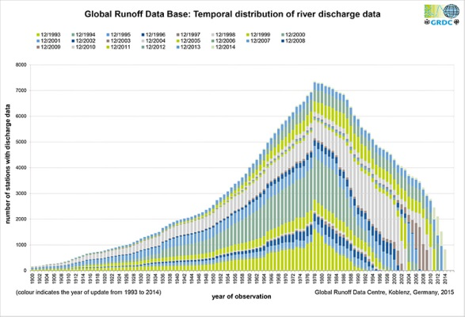
Observe water “on site”
Stations are not necessarily well distributed on the continents
Less and less stations which data can be easily recovered
Dark blue dots : river discharge measurement stations which data are disseminated after 2010
All other colors: stations available before 2010
7000
5000
Number of stations (discharge)
3000
1000
1920
1950
1980
1996
2014
Observation dates
Notes:
in situ: installation, maintenance and data distribution costs are a problem
70 to 80 stations closed every year in the USA.
30% of stations lost since the 1990s in what was the territory of the former USSR
very few new stations, especially in developing countries
Map : https://www.bafg.de/SharedDocs/Bilder/Bilder_GRDC/grdcTSEall.jpg?__blob=poster
Except otherwise noted, “Freshwater from space. Why from space ? satellites” presentation by Cnes/Aviso is licensed under CC BY-SA 4.0. To view a copy of this license, visit https://creativecommons.org/licenses/by-sa/4.0

Slide 4
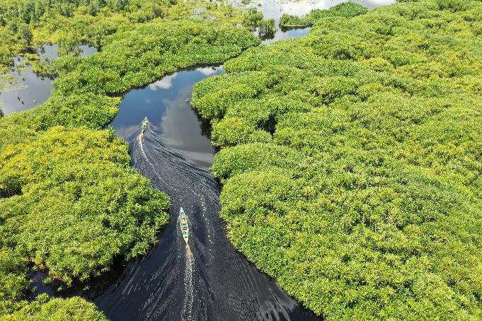
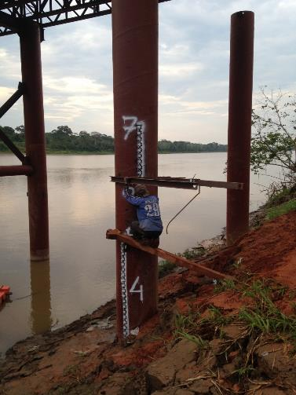
Observe water “on site”
Go to the sites can be difficult (dense forests, mountains), to record the data or do some maintenance
Barkah Wibowo on Unsplash
Hybam Project
Notes:
Except otherwise noted, “Freshwater from space. Why from space ? satellites” presentation by Cnes/Aviso is licensed under CC BY-SA 4.0. To view a copy of this license, visit https://creativecommons.org/licenses/by-sa/4.0

Slide 5
Observe water “on site”
Data are often shared too long after the measurement to be used for forecasting
Not always shared with neighboring countries, let alone internationally
Or not shared at all.
Notes:
Except otherwise noted, “Freshwater from space. Why from space ? satellites” presentation by Cnes/Aviso is licensed under CC BY-SA 4.0. To view a copy of this license, visit https://creativecommons.org/licenses/by-sa/4.0

Slide 6
Why observe freshwater from space?
Space techniques are
Global
Repeated
Homogeneous
Fast and automated
Notes:
Global: they measure the entire Earth or a portion of the Earth without borders
Repetitive: they measure at the same place at regular intervals (depending on the satellite, from a few minutes to several days (~30 at most)) and this for several years
Homogeneous: the instrument is the same for the whole Earth, at all dates. When a satellite takes over from another, they are intercalibrated to ensure that there is no discontinuity
Operational: data distribution is often performed a few minutes or hours after the measurement, always in an automated way
Except otherwise noted, “Freshwater from space. Why from space ? satellites” presentation by Cnes/Aviso is licensed under CC BY-SA 4.0. To view a copy of this license, visit https://creativecommons.org/licenses/by-sa/4.0

Slide 7
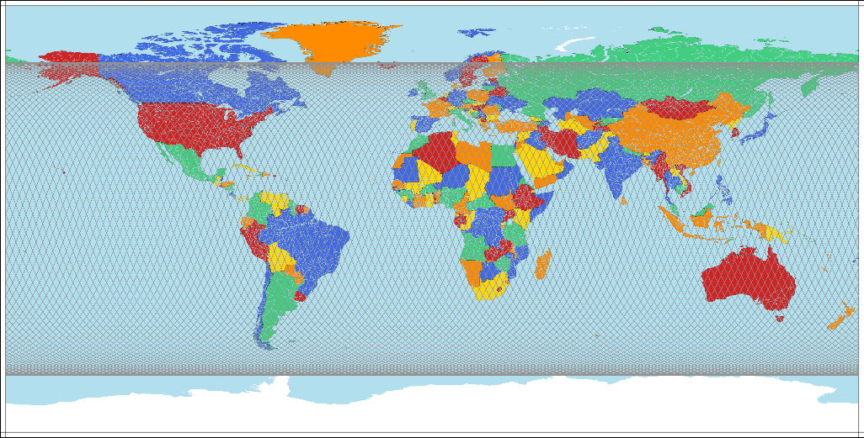
Why observe freshwater from space?
Space techniques are
Global: they measure the whole Earth or a whole portion of it, without borders
© Cnes/Aviso
Notes:
Except otherwise noted, “Freshwater from space. Why from space ? satellites” presentation by Cnes/Aviso is licensed under CC BY-SA 4.0. To view a copy of this license, visit https://creativecommons.org/licenses/by-sa/4.0

Slide 8
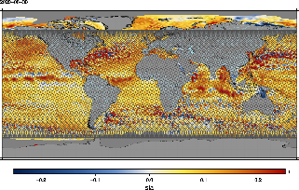
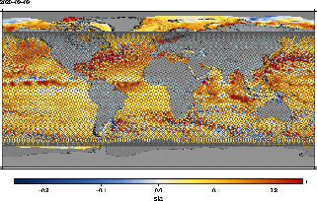
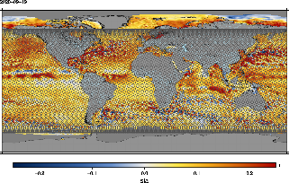
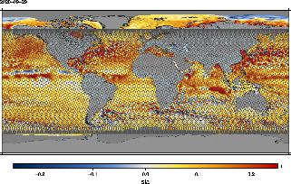
Why observe freshwater from space?
Space techniques are
Repeated : they measure at the same place most often at regular intervals (depending on the satellite, from a few minutes to several days up to one year), during several years
© Cnes/Aviso
30 August 2020
© Cnes/Aviso
+10 days
9 September 2020
© Cnes/Aviso
+10 days
19 September 2020
© Cnes/Aviso
+10 days
29 September 2020
Notes:
Except otherwise noted, “Freshwater from space. Why from space ? satellites” presentation by Cnes/Aviso is licensed under CC BY-SA 4.0. To view a copy of this license, visit https://creativecommons.org/licenses/by-sa/4.0

Slide 9
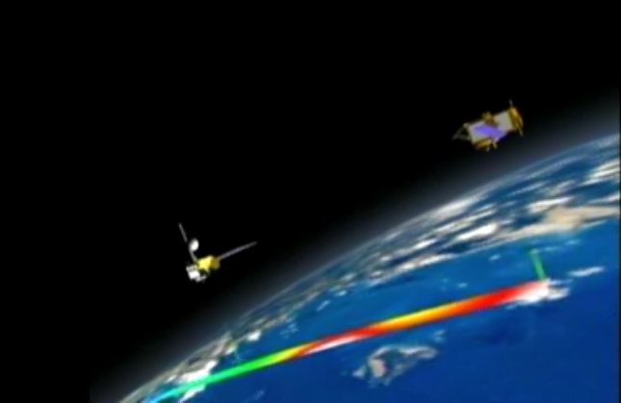
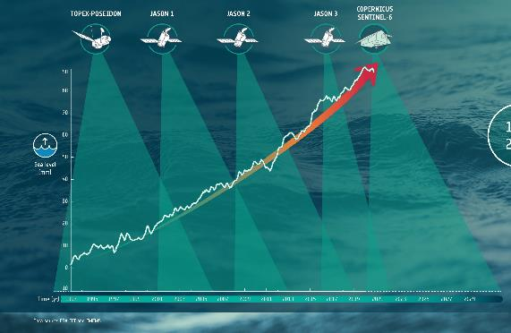
Why observe freshwater from space?
Space techniques are
Homogeneous: the instrument is the same for the whole Earth, all the time.
When a satellite takes over from another, they can be intercalibrated to ensure that there is no discontinuity
© JPL
© ESA
Notes:
Except otherwise noted, “Freshwater from space. Why from space ? satellites” presentation by Cnes/Aviso is licensed under CC BY-SA 4.0. To view a copy of this license, visit https://creativecommons.org/licenses/by-sa/4.0

Slide 10
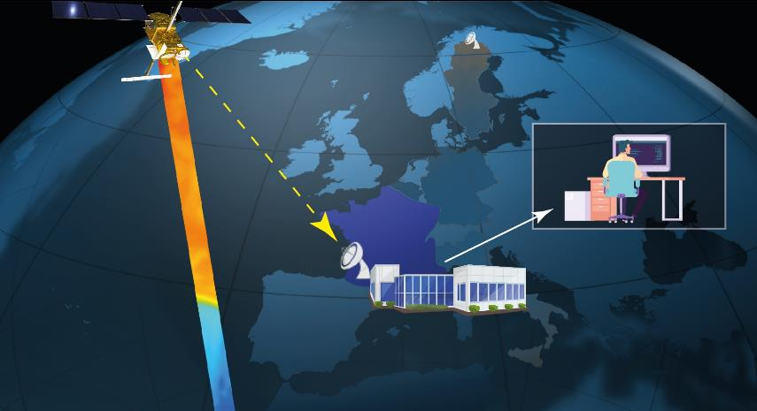
Why observe freshwater from space?
Space techniques are
Fast and automated (“operational”) : data processing and distribution are often performed a few minutes or at the most hours after the measurement, in an automated way
© Cnes/Mira Production
Notes:
Except otherwise noted, “Freshwater from space. Why from space ? satellites” presentation by Cnes/Aviso is licensed under CC BY-SA 4.0. To view a copy of this license, visit https://creativecommons.org/licenses/by-sa/4.0

Slide 11
Satellites
Notes:
Except otherwise noted, “Freshwater from space. Why from space ? satellites” presentation by Cnes/Aviso is licensed under CC BY-SA 4.0. To view a copy of this license, visit https://creativecommons.org/licenses/by-sa/4.0

Slide 12
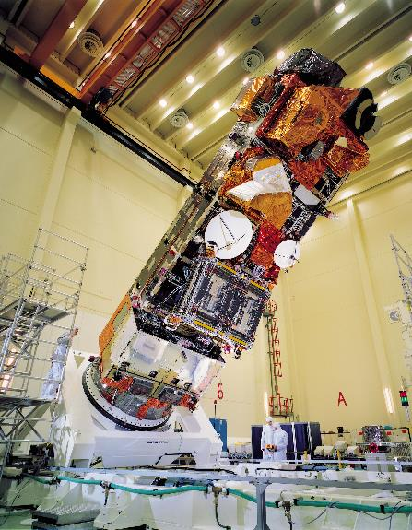
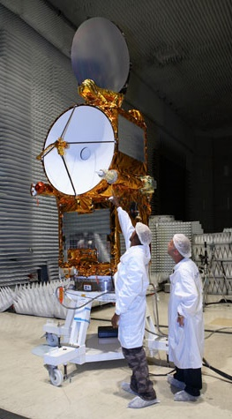
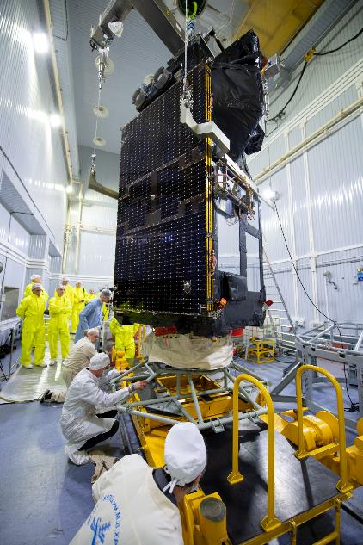
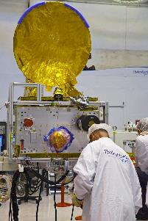
All satellites are different (or almost all)
© ESA
© Cnes/TAS
© Cnes/TAS
© ESA
Notes:
Photos of satellites during their building, with people to show the size.
Left to right: Envisat (the size of a double-deck bus), Saral (~1 m x 1 m), Jason-2 (~1 m x 2 m), Sentinel-3A
Some few satellites are built in pairs or constellations – those can be identical.
Except otherwise noted, “Freshwater from space. Why from space ? satellites” presentation by Cnes/Aviso is licensed under CC BY-SA 4.0. To view a copy of this license, visit https://creativecommons.org/licenses/by-sa/4.0

Slide 13
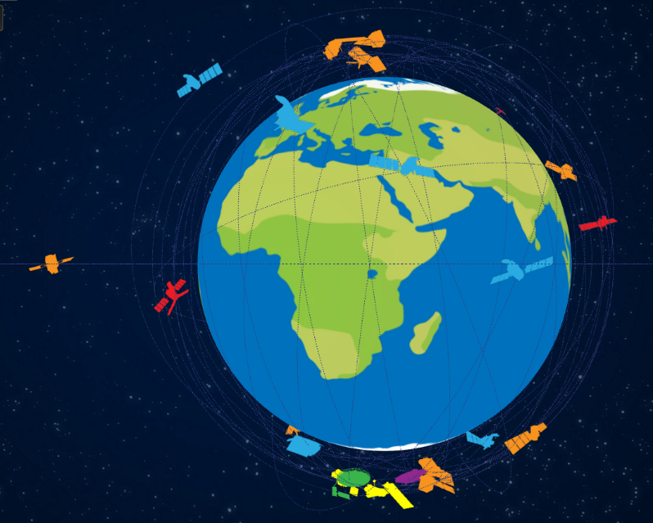
All satellites are different (or almost all)
Altitude: from 500 km to 36000 km
latitudes maximum north/south: from 0° (Equator), to 89,5°N and S (nearly up to the poles)
© Cnes
Notes:
NB. not all altitude/inclination combinations are possible, and imply that the satellite returns over the same point with a different duration (duration of a "cycle").
In particular, a geostationary satellite is necessarily at the equator and only there (it will never "see" one of the poles); it revolves around the Earth in 24 hours at the same rate as the Earth (and thus remains above the same point; it will never see the other side of the planet (but will see "its" side permanently)).
Except otherwise noted, “Freshwater from space. Why from space ? satellites” presentation by Cnes/Aviso is licensed under CC BY-SA 4.0. To view a copy of this license, visit https://creativecommons.org/licenses/by-sa/4.0

Slide 14
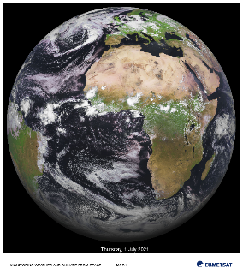
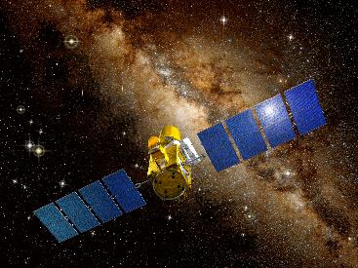
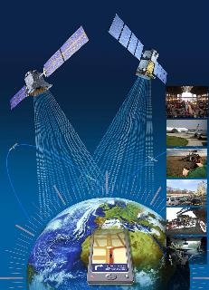
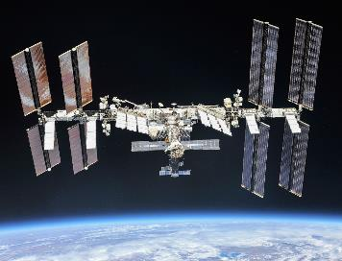
All satellites are not doing the same things
© CNES/DUCROS David, 2006
© NASA/Roscosmos/, 2018
Astronomical observations (sun, other stars, galaxies, nebula…) The word “probe” can be used when it is around another planet
© ESA/ZigZag-DR/, 2005
International (and chinese) space station
Earth observations
telecom : data transmission (television, phone, internet) + localization (Argos, Galileo, GPS...)
Notes:
Only artificial satellites are mentioned here, of course.
(images: Meteosat, Corot (astrometry), Galileo, ISS)
Except otherwise noted, “Freshwater from space. Why from space ? satellites” presentation by Cnes/Aviso is licensed under CC BY-SA 4.0. To view a copy of this license, visit https://creativecommons.org/licenses/by-sa/4.0

Slide 15
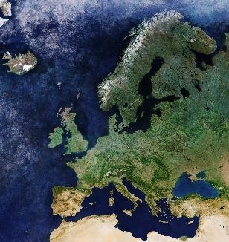
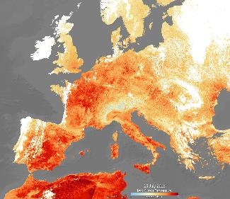
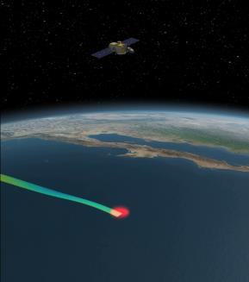
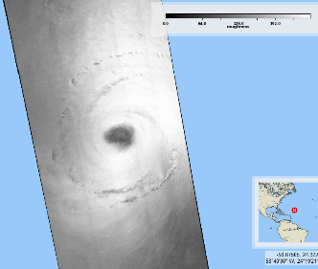
All satellites are not doing the same things
© ESA
© CLS/Ifremer for ESA
© ESA
© JPL
Some are taking images looking like photos « optical imagers »
Others are taking images but that our eyes would not see « infrared or microwave imagers »
Others again are taking images but after the satellite sent a signal towards the surface « imaging radars »
Other are taking measurements just beneath themselves (and not images) « altimeters »
© ESA
Passive instruments (collect what is emitted/reflected by the surface)
Active instruments (send a signal towards surface and collect what is reflected to them
Earth observation (civilian)
Notes:
Images : Sentinel-2, Sentinel-3 infrared (surface temperateur), Sentinel-1 (sea surface roughness, Hurrican Larry), Jason-1 (JPL movie)
Altimeters : radar or lidar.
Other are taking measurements just beneath themselves: NB. There are sounders for atmosphere, not all of them active instruments (IASI)
Except otherwise noted, “Freshwater from space. Why from space ? satellites” presentation by Cnes/Aviso is licensed under CC BY-SA 4.0. To view a copy of this license, visit https://creativecommons.org/licenses/by-sa/4.0

Slide 16
Measuring from space, using what?
Satellites are using electromagnetic signals of similar nature than light (but not only the ones visible by our eyes
Each color (wavelength) can show different things:
E.g., in visible wavelengths, the green of vegetation (including algae)
It is true also outside the visible part of the spectrum. Water in particular can be detected using specific wavelengths
Every material emits an electromagnetic signal depending on its temperature
A few satellites function differently, but they always use electromagnetic signals to communicate with Earth
Notes:
Except otherwise noted, “Freshwater from space. Why from space ? satellites” presentation by Cnes/Aviso is licensed under CC BY-SA 4.0. To view a copy of this license, visit https://creativecommons.org/licenses/by-sa/4.0

Slide 17
Measuring from space, using what? Electromagnetic signals
© NASA
Notes:
Except otherwise noted, “Freshwater from space. Why from space ? satellites” presentation by Cnes/Aviso is licensed under CC BY-SA 4.0. To view a copy of this license, visit https://creativecommons.org/licenses/by-sa/4.0

Slide 18
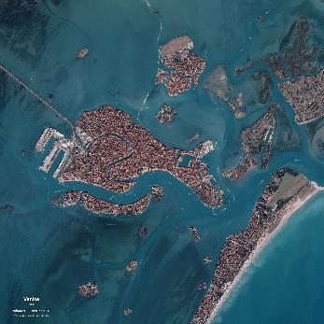
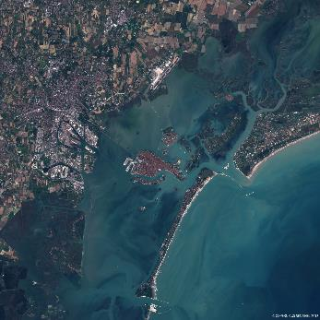
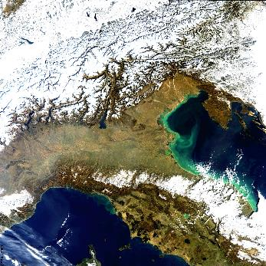
Resolutions
We can get an image covering a very large area with a very high level of details (very high resolution)
very high-resolution images (pixel is 30 cm for Pleiades Neo) will only cover a small area in one shot (14 kmfor Pleiades Neo)
Other satellites will measure over 2 300 km x 10 km, but the pixel will be between 250 m and 1000 m.
Resolution: 0.5 m swath: 20 km
Resolution: 10 m swath: 190 km
Résolution: 250-300 m swath: 1150 km
Venice seen by Pleiades satellite © CNES/Distribution Airbus DS, 2021
Venice laguna seen by Sentinel-2A © CNES/Copernicus EU
North of Italy by Meris (Envisat) Credit ESA
Notes:
Cnes Images: Press, Science, Education and Outreach publications. All right reserved.
Except otherwise noted, “Freshwater from space. Why from space ? satellites” presentation by Cnes/Aviso is licensed under CC BY-SA 4.0. To view a copy of this license, visit https://creativecommons.org/licenses/by-sa/4.0

Slide 19
What can we observe about freshwater from satellites?
Notes:
Except otherwise noted, “Freshwater from space. Why from space ? satellites” presentation by Cnes/Aviso is licensed under CC BY-SA 4.0. To view a copy of this license, visit https://creativecommons.org/licenses/by-sa/4.0

Slide 20
Freshwater measurements made by satellites
Rain, snow, hail (precipitation)
Evaporation
Transpiration
Water level
River flow velocity / discharge
Groundwater stocks
Soil moisture
Amount of snow and ice
Water quality
Water surface temperature
Extent of water bodies
(transparent) water depth up to about 6 m
what vegetation / construction is where ("land cover")
Data collection
Notes:
Except otherwise noted, “Freshwater from space. Why from space ? satellites” presentation by Cnes/Aviso is licensed under CC BY-SA 4.0. To view a copy of this license, visit https://creativecommons.org/licenses/by-sa/4.0

Slide 21
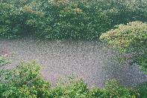
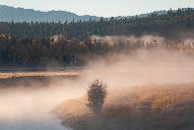
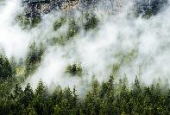
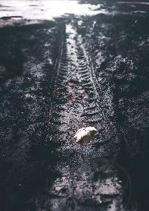
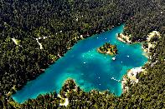
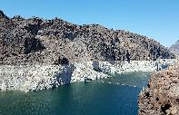
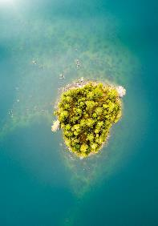
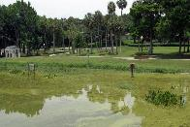
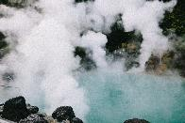
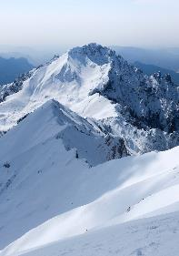
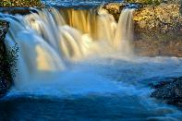
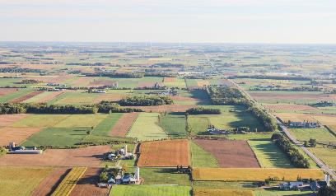
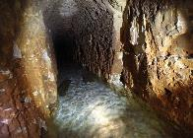
Freshwater measurements made by satellites
Rain, snow, hail (precipitation)
Extent of water bodies
Water level
Evaporation
Vegetation transpiration
Soil moisture
Christopher on Unsplash
Mason Field on Unsplash
Dave Hoefler on Unsplash
Jairph on Unsplash
L L Sammons on Unsplash
(transparent) water depth up to about 6 m
Water surface temperature
Amount of snow and ice
Water quality
River flow velocity / discharge
USGS
Tayawee Supan on Unsplash
The Ian on Unsplash
David Wirzba on Unsplash
what vegetation / construction is where ("land cover")
Groundwater stocks
Dave Hoefler on Unsplash
Colette Bawin
Alessio Soggetti on Unsplash
NB. Some satellites can also collect data measured on site, including in hardly accessible areas.
Sveta Fedarava on Unsplash
Notes:
Except otherwise noted, “Freshwater from space. Why from space ? satellites” presentation by Cnes/Aviso is licensed under CC BY-SA 4.0. To view a copy of this license, visit https://creativecommons.org/licenses/by-sa/4.0

Slide 22
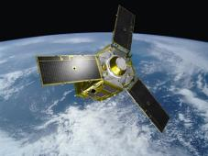
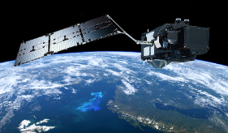
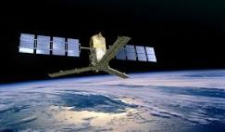
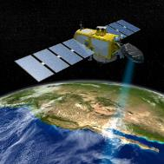
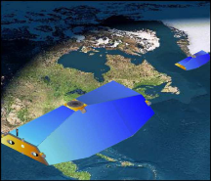
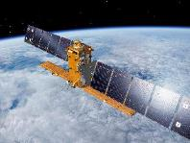
How to observe water from space
Space techniques used in hydrology
Infrared radiometer imager
Sentinel-3
Microwave radiometer imager
Smos, Smap, Smos Next
Optical radiometer imager
Spot -5, -6, -7, Landsat-8
Pléiades-1, -2, Sentinel-2 Metop, Meteosat
Synthetic Aperture Radar (SAR) Sentinel-1
Radar altimeter
Jason-2, -3, -CS, Saral,
Sentinel-3, Swot
Gravimetry satellite
Grace-1, -2
Notes:
Except otherwise noted, “Freshwater from space. Why from space ? satellites” presentation by Cnes/Aviso is licensed under CC BY-SA 4.0. To view a copy of this license, visit https://creativecommons.org/licenses/by-sa/4.0

