Slide 1
Swot in a nutshell
Notes:
Except otherwise noted, “Swot in a nutshell” presentation by Cnes/Aviso is licensed under CC BY-SA 4.0. To view a copy of this license, visit https://creativecommons.org/licenses/by-sa/4.0

Slide 2
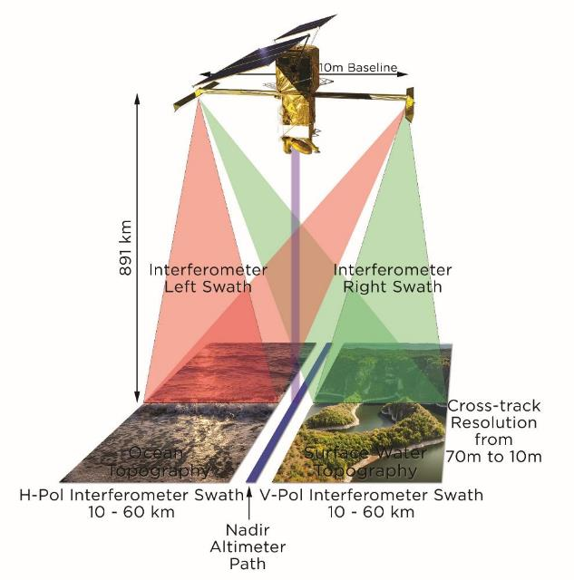
The Swot mission
Partnership between NASA, CNES, the Canadian Space Agency and the UK space agency,
A new concept, wide-swath interferometric altimetry (KaRIn)
two 50-km swaths
a bi-dimensional image
All weather, night & day measurements
Data
Direct measurements: water level, slope, width
Indirect measurements: discharge, tidal velocities and amplitudes, wave heights, current velocities…
© Cnes/Mira Production
Notes:
Except otherwise noted, “Swot in a nutshell” presentation by Cnes/Aviso is licensed under CC BY-SA 4.0. To view a copy of this license, visit https://creativecommons.org/licenses/by-sa/4.0

Slide 3
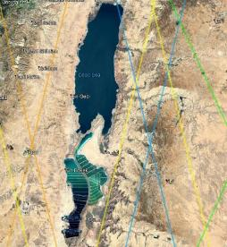
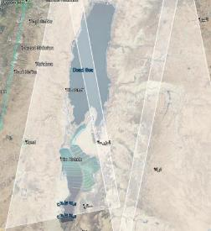
Swot for hydrology
Satellite measurements:
Water height (in 2D),
width,
slope
Inferred data: discharge
© Cnes
Classical altimetry vs Swot around the Dead Sea (left, classical altimetry, measurements are only under the colored lines ; right, with Swot, measurements are all over the whitened areas)
Number of observations of France rivers and lakes during a 21-day cycle
Notes:
Except otherwise noted, “Swot in a nutshell” presentation by Cnes/Aviso is licensed under CC BY-SA 4.0. To view a copy of this license, visit https://creativecommons.org/licenses/by-sa/4.0

Slide 4
The Swot mission
Inferred measurements
Current application examples
Swot's contribution
Lakes / reservoirs
Height
Water volume
Monitoring of water quantity variations in large lakes (a few hundred km²) ex: the drying of Aral Lake seen by Topex/Poseidon
Coverage of small lakes and reservoirs from 250 m x 250 m
Coverage of all rivers wider than 100 m (50 m target)
Rivers
Height
Surface slope
Runoff
Monitoring of water level and variations in large rivers ex: Amazon floods seen by Topex/Poseidon
Coastal area
Height
Tidal velocities and amplitudes
Currently no possibility
Possibility to visualize the coasts for the first time thanks to a better resolution
Ocean
Current velocities²
Wind speed³
Wave amplitude
Floating Objects
Measurement of Gulf Stream velocity fields by Envisat
Hurricane Isabel Tracking by Jason-1 and Envisat
Southern swell measurements (~ten meters) by Jason
Search and rescue tracking of boats by SAR (resolution according to speed / surface state)
Application to submesoscale (< 300 km)
Better accuracy and mitigation of perturbations
Best resolution (to be confirmed)
1. In bold: the quantities measurable directly by Swot. the others are obtained with models/interpolations completed possibly by other measurements
2. Deduce slope measurements from dynamic ocean topography and oceanographic modelling
3. Requiring a scatterometer
Notes:
Except otherwise noted, “Swot in a nutshell” presentation by Cnes/Aviso is licensed under CC BY-SA 4.0. To view a copy of this license, visit https://creativecommons.org/licenses/by-sa/4.0

Slide 5
The Swot mission
Overview of Swot potential application fields
hydrology
oceanography
Coastal currents
Representation of marine eddies at mesoscale scale
High resolution global ocean altimetry
Ocean Bathymetry
Quantity of water stored in lakes, rivers, reservoirs and other wetlands
Change in stored water quantities
Estimation of the discharge of large rivers
Collected data
enable …
enable…
Water sharing management (international & interregional)
Better modelling of floods
Freshwater management for urban, industrial and agricultural consumption
Management of hydroelectric production
Preventing the spread of epidemics,
Estuary management
Help to inland navigation
More accurate weather and climate forecasts
Help to navigation and rescue operations at sea
Assistance to fishermen
Assistance to oil platforms
Possible applications
Notes:
5
Except otherwise noted, “Swot in a nutshell” presentation by Cnes/Aviso is licensed under CC BY-SA 4.0. To view a copy of this license, visit https://creativecommons.org/licenses/by-sa/4.0

