Slide 1
Why study water on Earth?
Notes:
Except otherwise noted, “Why study water on Earth” presentation by Cnes/Aviso is licensed under CC BY-SA 4.0. To view a copy of this license, visit https://creativecommons.org/licenses/by-sa/4.0

Slide 2
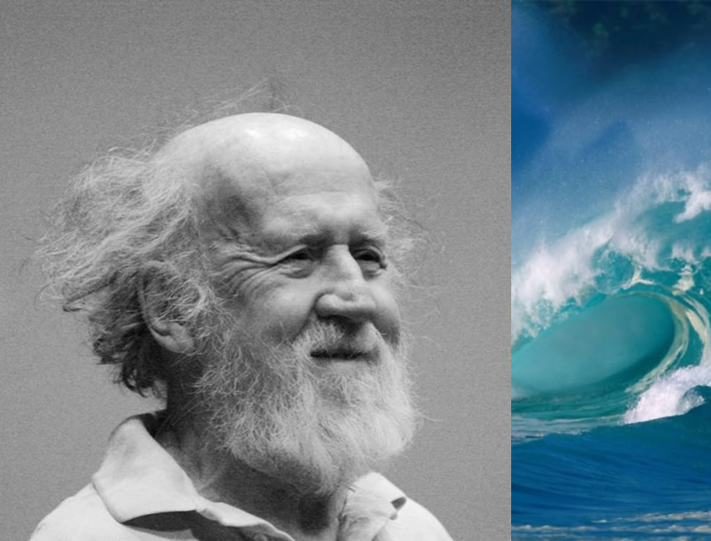
Introduction: issues
Hubert Reeves
Canadian astrophysicist
“At a cosmic scale, water is scarcer than gold”
Notes:
Except otherwise noted, “Why study water on Earth” presentation by Cnes/Aviso is licensed under CC BY-SA 4.0. To view a copy of this license, visit https://creativecommons.org/licenses/by-sa/4.0

Slide 3

Introduction: issues
“Water is the oil of the 21st Century”
Andrew Liveris,
Dow Chemical CEO
Notes:
Except otherwise noted, “Why study water on Earth” presentation by Cnes/Aviso is licensed under CC BY-SA 4.0. To view a copy of this license, visit https://creativecommons.org/licenses/by-sa/4.0

Slide 4
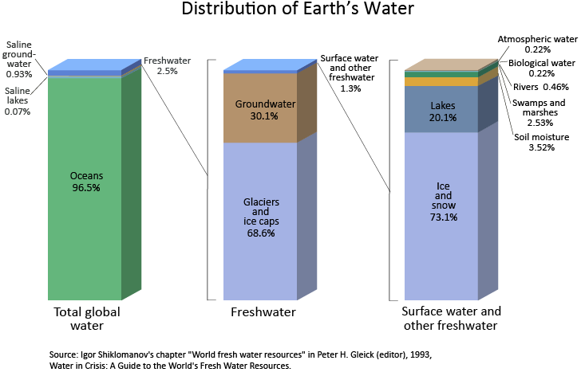
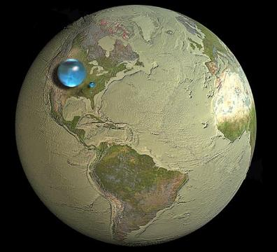
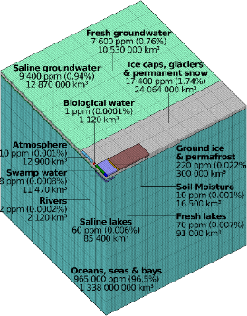
Introduction: issues
There’s no subsitute for water
Necessary for survival
A limited quantity – and very few of it available for human use
Only 2.5% of the total water is freshwater;
Only part of groundwater and surface freshwaters can be used, plus part of the precipitations.
Source USGS
Notes:
Choose only one of the figure, they basically show the same: that water is scarce on Earth, and even more water possible to use by human beings
The globe is : large drop, all waters; smaller drop : all freshwater; smallest drop: freshwater inlakes and rivers
Except otherwise noted, “Why study water on Earth” presentation by Cnes/Aviso is licensed under CC BY-SA 4.0. To view a copy of this license, visit https://creativecommons.org/licenses/by-sa/4.0

Slide 5
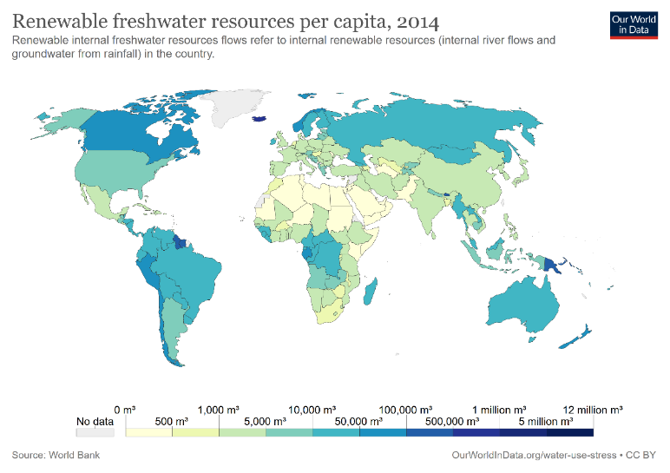
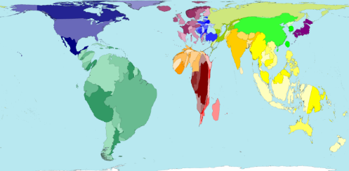
Introduction: issues
Uneven distribution
Asia has 60% of the population but only 36% of the water
South America has only 7% of the population but 30% of the water
Notes:
Map bottom left : Worldmapper.org contorts the shapes of world territories to reflect the relative proportions of the world’s freshwater resources found within their bounds. © Copyright SASI Group (University of Sheffield) and Mark Newman (University of Michigan).
http://archive.worldmapper.org/display.php?selected=102
For a population map : http://archive.worldmapper.org/display.php?selected=2
Map right: freshwater resources per capita.
Except otherwise noted, “Why study water on Earth” presentation by Cnes/Aviso is licensed under CC BY-SA 4.0. To view a copy of this license, visit https://creativecommons.org/licenses/by-sa/4.0

Slide 6
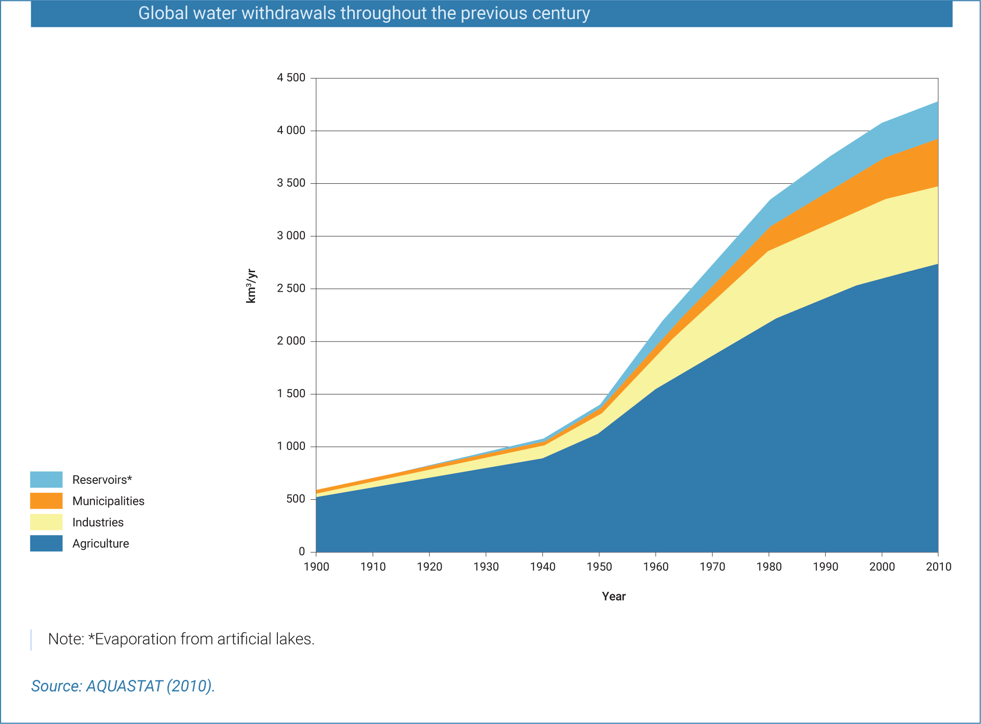
Introduction: issues
Water withdrawal
increases
Notes:
Except otherwise noted, “Why study water on Earth” presentation by Cnes/Aviso is licensed under CC BY-SA 4.0. To view a copy of this license, visit https://creativecommons.org/licenses/by-sa/4.0

Slide 7
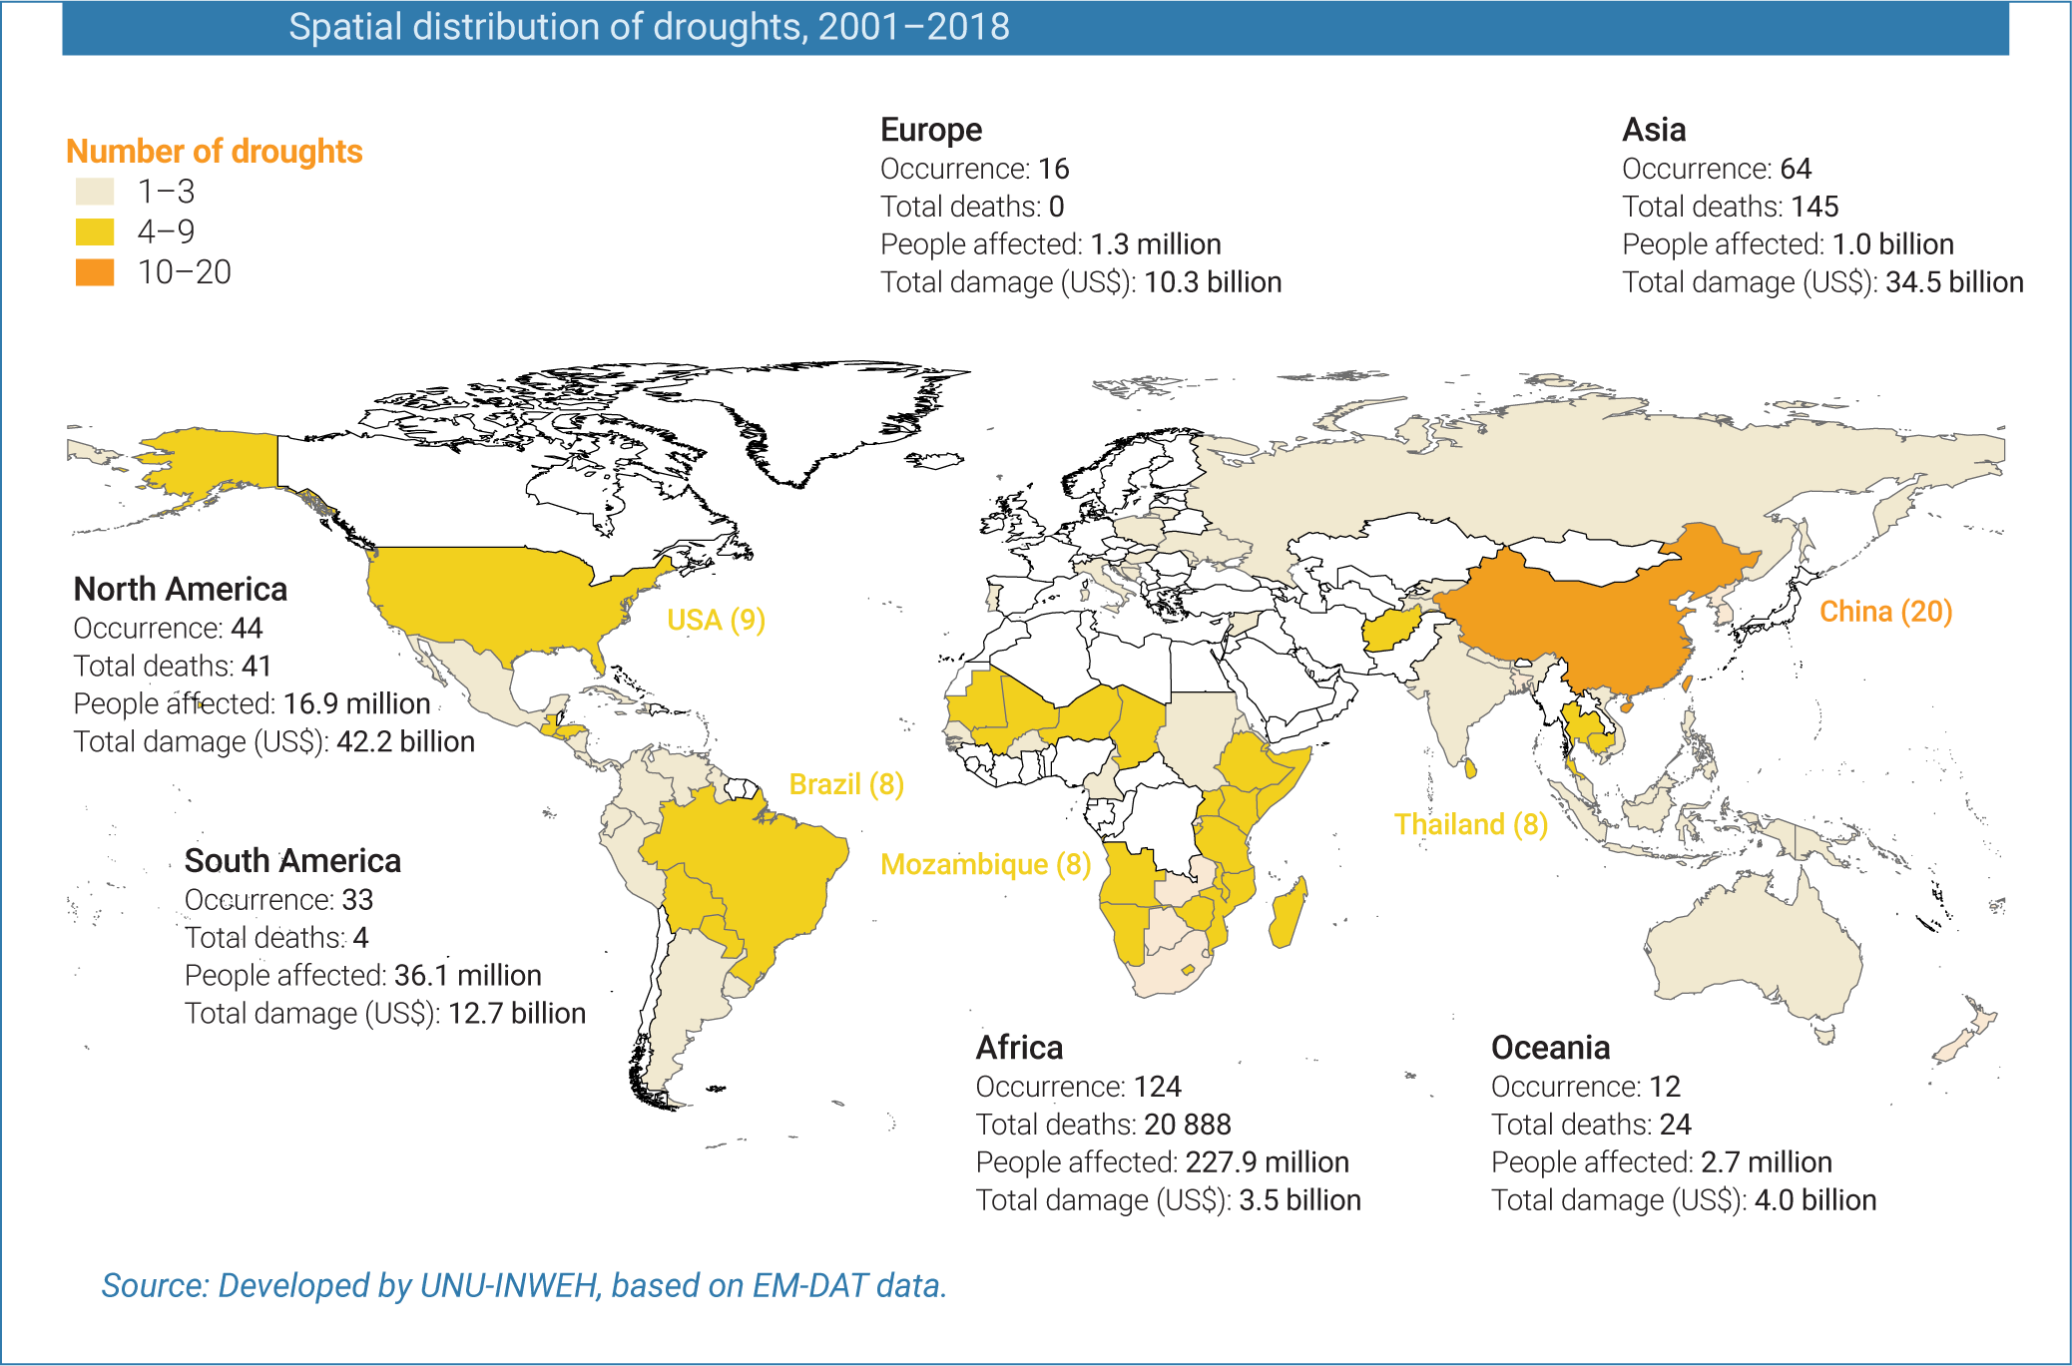
Introduction: issues
Drought afflicts growing parts of the world
Notes:
UNESCO, UN-Water, 2020: United Nations World Water Development Report 2020:Water and Climate Change, Paris, UNESCO.
https://en.unesco.org/themes/water-security/wwap/wwdr/2020
https://creativecommons.org/licenses/by-sa/3.0/igo/deed.en
Except otherwise noted, “Why study water on Earth” presentation by Cnes/Aviso is licensed under CC BY-SA 4.0. To view a copy of this license, visit https://creativecommons.org/licenses/by-sa/4.0

Slide 8
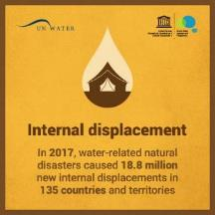
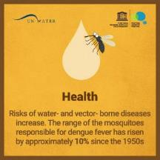
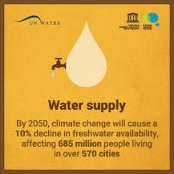
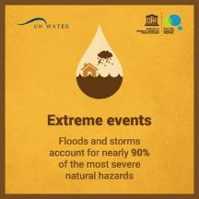
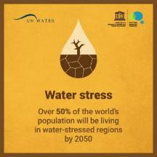
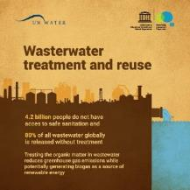
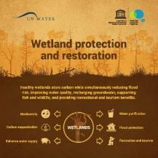
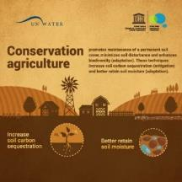
Introduction: issues
UNESCO, UN-Water, 2020: United Nations World Water Development Report 2020: Water and Climate Change, Paris, UNESCO.
Notes:
Except otherwise noted, “Why study water on Earth” presentation by Cnes/Aviso is licensed under CC BY-SA 4.0. To view a copy of this license, visit https://creativecommons.org/licenses/by-sa/4.0

Slide 9

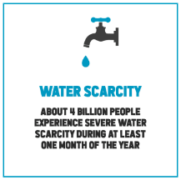
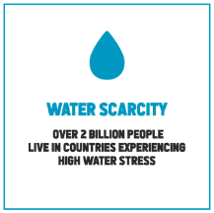
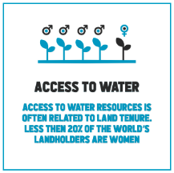
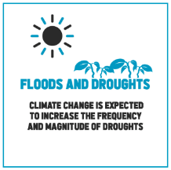
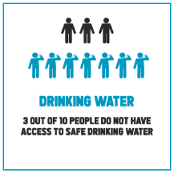
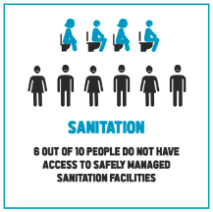
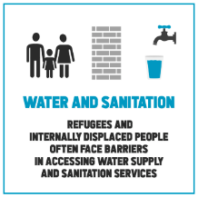
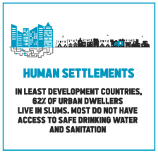

Introduction: issues
UNESCO, UN-Water, 2019: United Nations World Water Development Report 2019: Leaving No One Behind. Paris, UNESCO.
Notes:
Except otherwise noted, “Why study water on Earth” presentation by Cnes/Aviso is licensed under CC BY-SA 4.0. To view a copy of this license, visit https://creativecommons.org/licenses/by-sa/4.0

Slide 10
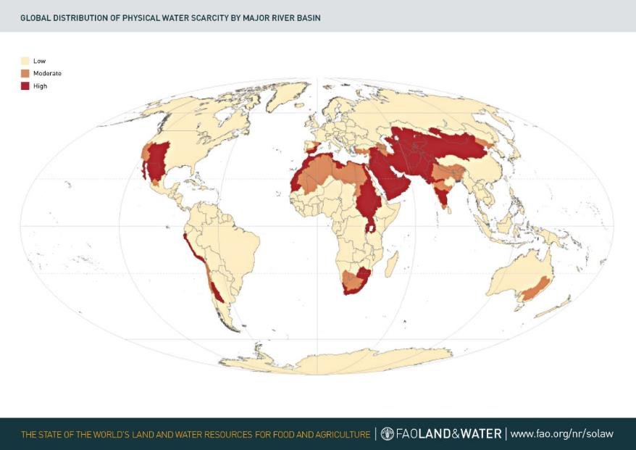
Introduction: issues
Total amount of water constant, but:
more and more people
more and more needs, especially in developing countries
uneven distribution
Notes:
Except otherwise noted, “Why study water on Earth” presentation by Cnes/Aviso is licensed under CC BY-SA 4.0. To view a copy of this license, visit https://creativecommons.org/licenses/by-sa/4.0

Slide 11
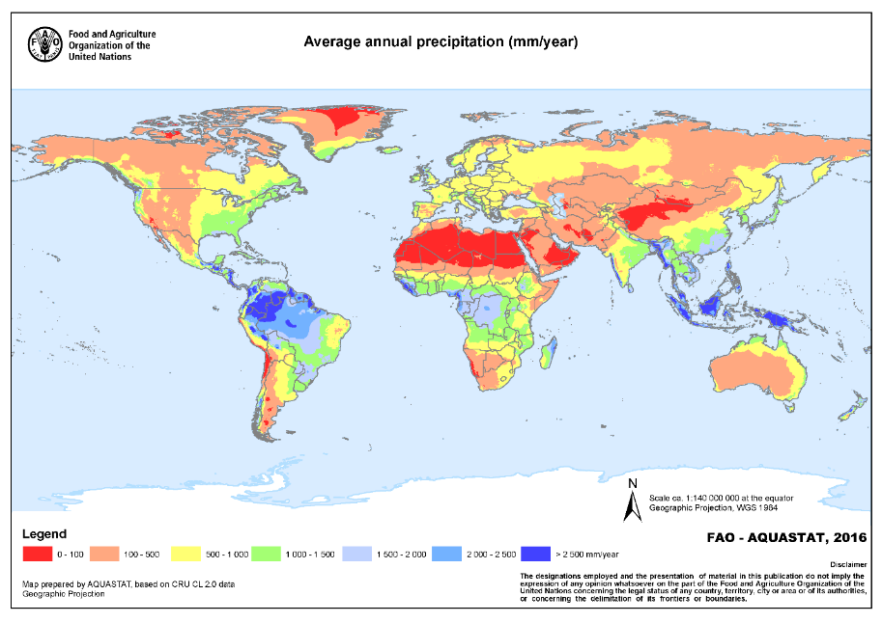
Introduction: issues
Notes:
Except otherwise noted, “Why study water on Earth” presentation by Cnes/Aviso is licensed under CC BY-SA 4.0. To view a copy of this license, visit https://creativecommons.org/licenses/by-sa/4.0

Slide 12
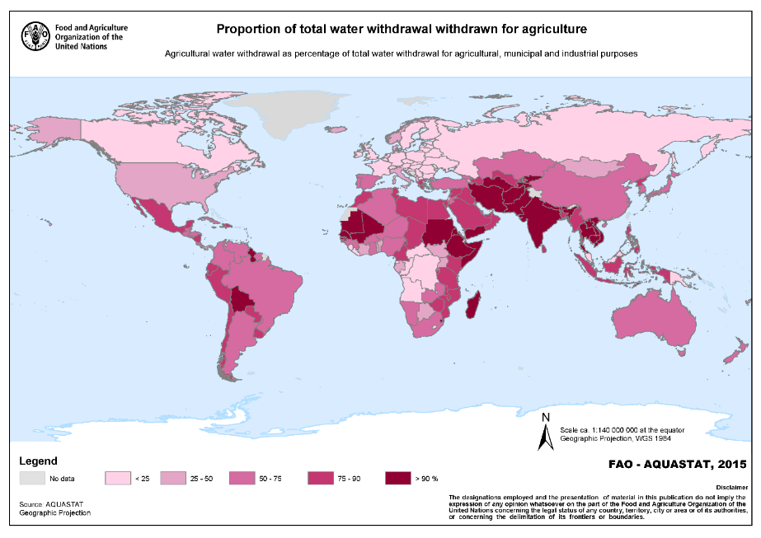
Introduction: issues
Notes:
Except otherwise noted, “Why study water on Earth” presentation by Cnes/Aviso is licensed under CC BY-SA 4.0. To view a copy of this license, visit https://creativecommons.org/licenses/by-sa/4.0

Slide 13
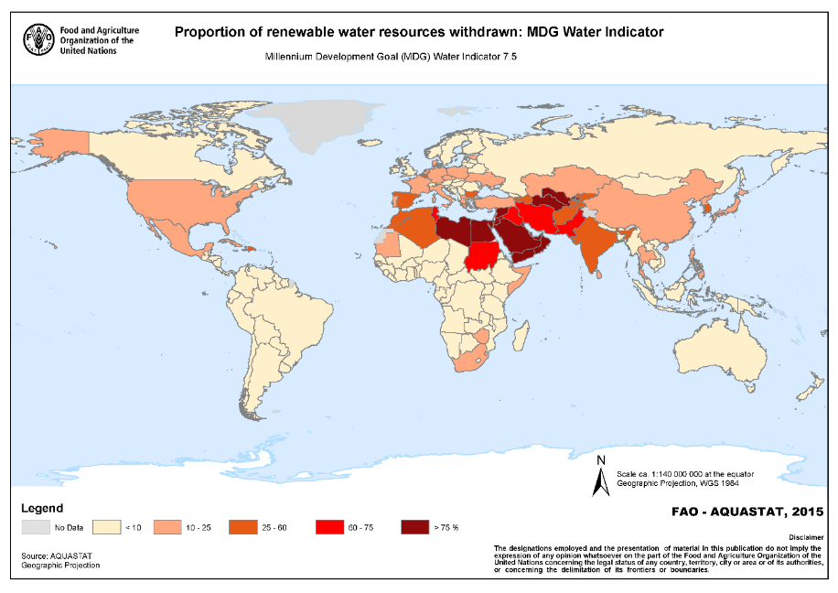
Introduction: issues
Notes:
Except otherwise noted, “Why study water on Earth” presentation by Cnes/Aviso is licensed under CC BY-SA 4.0. To view a copy of this license, visit https://creativecommons.org/licenses/by-sa/4.0

Slide 14
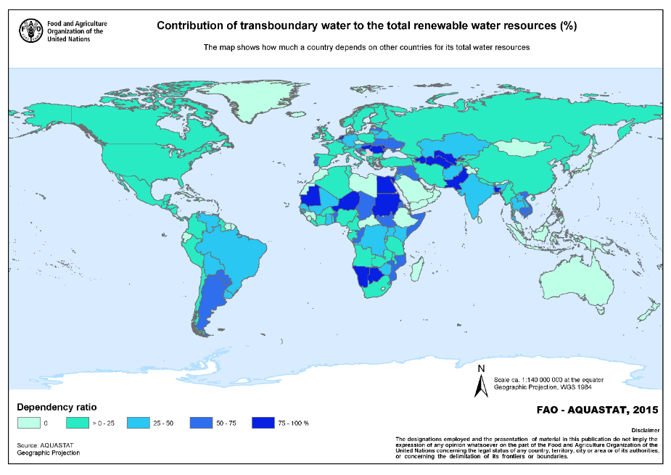
Introduction: issues
Notes:
Except otherwise noted, “Why study water on Earth” presentation by Cnes/Aviso is licensed under CC BY-SA 4.0. To view a copy of this license, visit https://creativecommons.org/licenses/by-sa/4.0

Slide 15
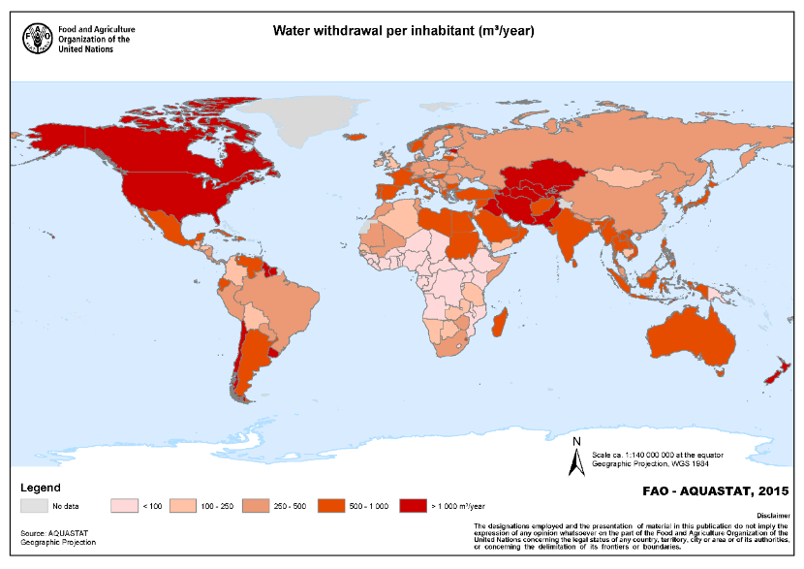
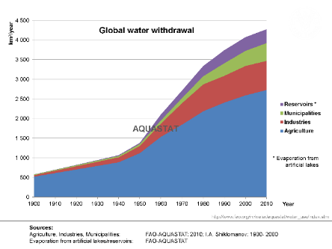
Introduction: issues
Notes:
Except otherwise noted, “Why study water on Earth” presentation by Cnes/Aviso is licensed under CC BY-SA 4.0. To view a copy of this license, visit https://creativecommons.org/licenses/by-sa/4.0

Slide 16
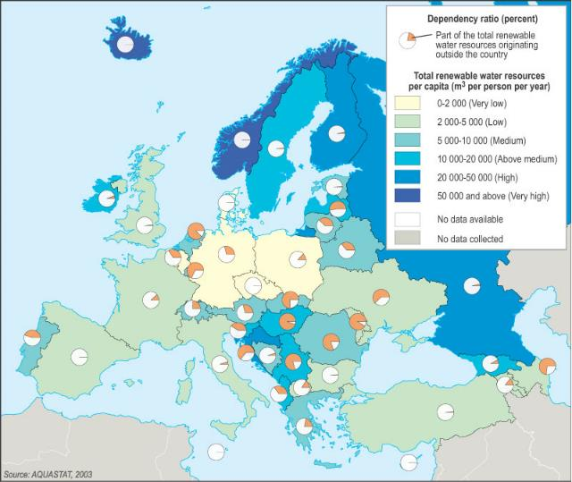
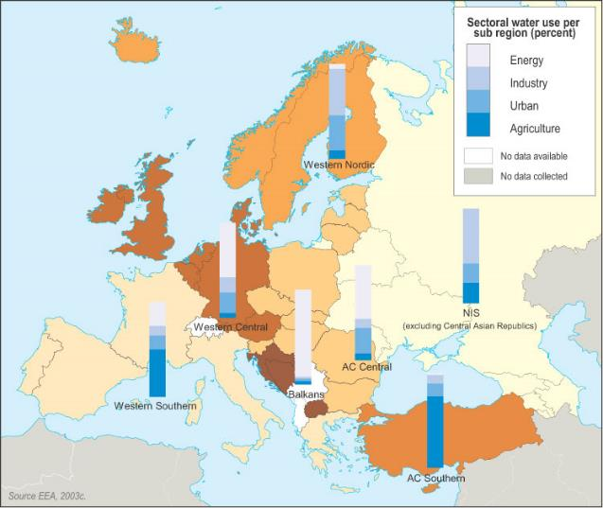
Introduction: issues in Europe
Water resources
Water uses
Notes:
Except otherwise noted, “Why study water on Earth” presentation by Cnes/Aviso is licensed under CC BY-SA 4.0. To view a copy of this license, visit https://creativecommons.org/licenses/by-sa/4.0

Slide 17
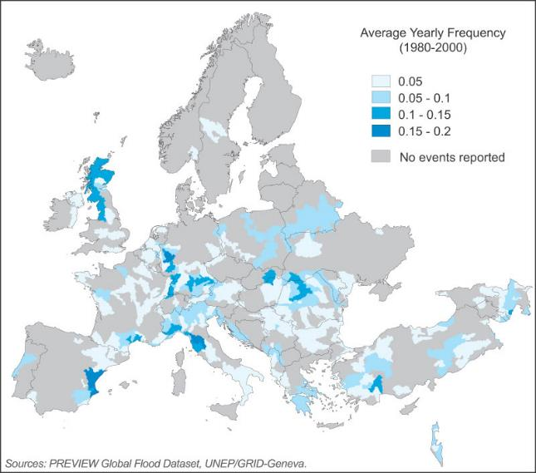
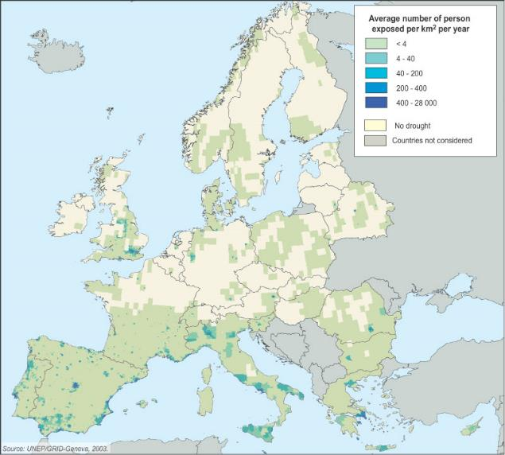
Introduction: issues in Europe
Floods
Droughts
Notes:
Except otherwise noted, “Why study water on Earth” presentation by Cnes/Aviso is licensed under CC BY-SA 4.0. To view a copy of this license, visit https://creativecommons.org/licenses/by-sa/4.0

Slide 18
Issues around the Mediterranean Sea
3% of the Earth's water resources (7% of the human population)
  20 million people around the Mediterranean Sea without access to drinking water
  47 million without access to water sanitation
11% of the total water used comes from outside the Mediterranean countries.
  The countries on the South and East coasts have only 10% of the water around the Mediterranean Sea.
Irrigation uses 64% of water (45% in northern countries, 81% in eastern and southern countries).
Very strong seasonal variations in the demand for drinking water (particularly in relation with tourism)
Notes:
Except otherwise noted, “Why study water on Earth” presentation by Cnes/Aviso is licensed under CC BY-SA 4.0. To view a copy of this license, visit https://creativecommons.org/licenses/by-sa/4.0

