Slide 1
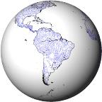
Hydrology from space
Notes:
Except otherwise noted, “Hydrology from space” presentation by Cnes/Aviso is licensed under CC BY-SA 4.0. To view a copy of this license, visit https://creativecommons.org/licenses/by-sa/4.0

Slide 2
Observing water from space - why?
Space techniques are:
  Global
  Repetitive
  Homogeneous
  Operational
Notes:
Global: they measure all over Earth or portion of Earth without any border
Repetitive: they measure the same place at regular intervals (depending on the satellite, from minutes to several days (~30 at most)) during several years
Homogeneous: the instrument is the same for all Earth, all period. When a satellite takes over another, they are intercalibrated to continue on without gaps
Operational: Data dissemination often a few minutes/hours after measurements, always automated
Except otherwise noted, “Hydrology from space” presentation by Cnes/Aviso is licensed under CC BY-SA 4.0. To view a copy of this license, visit https://creativecommons.org/licenses/by-sa/4.0

Slide 3
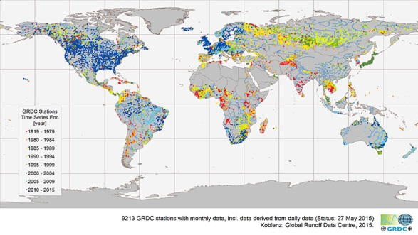
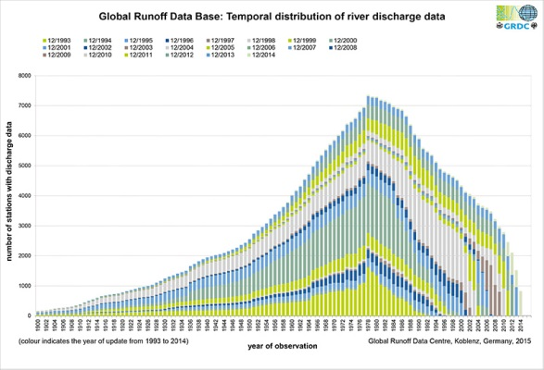
Observing water from space vs in situ
In situ networks not regularly spread
less and less stations in service
Access to stations can be difficult (dense forests, mountains…)
Access time to data often too long for forecasting
Data not always shared at international level
Blue dots: GRDC monthly discharge stations with data after 2010
7000
5000
Number of stations (discharge)
3000
1000
1920
1950
1980
1996
2014
Time of observation
Notes:
70 to 80 stations discontinued every year in the USA.
30% stations lost since the 1990s in former USSR territory
Very few new ones, in particular in developing countries
Except otherwise noted, “Hydrology from space” presentation by Cnes/Aviso is licensed under CC BY-SA 4.0. To view a copy of this license, visit https://creativecommons.org/licenses/by-sa/4.0

Slide 4
Observing water from space
Current satellite observations linked with discharge:
  point-based water elevation = nadir altimetry but for big rivers
  River width = optic and radar images from different satellites
→ Need new satellites to complement in-situ network and existing satellites with 2D observation
Notes:
Except otherwise noted, “Hydrology from space” presentation by Cnes/Aviso is licensed under CC BY-SA 4.0. To view a copy of this license, visit https://creativecommons.org/licenses/by-sa/4.0

Slide 5
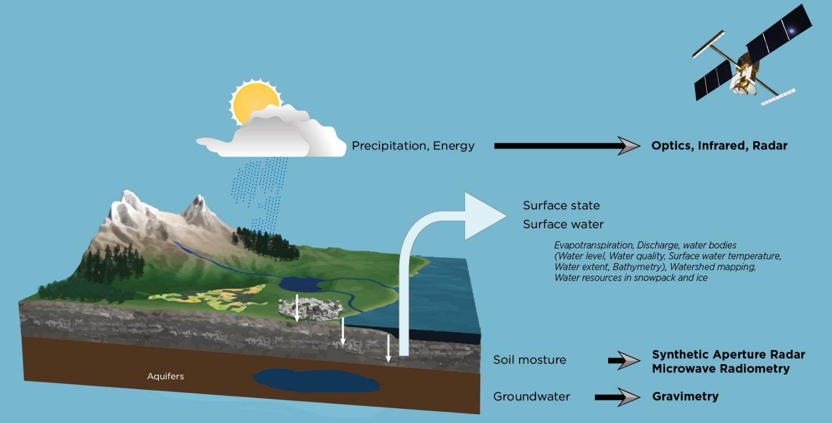
Observing water from space - why?
What space observations are bringing in to water budget?
© Cnes/Mira Production
Notes:
Except otherwise noted, “Hydrology from space” presentation by Cnes/Aviso is licensed under CC BY-SA 4.0. To view a copy of this license, visit https://creativecommons.org/licenses/by-sa/4.0
5

Slide 6
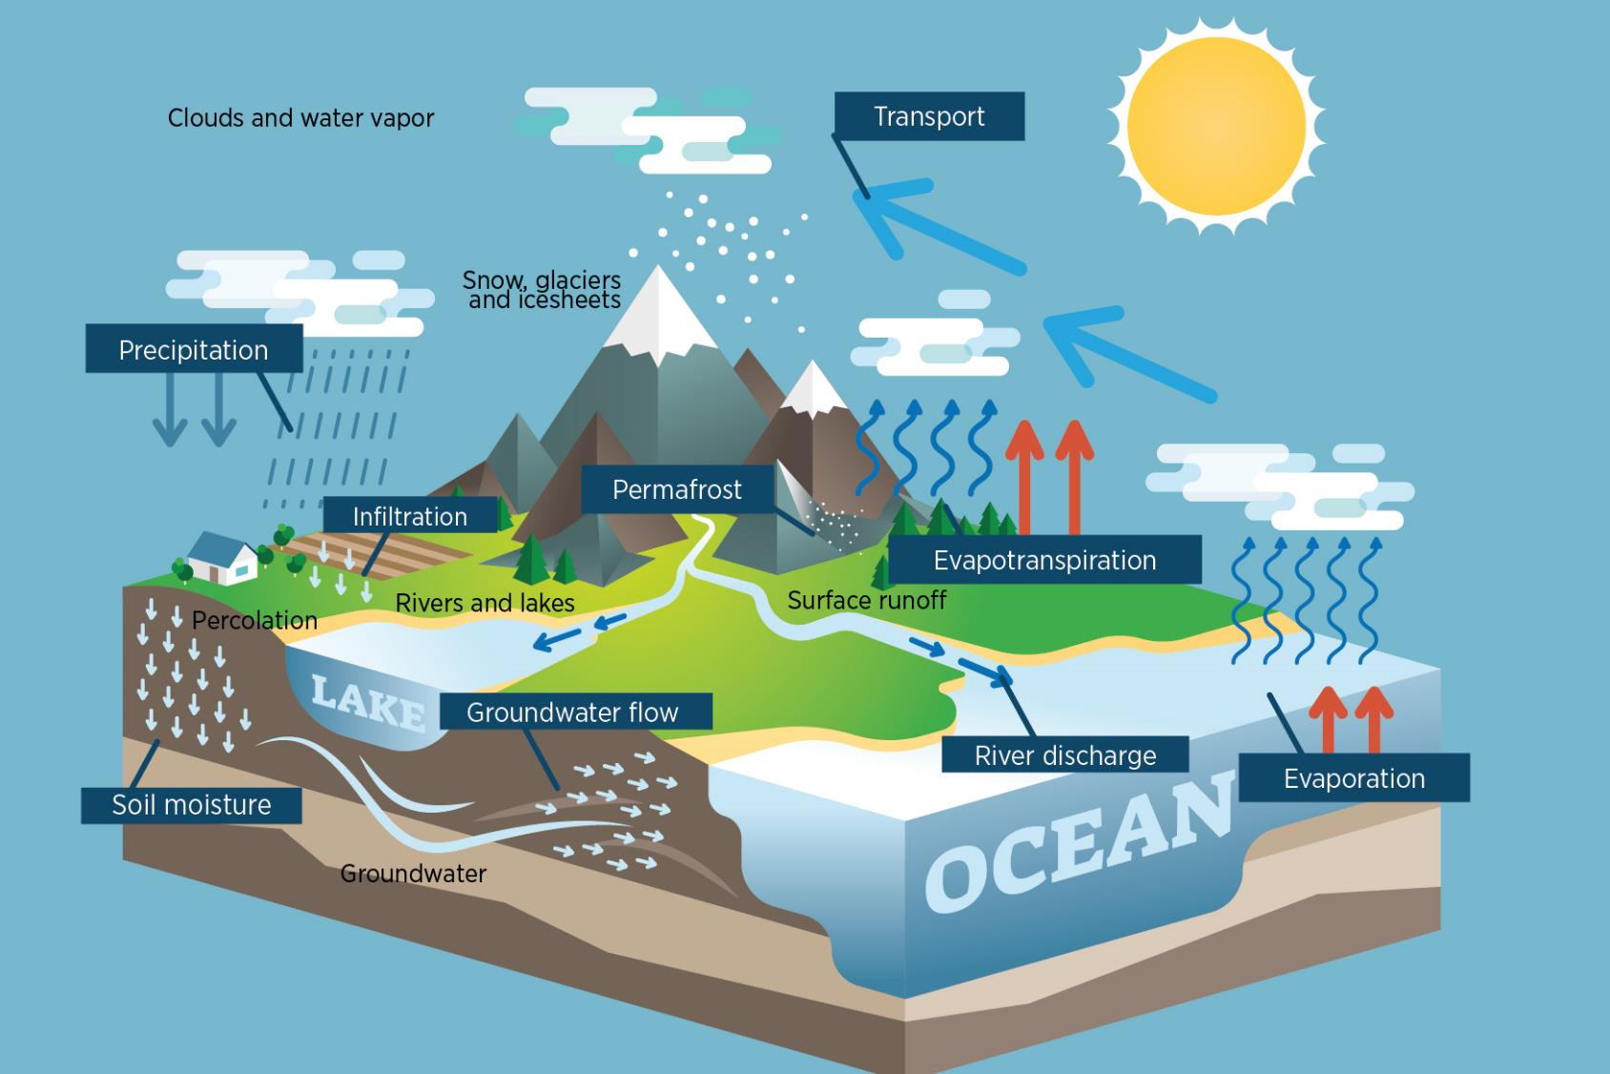
© Cnes/Mira Production
Notes:
WATER CYCLE
Except otherwise noted, “Hydrology from space” presentation by Cnes/Aviso is licensed under CC BY-SA 4.0. To view a copy of this license, visit https://creativecommons.org/licenses/by-sa/4.0

Slide 7
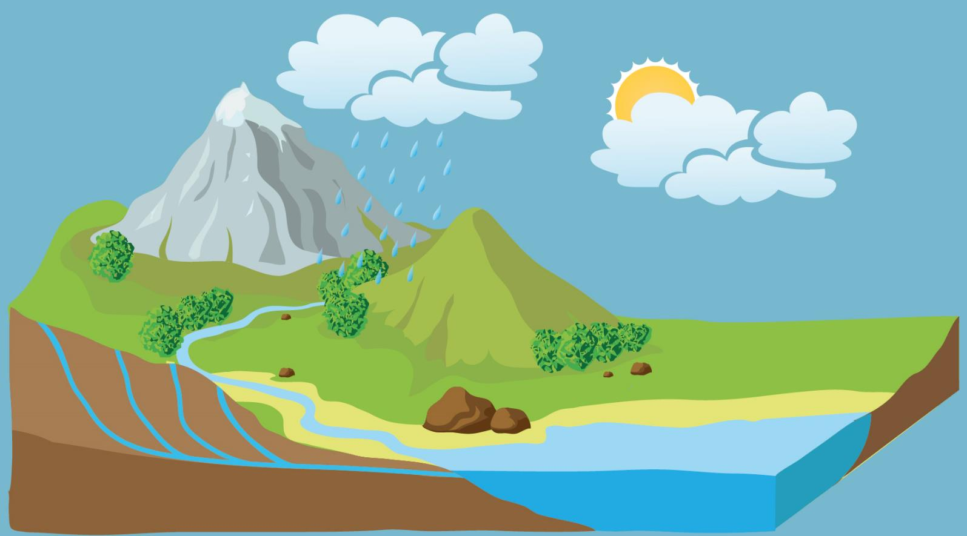
Observing water from space
Potential application domains
  Surface states (Occupation, roughness…)
  Digital elevation models and derived models
  Erosion risks
  Hydrologic Stress
  Irrigation
  Flooding
  Precipitation fields
  Soil moisture
  runoff, Water resources
  Water quality
© Cnes/Mira Production
Notes:
Except otherwise noted, “Hydrology from space” presentation by Cnes/Aviso is licensed under CC BY-SA 4.0. To view a copy of this license, visit https://creativecommons.org/licenses/by-sa/4.0

Slide 8
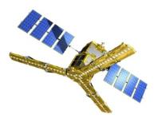
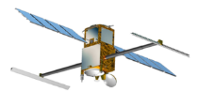
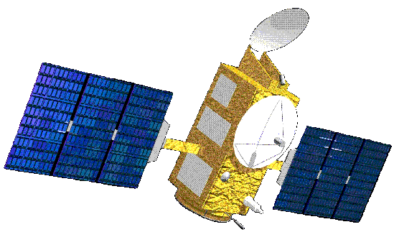
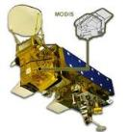
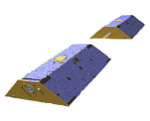
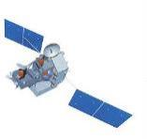
Water resources from space
SMOS, SMOS-Next,
SMAP
TMI, AMSR-E, ASCAT
Jason
Saral Altika
SWOT
Jason
Saral Altika
SWOT
CERES,
AIRS, MODIS
THIRSTY
GRACE
GRACE-2
TRMM,
GPM
SCLP
Notes:
Except otherwise noted, “Hydrology from space” presentation by Cnes/Aviso is licensed under CC BY-SA 4.0. To view a copy of this license, visit https://creativecommons.org/licenses/by-sa/4.0

Slide 9
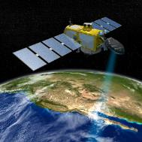
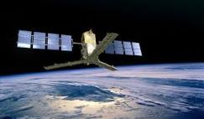
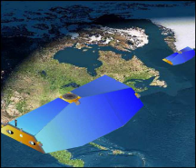
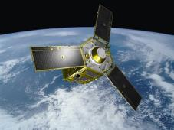
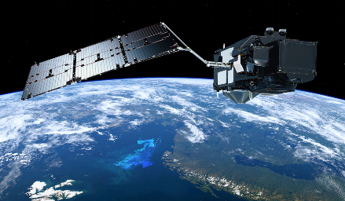
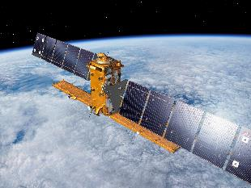
Observing water from space: how?
Some space Techniques used for hydrology
Microwave imaging radiometer
SMOS, SMAP, SMOS Next
Radar altimetry
Jason 2, 3, CS, Saral,
Sentinel 3, SWOT
Gravimetry
Grace 1, 2
Optical imaging radiometer
SPOT 5, 6, 7, Landsat 8
Pléiades 1, 2, Sentinel 2
Metop, Météosat
Infrared imaging radiometer
Sentinel-3,
Synthetic Aperture Radar (SAR)
Notes:
Except otherwise noted, “Hydrology from space” presentation by Cnes/Aviso is licensed under CC BY-SA 4.0. To view a copy of this license, visit https://creativecommons.org/licenses/by-sa/4.0

