Slide 1
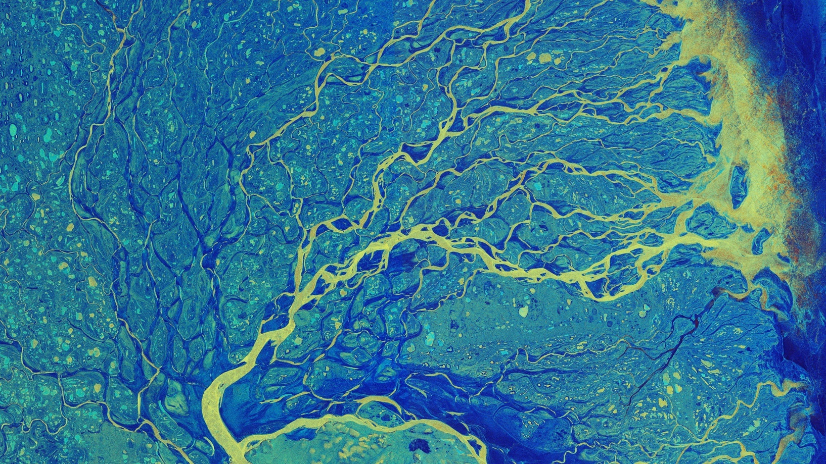
Hydrology from space
What can be measured?
Cnes/Aviso
© River Lena delta by Sentinel-1 (SAR) © Esa
Notes:
Except otherwise noted, “Hydrology from space: what can be measured?” presentation by Cnes/Aviso is licensed under CC BY-SA 4.0. To view a copy of this license, visit https://creativecommons.org/licenses/by-sa/4.0

Slide 2
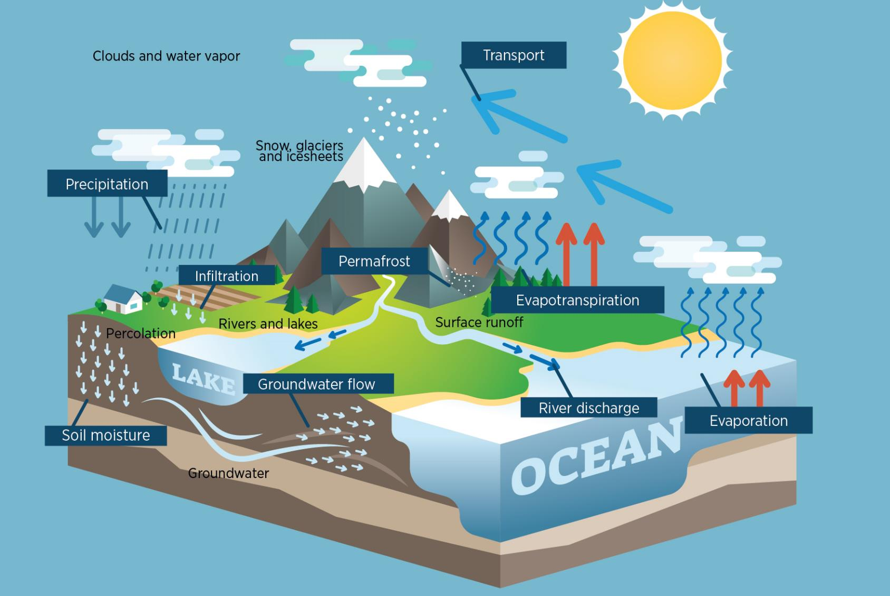
© Cnes/Mira Production
Notes:
Except otherwise noted, “Hydrology from space: what can be measured?” presentation by Cnes/Aviso is licensed under CC BY-SA 4.0. To view a copy of this license, visit https://creativecommons.org/licenses/by-sa/4.0

Slide 3
Precipitation
Crystals or water droplets that, when they become too heavy to remain suspended in the air, fall to the ground.
Utility: Precipitation is the key element of the water cycle in its terrestrial phase.
Quantity to be measured/estimated: Distribution, multi-year variations
Space technology :
  Optical/Infrared Imaging Radiometer
  Microwave imaging radiometer
  Atmospheric depth sounder temperature and humidity
Notes:
Except otherwise noted, “Hydrology from space: what can be measured?” presentation by Cnes/Aviso is licensed under CC BY-SA 4.0. To view a copy of this license, visit https://creativecommons.org/licenses/by-sa/4.0

Slide 4
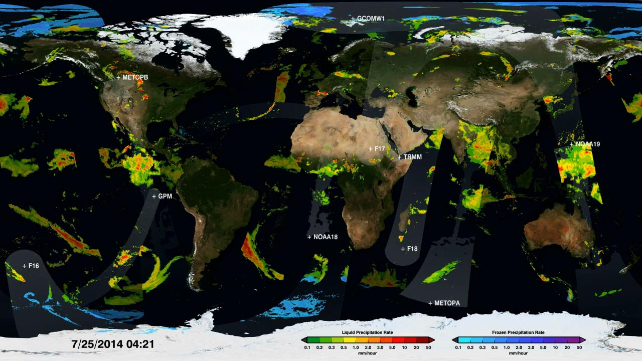
Global Precipitation Measurement constellation (image: Nasa)
Notes:
Except otherwise noted, “Hydrology from space: what can be measured?” presentation by Cnes/Aviso is licensed under CC BY-SA 4.0. To view a copy of this license, visit https://creativecommons.org/licenses/by-sa/4.0

Slide 5
© Cnes/Mira Production
Notes:
Except otherwise noted, “Hydrology from space: what can be measured?” presentation by Cnes/Aviso is licensed under CC BY-SA 4.0. To view a copy of this license, visit https://creativecommons.org/licenses/by-sa/4.0

Slide 6
Evaporation – evapotranspiration
the amount of water transferred from the soil to the atmosphere by surface evaporation and plant transpiration.
Utility: variations in surface reservoirs, influence of vegetation cover on the water vapor content of the atmosphere
Quantity to be measured/estimated: evaporation is a function of the relative temperatures of the water body and air, and of the surface agitation of this water body and therefore of the wind force
Space technology :
  optical/imaging infrared radiometer (geostationary and polar-orbiting)
  + models, used to compute evaporation from satellite measurements
Notes:
Except otherwise noted, “Hydrology from space: what can be measured?” presentation by Cnes/Aviso is licensed under CC BY-SA 4.0. To view a copy of this license, visit https://creativecommons.org/licenses/by-sa/4.0

Slide 7
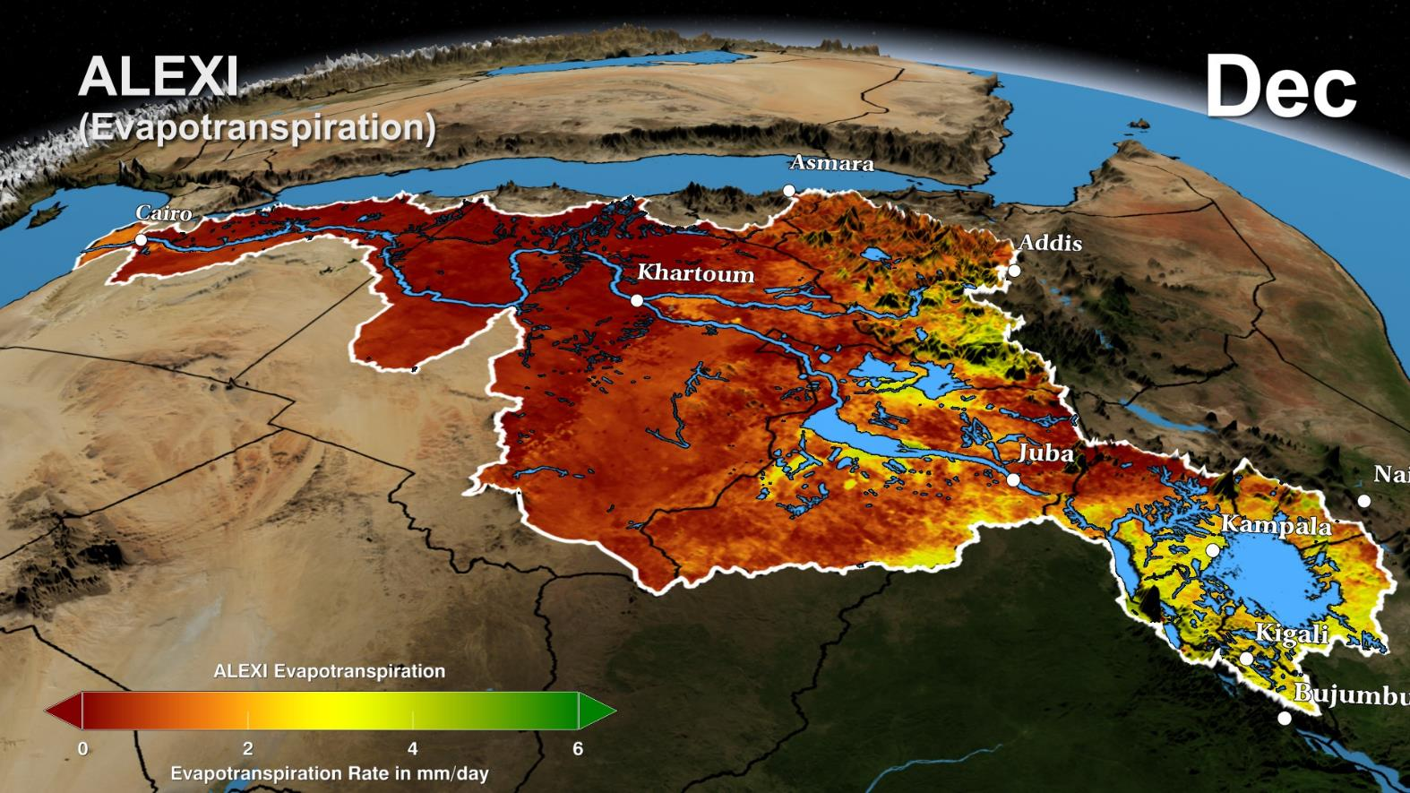
© Nasa / GSFC / SVS
Notes:
Except otherwise noted, “Hydrology from space: what can be measured?” presentation by Cnes/Aviso is licensed under CC BY-SA 4.0. To view a copy of this license, visit https://creativecommons.org/licenses/by-sa/4.0

Slide 8
© Cnes/Mira Production
Notes:
Except otherwise noted, “Hydrology from space: what can be measured?” presentation by Cnes/Aviso is licensed under CC BY-SA 4.0. To view a copy of this license, visit https://creativecommons.org/licenses/by-sa/4.0

Slide 9
Water level
Water level (or height) of a river or lake in relation to a reference
Utility: navigation, Flow calculation on river sections, Water resource management, floods...
Quantity to be measured/estimated: height variations over time
Space technology :
  radar altimeter, including Swot
  altimetric lidar (Icesat)
Notes:
Except otherwise noted, “Hydrology from space: what can be measured?” presentation by Cnes/Aviso is licensed under CC BY-SA 4.0. To view a copy of this license, visit https://creativecommons.org/licenses/by-sa/4.0

Slide 10
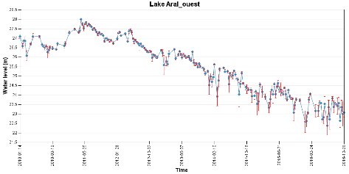
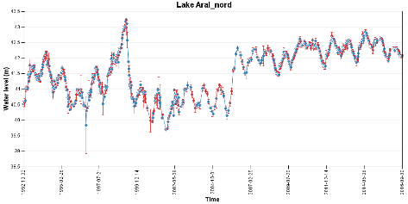
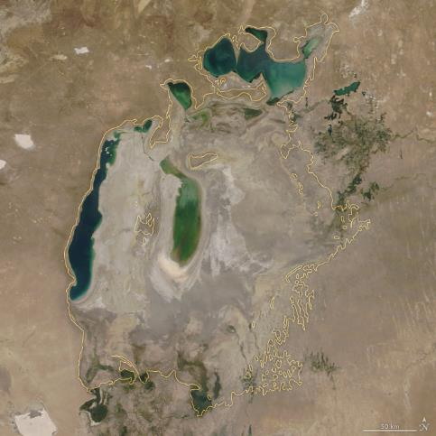
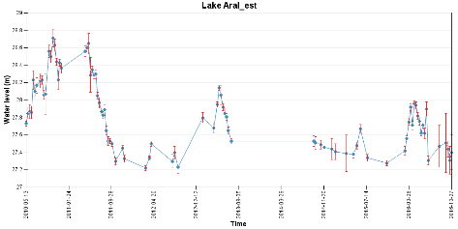
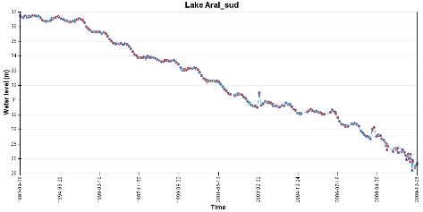
Hydroweb
Hydroweb
Hydroweb
Hydroweb
(Credits Nasa/JPL)
Aral sea on August 21, 2018.
In yellow, 1960 approximate shorelines
Notes:
Image : https://earthobservatory.nasa.gov/world-of-change/AralSea
hydroweb.theia-land.fr/hydroweb/view/L_aral_sud?lang=en
hydroweb.theia-land.fr/hydroweb/view/L_aral_nord?lang=en
hydroweb.theia-land.fr/hydroweb/view/L_aral_ouest?lang=en
hydroweb.theia-land.fr/hydroweb/view/L_aral_est?lang=en
Except otherwise noted, “Hydrology from space: what can be measured?” presentation by Cnes/Aviso is licensed under CC BY-SA 4.0. To view a copy of this license, visit https://creativecommons.org/licenses/by-sa/4.0

Slide 11
© Cnes/Mira Production
Notes:
Except otherwise noted, “Hydrology from space: what can be measured?” presentation by Cnes/Aviso is licensed under CC BY-SA 4.0. To view a copy of this license, visit https://creativecommons.org/licenses/by-sa/4.0

Slide 12
Surface current velocity
Current velocity at the surface of a river or lake (in m/s)
(NB. Wind can alter surface currents, and surface currents often differ from overall flow velocities)
Utility: estimates of free surface runoff, navigation, estimation of risk areas during floods, ecosystem monitoring, flow estimates
Quantity to be measured/estimated: variations in current velocity over time
Space technology :
  Synthetic Aperture Radar (SAR) (Sentinel-1): instantaneous measurement of the component in the axis of the current radar on a liquid
  SWOT
Notes:
Except otherwise noted, “Hydrology from space: what can be measured?” presentation by Cnes/Aviso is licensed under CC BY-SA 4.0. To view a copy of this license, visit https://creativecommons.org/licenses/by-sa/4.0

Slide 13
Notes:
Except otherwise noted, “Hydrology from space: what can be measured?” presentation by Cnes/Aviso is licensed under CC BY-SA 4.0. To view a copy of this license, visit https://creativecommons.org/licenses/by-sa/4.0

Slide 14
Discharge
total volume of water flowing through a straight section of a watercourse for one unit of time
(runoff: total discharge during a given time)
Utility: estimation of water resources, sizing of structures, calibration/validation of models
Quantity to be measured/estimated: flow variations over time
Space technology :
  radar altimeter + in situ (use of calibration curves from in situ measurement campaigns to estimate the flow with respect to a measured height).
  Or satellite-based width + in situ (id. With a measured width)
  Or observations with model (the model is used to compute the flow by assimilating the measurements)
Notes:
Except otherwise noted, “Hydrology from space: what can be measured?” presentation by Cnes/Aviso is licensed under CC BY-SA 4.0. To view a copy of this license, visit https://creativecommons.org/licenses/by-sa/4.0

Slide 15
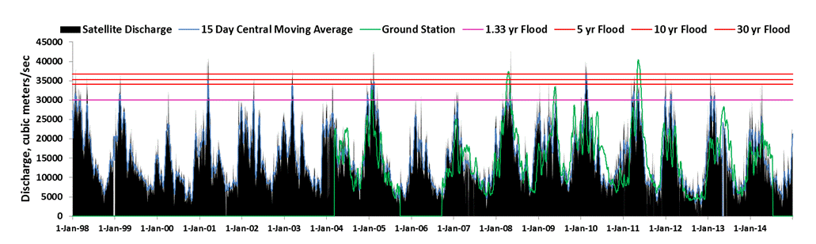
http://floodobservatory.colorado.edu
# USGS 07374000 Mississippi River at Baton Rouge, LA
Experimental Satellite-Based River Discharge Measurements using passive microwave radiometry (width measurement
Notes:
Except otherwise noted, “Hydrology from space: what can be measured?” presentation by Cnes/Aviso is licensed under CC BY-SA 4.0. To view a copy of this license, visit https://creativecommons.org/licenses/by-sa/4.0

Slide 16
© Cnes/Mira Production
Notes:
Except otherwise noted, “Hydrology from space: what can be measured?” presentation by Cnes/Aviso is licensed under CC BY-SA 4.0. To view a copy of this license, visit https://creativecommons.org/licenses/by-sa/4.0

Slide 17
Groundwater resources
Water quantity in groundwater and aquifers
Utility: water resource management, water cycle modelling
Quantity to be measured/estimated: variations in the gravity field, and therefore in the mass. By "subtraction" of surface water, we obtain the variations in groundwater volume.
Space technology :
  space gravimetry (GRACE satellites)
Notes:
Except otherwise noted, “Hydrology from space: what can be measured?” presentation by Cnes/Aviso is licensed under CC BY-SA 4.0. To view a copy of this license, visit https://creativecommons.org/licenses/by-sa/4.0

Slide 18
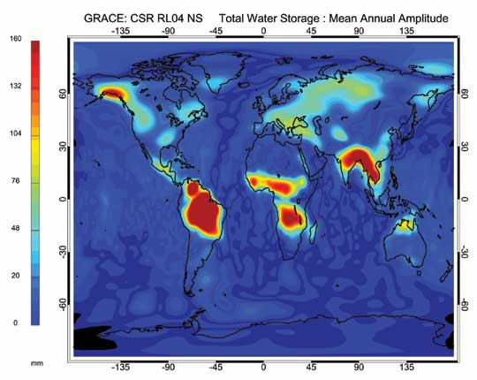
© Nasa
Notes:
Except otherwise noted, “Hydrology from space: what can be measured?” presentation by Cnes/Aviso is licensed under CC BY-SA 4.0. To view a copy of this license, visit https://creativecommons.org/licenses/by-sa/4.0

Slide 19
© Cnes/Mira Production
Notes:
Except otherwise noted, “Hydrology from space: what can be measured?” presentation by Cnes/Aviso is licensed under CC BY-SA 4.0. To view a copy of this license, visit https://creativecommons.org/licenses/by-sa/4.0

Slide 20
Soil moisture
water content and therefore soil saturation state, on the surface (the first 4-5 cm) and deeper, in the root zone and below.
Tendency of the soil to run off more or less (and therefore produce floods), impact the mechanisms of evaporation, infiltration of water into the soil.
The water content in the root zone can influence the water stress of vegetation, and therefore irrigation needs
Utility: Water resources management, irrigation management, flood forecasting, water cycle modelling
Quantity to be measured/estimated: changes in humidity over time
Space techniques (surface humidity):
  Microwave imaging radiometer (SMOS, Aquarius, SMAP)
  Microwave imaging radar (METOP scatterometer)
  Synthetic Aperture Radar (SAR)
Notes:
Except otherwise noted, “Hydrology from space: what can be measured?” presentation by Cnes/Aviso is licensed under CC BY-SA 4.0. To view a copy of this license, visit https://creativecommons.org/licenses/by-sa/4.0

Slide 21
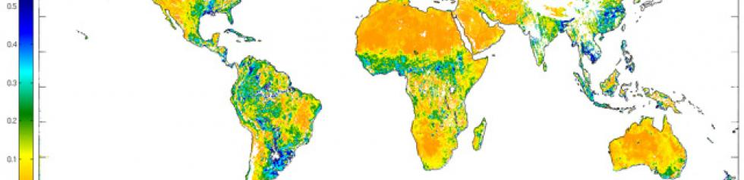
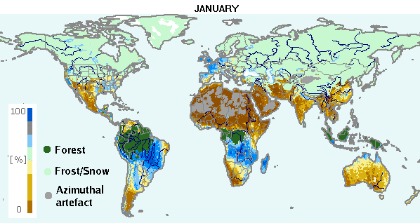
SMOS (CATDS)
SWI
Notes:
Except otherwise noted, “Hydrology from space: what can be measured?” presentation by Cnes/Aviso is licensed under CC BY-SA 4.0. To view a copy of this license, visit https://creativecommons.org/licenses/by-sa/4.0

Slide 22
© Cnes/Mira Production
Notes:
Except otherwise noted, “Hydrology from space: what can be measured?” presentation by Cnes/Aviso is licensed under CC BY-SA 4.0. To view a copy of this license, visit https://creativecommons.org/licenses/by-sa/4.0

Slide 23
Water resources in snowpack and ice
Amount of water contained in ice and snow cover, and its evolution over the seasons increases flows and flood risks during periods of intensive melting; reduces low water levels in rivers during dry periods.
Utility: Water resource management, Water cycle modelling, Navigation and breakup forecasting for frozen water bodies
Quantity to be measured/estimated: snow depth, ice depth, variations in depth, extension of snow cover or ice. Water equivalent.
Space technology (depending on the measurement):
  Radar altimeter: sea ice thickness
  Microwave imaging radiometer: Snow thickness on large moderate relief plains (SSM/I Amsr-e)
  High-resolution optical imaging radiometer: variations in glacier height: stereographic processing based on high-resolution images
  Optical/Infrared Imaging Radiometer: extension (2D) of the snow cover or glaciers obtained by the different imaging techniques
Notes:
Except otherwise noted, “Hydrology from space: what can be measured?” presentation by Cnes/Aviso is licensed under CC BY-SA 4.0. To view a copy of this license, visit https://creativecommons.org/licenses/by-sa/4.0

Slide 24
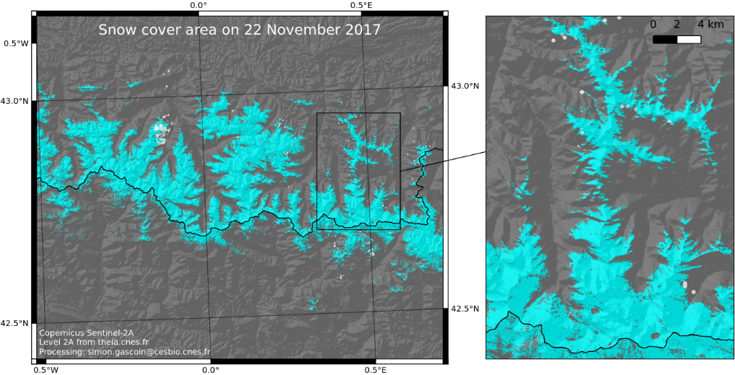
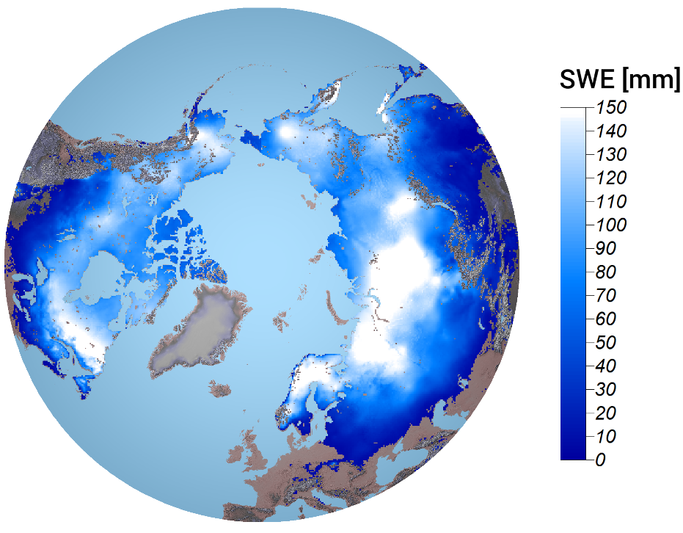
Snow water equivalent
(Copernicus Global Land)
Notes:
Except otherwise noted, “Hydrology from space: what can be measured?” presentation by Cnes/Aviso is licensed under CC BY-SA 4.0. To view a copy of this license, visit https://creativecommons.org/licenses/by-sa/4.0

Slide 25
© Cnes/Mira Production
Notes:
Except otherwise noted, “Hydrology from space: what can be measured?” presentation by Cnes/Aviso is licensed under CC BY-SA 4.0. To view a copy of this license, visit https://creativecommons.org/licenses/by-sa/4.0

Slide 26
Water quality
Water turbidity (and especially its variations) is a characterization of the suspended matter load.
Utility: Water resource and environmental quality, pollution monitoring, recreational water use, sediment transports (silting of structures)
Quantity to be measured/estimated: Total suspended solids represent all suspended particles in water (mineral, organic and colloidal). This can also be an indicator of bacteriological pollution.
Space technology :
  High resolution optical imaging radiometer,
  Optical imaging radiometer "water color"
  Optical/Infrared Imaging Radiometer
  Instrument with multiple polarization and direction (visible/infrared or microwave) <-Terra (MISR)
Notes:
Except otherwise noted, “Hydrology from space: what can be measured?” presentation by Cnes/Aviso is licensed under CC BY-SA 4.0. To view a copy of this license, visit https://creativecommons.org/licenses/by-sa/4.0

Slide 27
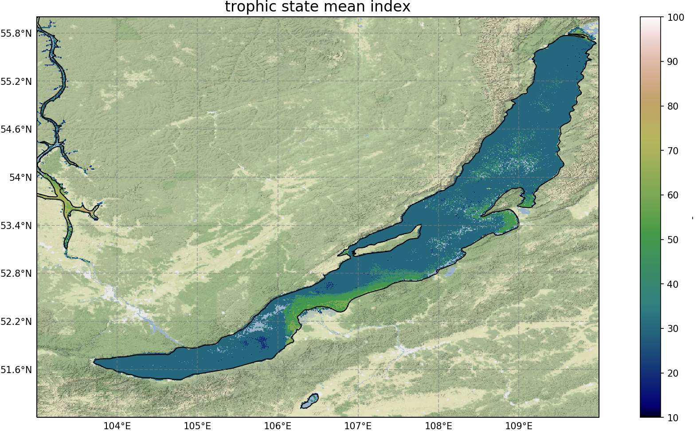
Copernicus Global Land
Notes:
Except otherwise noted, “Hydrology from space: what can be measured?” presentation by Cnes/Aviso is licensed under CC BY-SA 4.0. To view a copy of this license, visit https://creativecommons.org/licenses/by-sa/4.0

Slide 28
© Cnes/Mira Production
Notes:
Except otherwise noted, “Hydrology from space: what can be measured?” presentation by Cnes/Aviso is licensed under CC BY-SA 4.0. To view a copy of this license, visit https://creativecommons.org/licenses/by-sa/4.0

Slide 29
Surface water temperature
Temperature of the water at its surface
Utility: Water resource and environmental quality, Characterization of exchanges between surface waters and aquifers in catchment basins
Quantity to be measured/estimated: temperature variations over time
Space technology: measurement of thermal emission from the water surface
  Microwave imaging radiometer
  Multi-spectral imaging radiometer (optical/infrared)
  Atmospheric depth sounder temperature and humidity
Notes:
Except otherwise noted, “Hydrology from space: what can be measured?” presentation by Cnes/Aviso is licensed under CC BY-SA 4.0. To view a copy of this license, visit https://creativecommons.org/licenses/by-sa/4.0

Slide 30
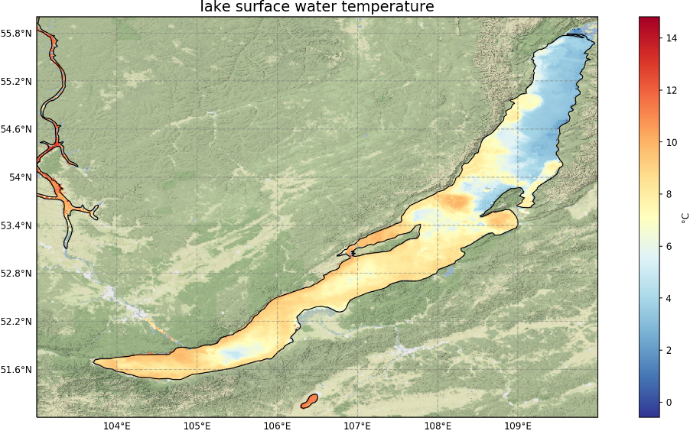
Copernicus Global Land
Notes:
Except otherwise noted, “Hydrology from space: what can be measured?” presentation by Cnes/Aviso is licensed under CC BY-SA 4.0. To view a copy of this license, visit https://creativecommons.org/licenses/by-sa/4.0

Slide 31
© Cnes/Mira Production
Notes:
Except otherwise noted, “Hydrology from space: what can be measured?” presentation by Cnes/Aviso is licensed under CC BY-SA 4.0. To view a copy of this license, visit https://creativecommons.org/licenses/by-sa/4.0

Slide 32
Water extent
Area occupied by water (surface)
Utility: water resource study, water cycle modelling, surface reservoir monitoring, water stock estimation, wetland monitoring, flood studies
Quantity to be measured/estimated: contours of the water-covered area
Space technology :
  Optical imaging radiometer
  Optical/Infrared Imaging Radiometer
  Synthetic Aperture Radar (SAR)
Notes:
Except otherwise noted, “Hydrology from space: what can be measured?” presentation by Cnes/Aviso is licensed under CC BY-SA 4.0. To view a copy of this license, visit https://creativecommons.org/licenses/by-sa/4.0

Slide 33
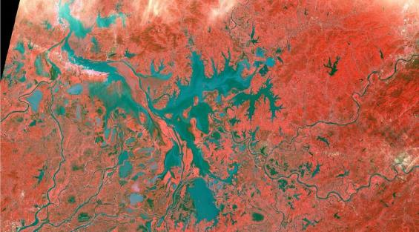
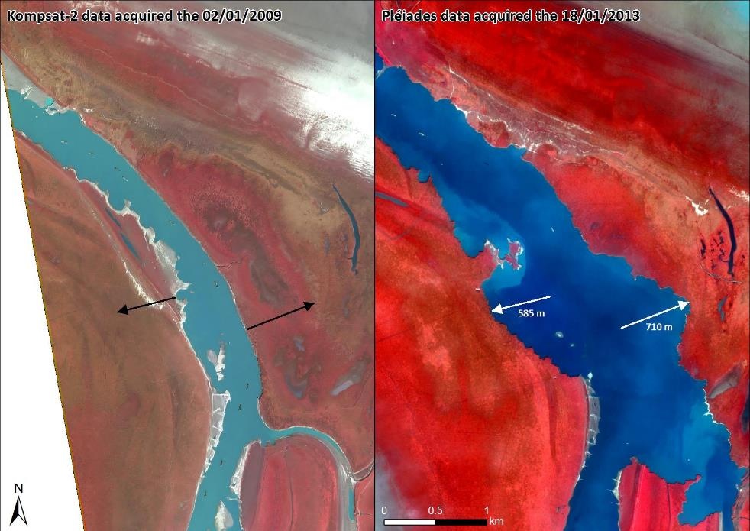
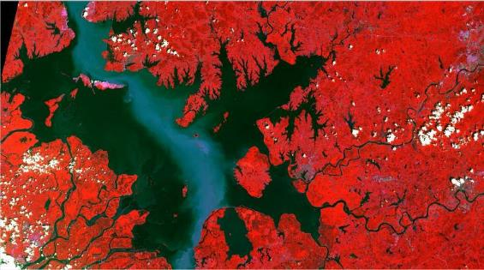
Sentinel-2 optical image over the Poyang for 2016-02-17 (top): the lake is then at its lowest and presenting a myriad of small water bodies and sub lakes, and for 2016-08-15 (bottom), at its highes, forming a single “continental sea”; in the central part the clearer corridor highlights the suspended sediments, mostly linked with sand extraction activities. Both images cover a 75x130 km area (Credits Sertit/ICube)
ICube-Sertit / European Union, contains modified Copernicus Sentinel data
ICube-Sertit / European Union, contains modified Copernicus Sentinel data
Notes:
Except otherwise noted, “Hydrology from space: what can be measured?” presentation by Cnes/Aviso is licensed under CC BY-SA 4.0. To view a copy of this license, visit https://creativecommons.org/licenses/by-sa/4.0

Slide 34
© Cnes/Mira Production
Notes:
Except otherwise noted, “Hydrology from space: what can be measured?” presentation by Cnes/Aviso is licensed under CC BY-SA 4.0. To view a copy of this license, visit https://creativecommons.org/licenses/by-sa/4.0

Slide 35
Bathymetry
bathymetry of rivers and water bodies
Utility: necessary for accurate flow calculation, modelling, Determination of water stock, draught, determination of flows, water storage options, stream operation
Quantity to be measured/estimated:
Space technology :
(only for shallow and clear waters)
  High resolution optical imaging radiometer
  Optical/Infrared Imaging Radiometer
  Lidar (Icesat)
Notes:
Except otherwise noted, “Hydrology from space: what can be measured?” presentation by Cnes/Aviso is licensed under CC BY-SA 4.0. To view a copy of this license, visit https://creativecommons.org/licenses/by-sa/4.0

Slide 36
Topography
topography of the watershed, then that of the rivers
Utility: determine flows, water storage options, stream operation
  Determination of the hydrological network
  Determination of the reactivity of the basin
  Determination of flood risk areas
Quantity to be measured/estimated
Space technology :
  High resolution optical imaging radiometer
  Synthetic Aperture Radar (SAR)
  altimetric radar, interesting in "Z", but spatial resolution of 100 meters at best
  Optical/Infrared Imaging Radiometer
Notes:
Except otherwise noted, “Hydrology from space: what can be measured?” presentation by Cnes/Aviso is licensed under CC BY-SA 4.0. To view a copy of this license, visit https://creativecommons.org/licenses/by-sa/4.0

Slide 37
© Cnes/Mira Production
Notes:
Except otherwise noted, “Hydrology from space: what can be measured?” presentation by Cnes/Aviso is licensed under CC BY-SA 4.0. To view a copy of this license, visit https://creativecommons.org/licenses/by-sa/4.0

Slide 38
Land cover
Utility: describe what cover the soils...
  Wetland monitoring
  Agricultural monitoring: crop conditions, estimation of water stress, water needs, water pressures, etc.
  Health studies wrt environment
Space technology :
  HR Optical Imager
  Multi-spectral imaging radiometers (Screw/IR)
  SAR radar imagers provide information on soil "roughness" and are frequently used to study forest cover.
Notes:
Except otherwise noted, “Hydrology from space: what can be measured?” presentation by Cnes/Aviso is licensed under CC BY-SA 4.0. To view a copy of this license, visit https://creativecommons.org/licenses/by-sa/4.0

Slide 39
© Cnes/Mira Production
Notes:
Except otherwise noted, “Hydrology from space: what can be measured?” presentation by Cnes/Aviso is licensed under CC BY-SA 4.0. To view a copy of this license, visit https://creativecommons.org/licenses/by-sa/4.0

Slide 40
Watershed mapping
Integration of all previous information over a watershed
Utility: describe the hydrological processes that govern the water cycle: distribution of infiltration into groundwater and runoff to rivers, reactivity of the watershed to a shower, possibility of water recovery in the ground by evapotranspiration...
  Water resource study
  Modeling the water cycle (estimation of groundwater recharge, runoff, etc.)
  Monitoring of surface reservoirs, estimation of water stocks,
  Wetland monitoring
  Flood studies
  Agricultural monitoring: crop conditions, estimation of water stress, water needs, water pressures, etc.
Space technology :
  HR Optical Imager
  Multi-spectral imaging radiometers (Screw/IR)
  SAR radar imagers provide information on soil "roughness" and are frequently used to study forest cover.
Notes:
Except otherwise noted, “Hydrology from space: what can be measured?” presentation by Cnes/Aviso is licensed under CC BY-SA 4.0. To view a copy of this license, visit https://creativecommons.org/licenses/by-sa/4.0

Slide 41
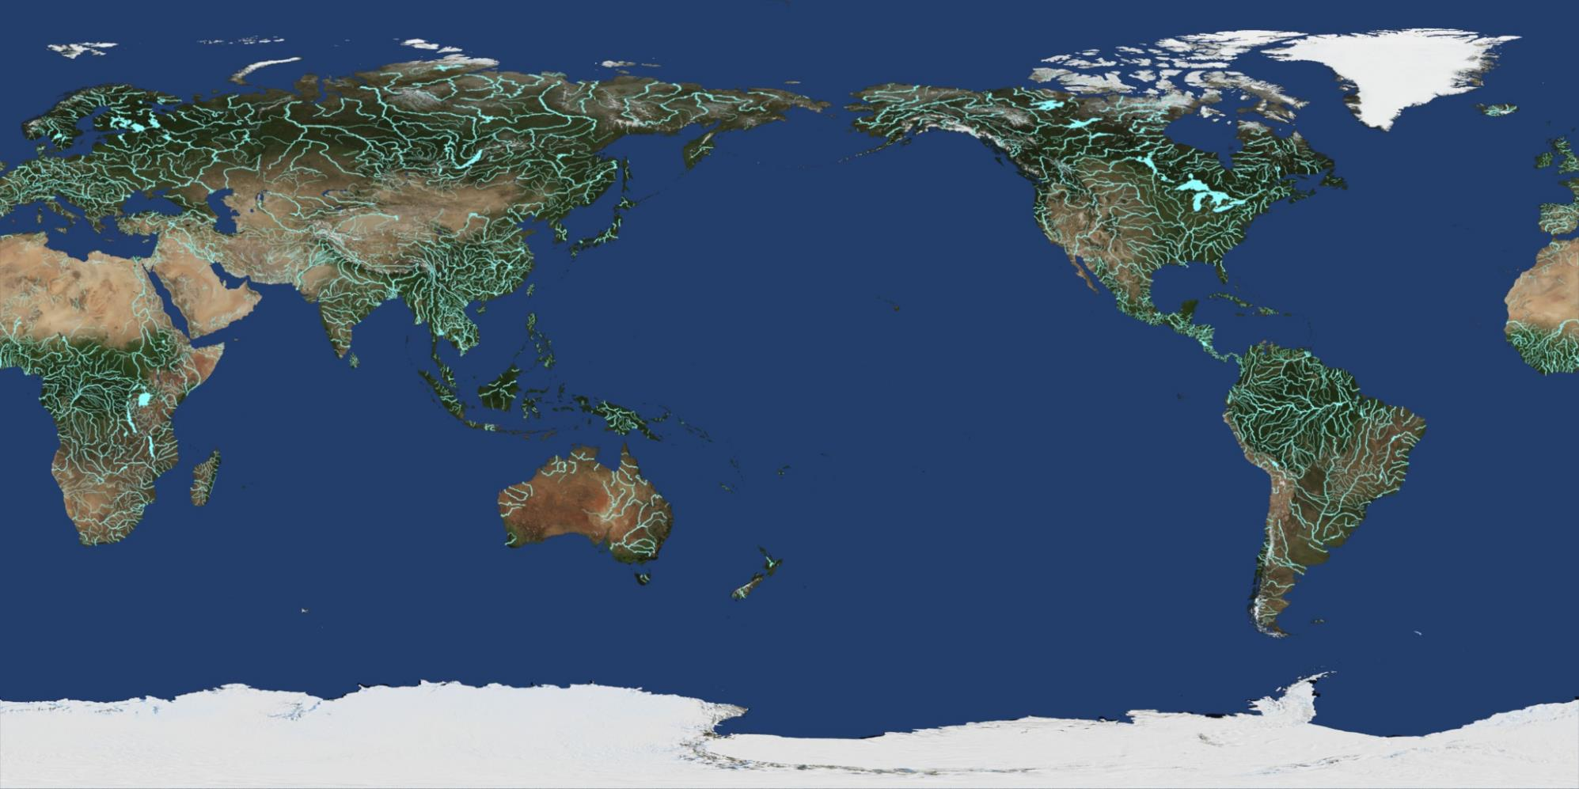
© Nasa / GSFC / SVS
Notes:
Except otherwise noted, “Hydrology from space: what can be measured?” presentation by Cnes/Aviso is licensed under CC BY-SA 4.0. To view a copy of this license, visit https://creativecommons.org/licenses/by-sa/4.0

Slide 42
Watershed mapping
Mapping of water bodies by SAR imaging
Land use by high-resolution optical imaging
Mapping of water bodies by optical imaging
Soil type by high resolution optical imaging
Determination of the dimension line and vegetation cover by high resolution optics
Notes:
Except otherwise noted, “Hydrology from space: what can be measured?” presentation by Cnes/Aviso is licensed under CC BY-SA 4.0. To view a copy of this license, visit https://creativecommons.org/licenses/by-sa/4.0

Slide 43
Data Access
Theia Data and Services center for continental surfaces
  Soil Moisture
  Snow
  Water levels of rivers and lakes
  Land Cover
https://www.theia-land.fr/en/
Notes:
Except otherwise noted, “Hydrology from space: what can be measured?” presentation by Cnes/Aviso is licensed under CC BY-SA 4.0. To view a copy of this license, visit https://creativecommons.org/licenses/by-sa/4.0

