Slide 1
How Swot is working?
Cnes/Aviso
Notes:
Except otherwise noted, “How Swot is working?” presentation by Cnes/Aviso is licensed under CC BY-SA 4.0. To view a copy of this license, visit https://creativecommons.org/licenses/by-sa/4.0

Slide 2
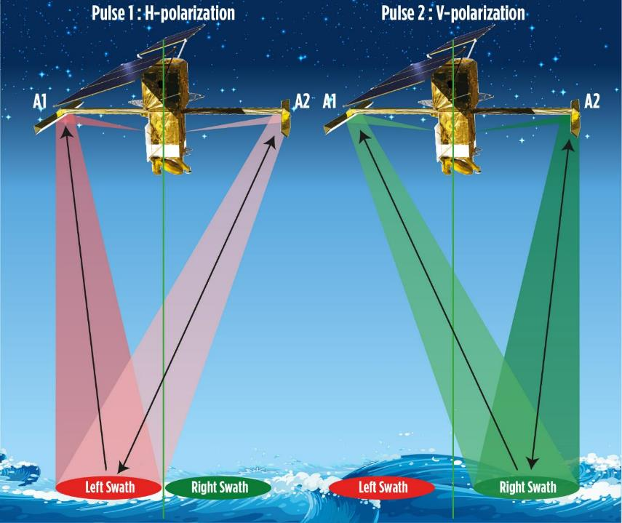
Swot emission scheme
One of the antenna emits (A2), aiming alternatively towards the left and the right swath, each with a different polarization
of the radar wave emitted. Both antennae are receiving. The two polarizations enable to determine the side the antenna pointed to; at the incidences used, the reflection on the water has no impact on polarization (contrary to classical SAR).
© Cnes/Mira Production
Notes:
Except otherwise noted, “How Swot is working?” presentation by Cnes/Aviso is licensed under CC BY-SA 4.0. To view a copy of this license, visit https://creativecommons.org/licenses/by-sa/4.0

Slide 3
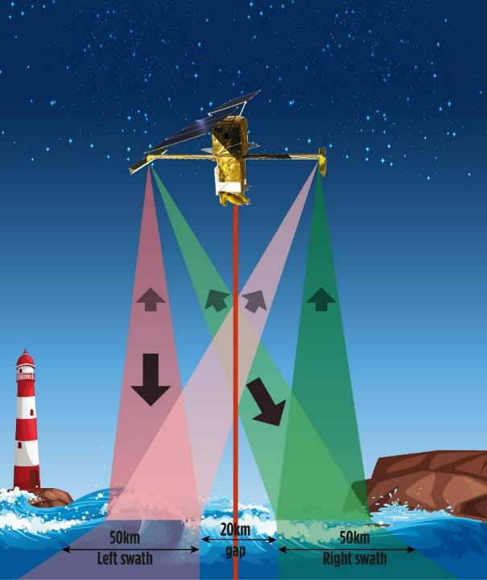
Swot emission scheme
One of the antenna emits, aiming alternatively towards the left and the right swath, each with a different polarization of the radar wave emitted. Both antennae are receiving.
The use of different polarizations for each swath enables to determine the side the antenna pointed to; at the incidences used, the reflection on the water has no impact on polarization (contrary to classical SAR).
Cnes/Aviso
© Cnes/Mira Production
Notes:
Except otherwise noted, “How Swot is working” presentation by Cnes/Aviso is licensed under CC BY-SA 4.0. To view a copy of this license, visit https://creativecommons.org/licenses/by-sa/4.0

Slide 4
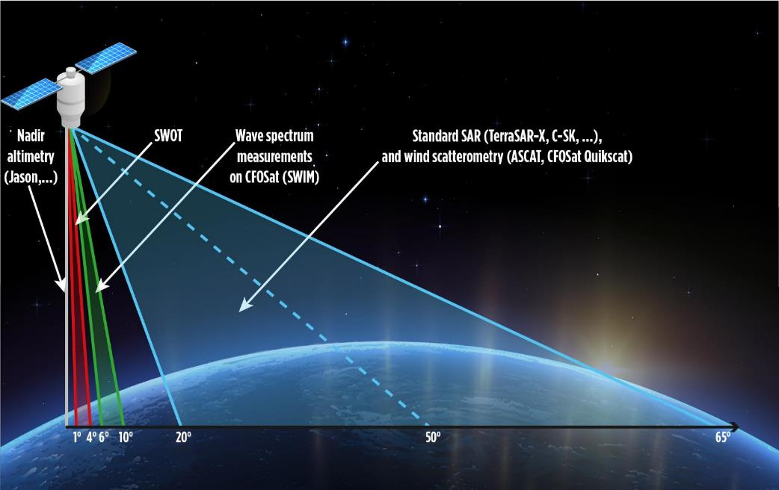
Swot incidence angle vs other satellites/techniques
© Cnes/Mira Production
Notes:
Other angles used:
- SWIM : 6 incidence angles: 0°, 2°, 4°, 6°, 8° et 10° (Antenna diameter: 90 cm (~2° aperture)) ; 0 à 4° pour SWH, 6 à 10° pour spectre des vagues
SCAT (sur CFOSat) : 20°-65°
- Seawind on quikscat : 40º (inner beam) and 46º look angle from nadir
- ASCAT: local incidence angles are between 25-65º (mid near at H min = 25º).
TerraSar-X : Four Beam ScanSAR 20° - 45° ; Six Beam ScanSAR : 15.6° - 49°.
Except otherwise noted, “How Swot is working” presentation by Cnes/Aviso is licensed under CC BY-SA 4.0. To view a copy of this license, visit https://creativecommons.org/licenses/by-sa/4.0

Slide 5
Swot incidence angle: why?
1-4° incidence:
Not nadir: this enables wide-swath measurement
But not as high as SAR (or scatterometers)
  Better accuracy on height determination
  get some backscatter even if roughness is very small (not, however if no roughness at all = “dark waters”, i.e. Descartes’ reflection law)
  A requirement to have enough backscatter over water to work on in Ka-band
  backscattering of water much higher than the one of land surfaces at those incidences
  (water is more mirror-like ; land is rougher)
Notes:
Near nadir (0.6-4° incidence) [typically 20-50° for spaceborne SAR]
Layover even for moderate topography (slope > 0.6-4°)
Strong relative incidence variation, implying strong/rapid variation in several key parameters: ground-projected range pixel size, ambiguity height…
Low Signal/Noise Ratio (power constraints) [20-30 dB below conventional spaceborne SAR]
- Most land surfaces are below thermal noise floor
- Noisy phase, need for spatial averaging to reach targeted height precision
Except otherwise noted, “How Swot is working” presentation by Cnes/Aviso is licensed under CC BY-SA 4.0. To view a copy of this license, visit https://creativecommons.org/licenses/by-sa/4.0

Slide 6
Use of Ka-band (λ = 8,6 mm)
less specular reflection
a smaller spacecraft/antenna/base
Smaller footprint
Small signal to noise ratio
Notes:
Except otherwise noted, “How Swot is working” presentation by Cnes/Aviso is licensed under CC BY-SA 4.0. To view a copy of this license, visit https://creativecommons.org/licenses/by-sa/4.0

Slide 7
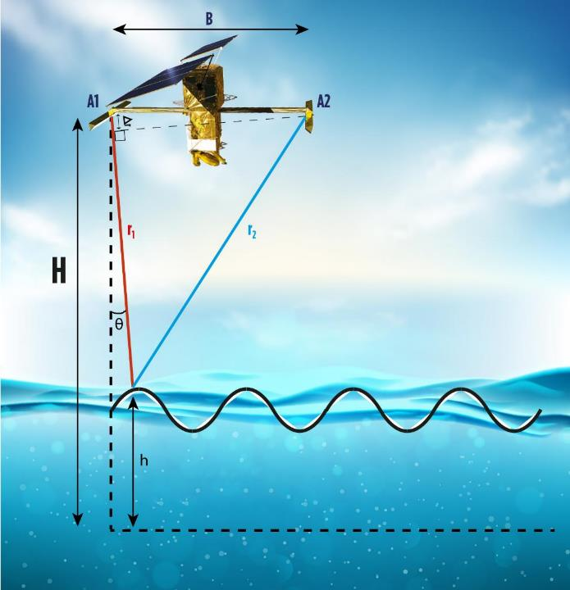
Swot measurement geometry
Both antenna receive the same signal reflected on the surface, but it hasn’t travelled the same distance. This enable to compute the surface height.
r1 is measured using the round-trip time between the satellite and the surface
(r1 - r2) is also estimated
θ is deduced from r1-r2 and B (distance between the two antennas).
H (satellite altitude) is measured by precise location system onboard (Doris, GPS/GNSS)
The water height is h = H – r1 cos (θ)
Cnes/Aviso
© Cnes/Mira Production
Notes:
Schematic geometry-only explanation glossing over the phase determination used to have r1-r2
Except otherwise noted, “How Swot is working” presentation by Cnes/Aviso is licensed under CC BY-SA 4.0. To view a copy of this license, visit https://creativecommons.org/licenses/by-sa/4.0

Slide 8
Swot measurement
r1: determined using the round-trip time between the satellite and the surface
r2 (or Δr): deduced from the interferences between the two returned signals:
the interferometric phase difference Δφ = -(2π/λ)(r2-r1)
but Δφ is known modulo 2π rad. So several values of (r2-r1) can provide with the same Δφ.
The ambiguity is raised using a DEM as reference, including surface heights over waters. This is possible if the height equivalent to a full 2π-phase shift is higher than the expected h (+/- 3 m near the nadir, but up to +/-30 m at the farthest in the swath).
θ is arcsin((r1-r2)/B) (or arcsin(λΔφ/2πB) )
The water height is then: h= H – r1 cos (θ)
Cnes/Aviso
© Cnes/Mira Production
Notes:
Except otherwise noted, “How Swot is working” presentation by Cnes/Aviso is licensed under CC BY-SA 4.0. To view a copy of this license, visit https://creativecommons.org/licenses/by-sa/4.0

Slide 9
Why use interferometry?
Very high precision for small differences
(in theory, a fraction of the wavelength, i.e. a fraction of 8 mm in Ka-Band. Things are more complex, though)
Seeing a surface in three dimensions requires at least two "eyes". Interferometry is the only way to obtain topographic images; doing so with 2 antennas on the same satellite makes it almost insensitive to surface variations.
Notes:
Except otherwise noted, “How Swot is working” presentation by Cnes/Aviso is licensed under CC BY-SA 4.0. To view a copy of this license, visit https://creativecommons.org/licenses/by-sa/4.0

Slide 10
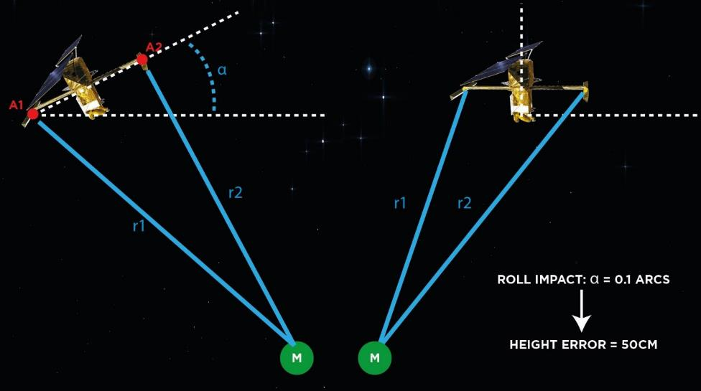
Roll effects
The base A1-A2 between the two antennas should be parallel to Earth surface
(perpendicular to nadir).
But the satellite can slightly roll (attitude controlled)
This roll has an impact on the height determination
© Cnes/Mira Production
Notes:
Except otherwise noted, “How Swot is working” presentation by Cnes/Aviso is licensed under CC BY-SA 4.0. To view a copy of this license, visit https://creativecommons.org/licenses/by-sa/4.0

Slide 11
Advantages / drawbacks
Among the advantages:
  Resolution
  swath, i.e., the ability of retrieving 2D data in a single satellite passage which is not currently possible with altimetry (either classical or « SAR » altimetry)
  Very innovative concept, technically challenging
Possible drawbacks
  The use of the Ka-band, while enabling higher resolution (smaller footprint), should provide with less data when it’s raining.
  Very innovative concept, technically challenging
Notes:
Except otherwise noted, “How Swot is working” presentation by Cnes/Aviso is licensed under CC BY-SA 4.0. To view a copy of this license, visit https://creativecommons.org/licenses/by-sa/4.0

Slide 12
Swot swath and pixel geometry
Notes:
Except otherwise noted, “How Swot is working” presentation by Cnes/Aviso is licensed under CC BY-SA 4.0. To view a copy of this license, visit https://creativecommons.org/licenses/by-sa/4.0

Slide 13
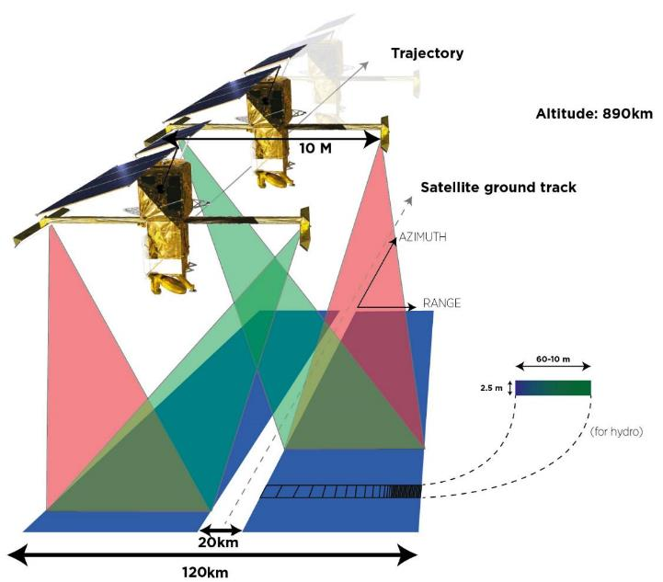
Swot swath and pixel geometry
Both antenna (at the end of each mast) receive the radar wave reflected from both swaths
The succession of pixels across the swath are derived from the time it takes the wave to return to the satellite
The further from the middle gap, the smaller the pixels (in width; height stays the same).
Doppler altimetry used to split the footprint in smaller units (along-track)
© Cnes/Mira Production
Notes:
Except otherwise noted, “How Swot is working” presentation by Cnes/Aviso is licensed under CC BY-SA 4.0. To view a copy of this license, visit https://creativecommons.org/licenses/by-sa/4.0

Slide 14
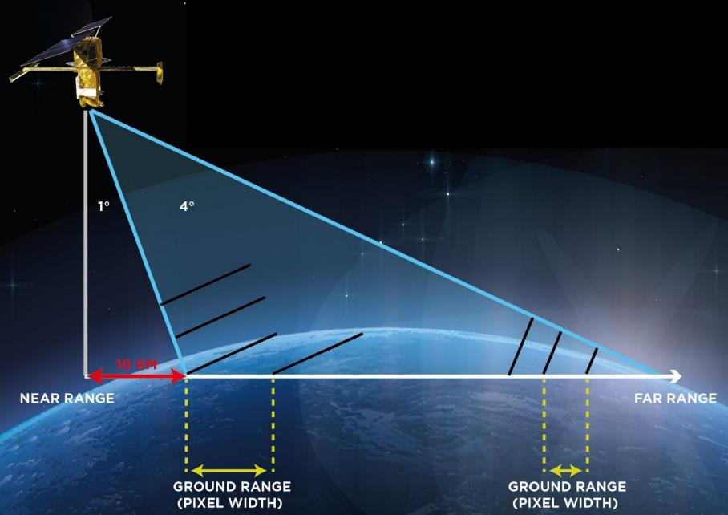
Swot swath and pixel geometry (side view)
Resolution loss at near range
+/- 10 km blind zone around nadir
Land / water contrast reduced at far range since water is reflecting more at small incidence, while land is reflecting about the same way at all incidence (land is rougher than water)
(exaggerated angles)
Cnes/Aviso
© Cnes /
Mira Production
Notes:
Except otherwise noted, “How Swot is working” presentation by Cnes/Aviso is licensed under CC BY-SA 4.0. To view a copy of this license, visit https://creativecommons.org/licenses/by-sa/4.0

Slide 15
Native pixels / dataset pixels ?
The native pixels from the measurement constrains are of different sizes.
Moreover the measurements for a given area can overlap
Among the processing: averaging
  Onboard for the “low rate” mode (the only one over open ocean)
  On ground for “high rate” mode (over land and coastal waters)
Notes:
Except otherwise noted, “How Swot is working” presentation by Cnes/Aviso is licensed under CC BY-SA 4.0. To view a copy of this license, visit https://creativecommons.org/licenses/by-sa/4.0

Slide 16
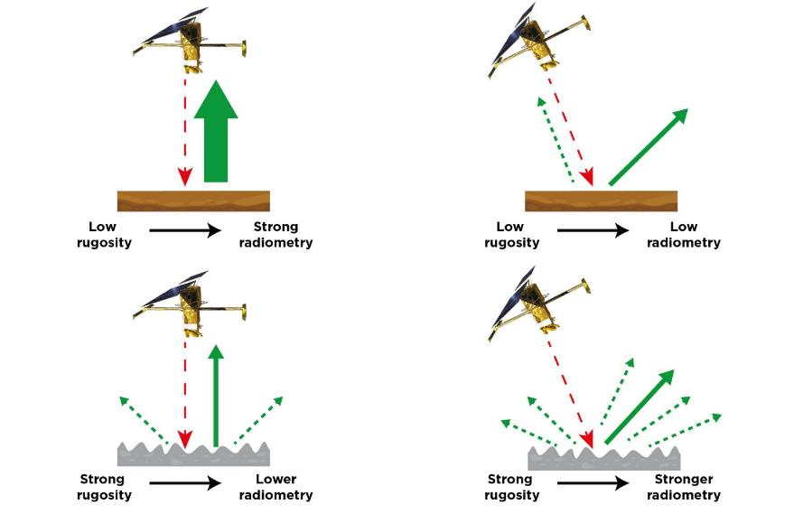
Dark waters (no reflection towards the satellite)
© Cnes/Mira Production
Notes:
Except otherwise noted, “How Swot is working” presentation by Cnes/Aviso is licensed under CC BY-SA 4.0. To view a copy of this license, visit https://creativecommons.org/licenses/by-sa/4.0

Slide 17
Value-added information from Swot
Notes:
Except otherwise noted, “How Swot is working” presentation by Cnes/Aviso is licensed under CC BY-SA 4.0. To view a copy of this license, visit https://creativecommons.org/licenses/by-sa/4.0

Slide 18
Discharge: how Swot enables to access it?
Swot is measuring height, width & slope. Not directly discharge, nor current speed. Discharge is computed from those measurements, though and be provided as part of the river dataset(s).
hydrology equations (Manning) are used to compute the discharge by error minimization of the equation solutions with a reference (Basin-scale estimates can be used as references)
Notes:
Except otherwise noted, “How Swot is working” presentation by Cnes/Aviso is licensed under CC BY-SA 4.0. To view a copy of this license, visit https://creativecommons.org/licenses/by-sa/4.0

