Slide 1
Swot mission
Notes:
Except otherwise noted, “Swot mission” presentation by Cnes/Aviso is licensed under CC BY-SA 4.0. To view a copy of this license, visit https://creativecommons.org/licenses/by-sa/4.0

Slide 2
Objectives & applications
Notes:
Except otherwise noted, “Swot mission” presentation by Cnes/Aviso is licensed under CC BY-SA 4.0. To view a copy of this license, visit https://creativecommons.org/licenses/by-sa/4.0

Slide 3
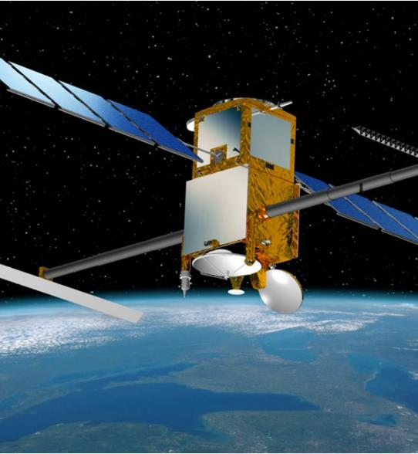
Surface Water & Ocean Topography
A new satellite concept for the study and monitoring of inland waters and the oceans
Partnership between NASA, CNES, the Canadian Space Agency and the UK space agency,
based on 25 years of CNES/NASA cooperation in altimetry with Topex/Poseidon and the Jason satellite family.
measurement of the water levels of rivers, lakes and flooded areas; improved ocean observations.
© Cnes
Notes:
Except otherwise noted, “Swot mission” presentation by Cnes/Aviso is licensed under CC BY-SA 4.0. To view a copy of this license, visit https://creativecommons.org/licenses/by-sa/4.0

Slide 4
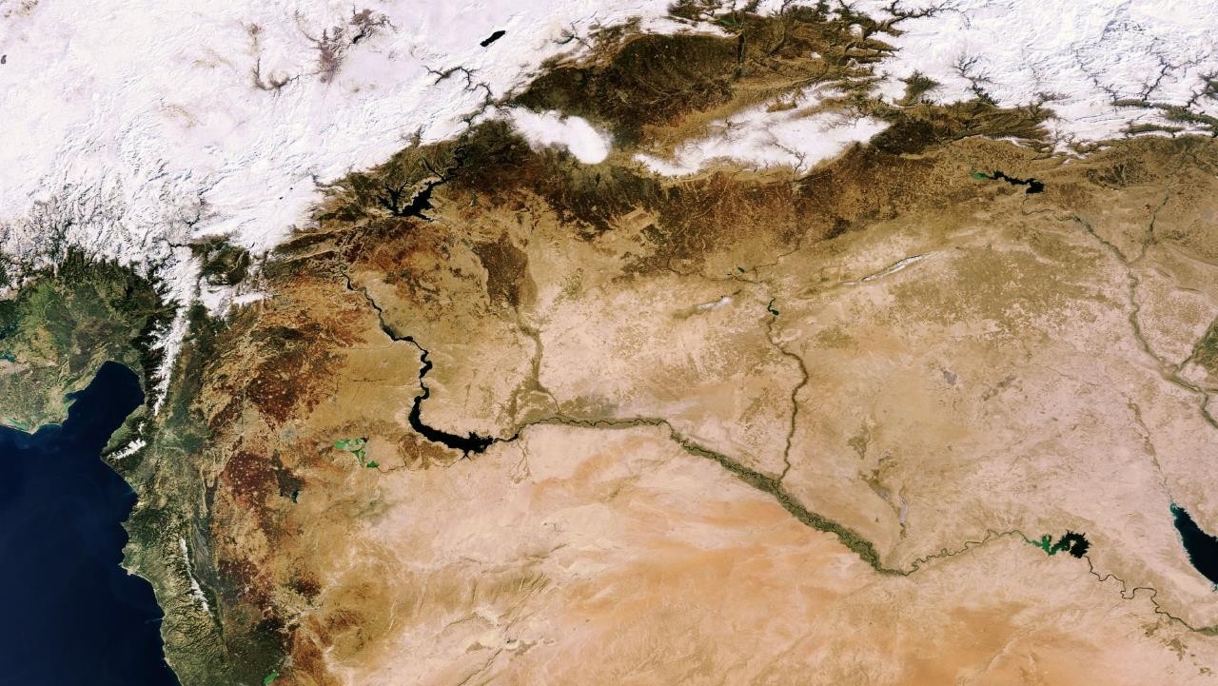
Management of water sharing issues
The sharing of river water often causes friction between neighboring states. Swot is providing global information as input for systems monitoring river basins & for verification.
 40% of the world’s population lives in river basins shared by at least two countries.
Cnes/Aviso
© ESA
Notes:
The_Middle_East_as_seen_by_Envisat
Except otherwise noted, “Swot mission” presentation by Cnes/Aviso is licensed under CC BY-SA 4.0. To view a copy of this license, visit https://creativecommons.org/licenses/by-sa/4.0

Slide 5
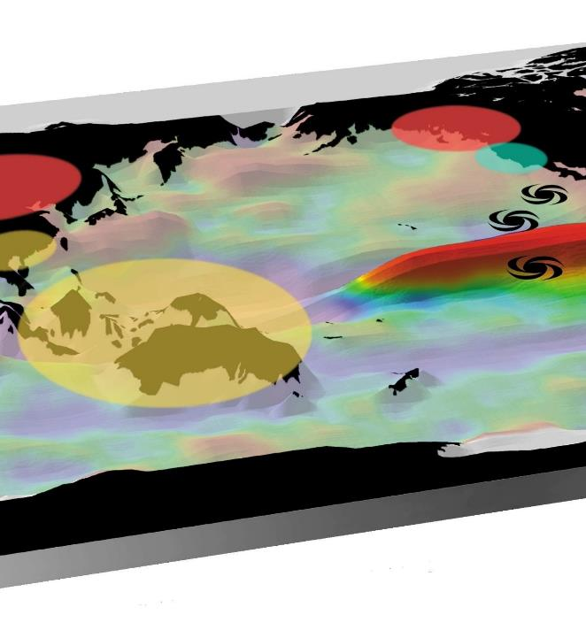
More accurate weather and climate forecasting
SWOT is enabling more accurate weather and climate forecasting, especially seasonal by providing better initial and limit conditions for ocean surface and hydrological conditions
 30% of the world’s GDP – the equivalent of $18 trillion in goods and services – are weather-dependent.
© Cnes
Notes:
Except otherwise noted, “Swot mission” presentation by Cnes/Aviso is licensed under CC BY-SA 4.0. To view a copy of this license, visit https://creativecommons.org/licenses/by-sa/4.0

Slide 6
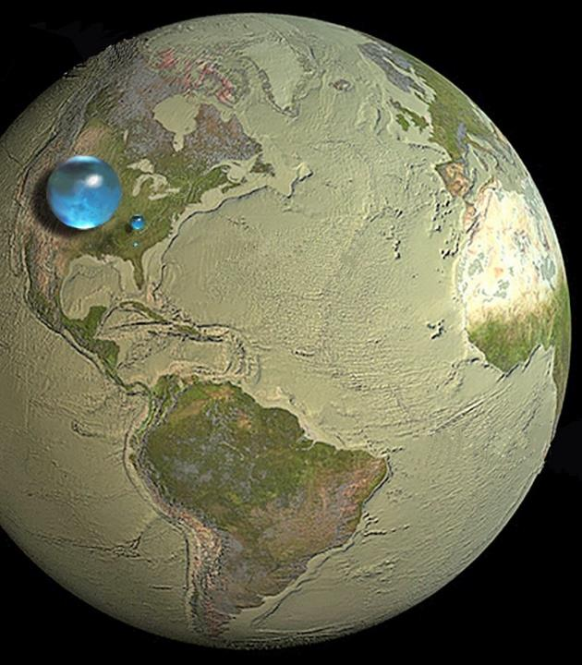
Managing freshwater for urban, industrial and agricultural uses
Data from SWOT are providing water supply services and distribution companies with information about major reservoirs and the largest rivers and catchment areas, at global level, thus enabling them to plan the management of water stocks.
 The world’s water services generate turnover of $125 billion
© USGS
Notes:
Largest sphere over western U.S., 1,385 kilometers in diameter: All water on Earth
Mid-sized sphere over Kentucky, 272.8 kilometers in diameter: Fresh liquid water in the ground, lakes, swamps, and rivers
Smallest sphere over Georgia, 56.2 kilometers in diameter: Fresh-water lakes and rivers .
Except otherwise noted, “Swot mission” presentation by Cnes/Aviso is licensed under CC BY-SA 4.0. To view a copy of this license, visit https://creativecommons.org/licenses/by-sa/4.0

Slide 7
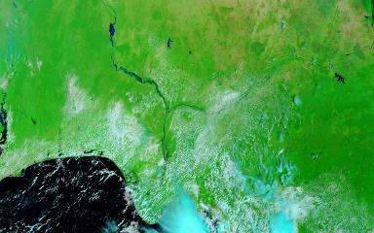
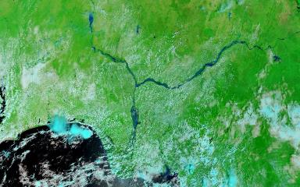
Improved flood modeling
© Nasa
Flooding, whether from rivers overflowing their banks or in coastal regions, is among the most disastrous of natural phenomena. Swot is measuring floodwater levels and local topographic details more reliably.
 51% of the victims of natural disasters between 1974 and 2003 suffered due to flooding (compared with 36% due to drought), i.e. 2.5 billion people.
© Nasa
Notes:
The Benue and Niger Rivers converge in southern Nigeria, and from there the Niger flows south toward the sea. The Moderate Resolution Imaging Spectroradiometer (MODIS) on NASA’s Terra satellite captured these images of the confluence of the Niger and Benue Rivers on October 20, 2008 (top), and October 13, 2012 (bottom), with an important flood in 2012.
Except otherwise noted, “Swot mission” presentation by Cnes/Aviso is licensed under CC BY-SA 4.0. To view a copy of this license, visit https://creativecommons.org/licenses/by-sa/4.0

Slide 8
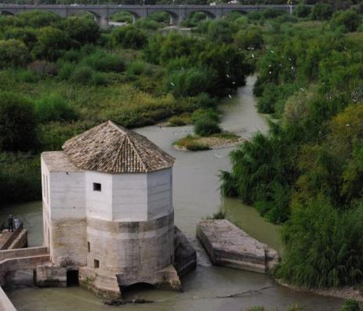
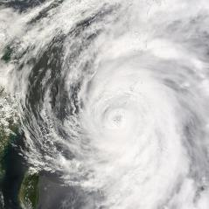

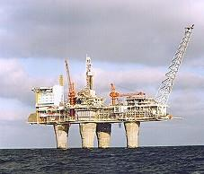
Reducing environmental risk and contributing to public policy-making
Swot is helping to improve our knowledge, enhance observations.
all these areas and more stand to benefit:
  Water resources,
  natural risks (floods, climate change, hurricane forecasting, etc.),
  biodiversity,
  health (preventing the propagation of epidemics),
  the agricultural sector,
  energy (including the management of electricity production and offshore gas and oil rigs),
  territorial development
Notes:
Except otherwise noted, “Swot mission” presentation by Cnes/Aviso is licensed under CC BY-SA 4.0. To view a copy of this license, visit https://creativecommons.org/licenses/by-sa/4.0

Slide 9
Spacecraft & instruments
Notes:
Except otherwise noted, “Swot mission” presentation by Cnes/Aviso is licensed under CC BY-SA 4.0. To view a copy of this license, visit https://creativecommons.org/licenses/by-sa/4.0

Slide 10
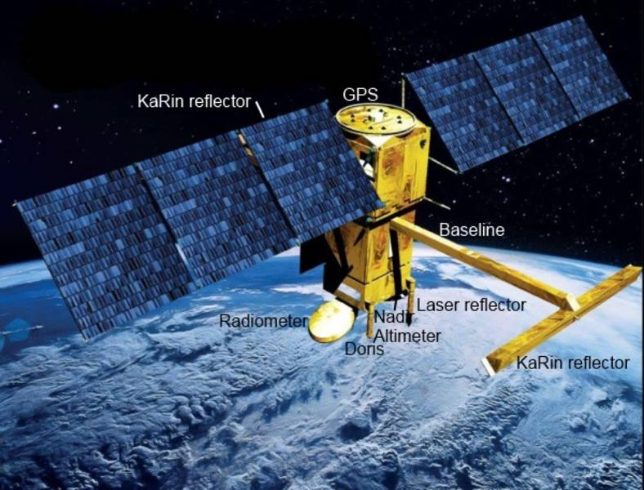
SWOT satellite
© TAS
Notes:
Except otherwise noted, “Swot mission” presentation by Cnes/Aviso is licensed under CC BY-SA 4.0. To view a copy of this license, visit https://creativecommons.org/licenses/by-sa/4.0

Slide 11
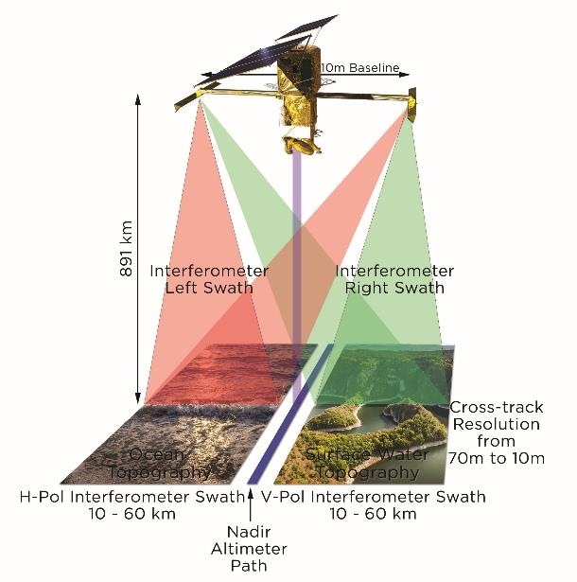
KaRIn – Ka-band Radar Interferometer (altimeter)
The main mission instrument
A new concept, with:
  two 50-km swaths
  a bi-dimensional image
  Using interferometry to estimate water height
  Synthetic Aperture Radar processing
  a Ka-band emission source
  two synthetic aperture radar (SAR) antennae at opposite ends of a 10 m boom
© Cnes/Mira Production
Notes:
Except otherwise noted, “Swot mission” presentation by Cnes/Aviso is licensed under CC BY-SA 4.0. To view a copy of this license, visit https://creativecommons.org/licenses/by-sa/4.0

Slide 12
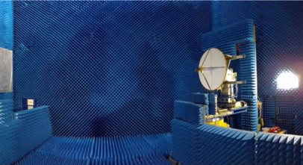
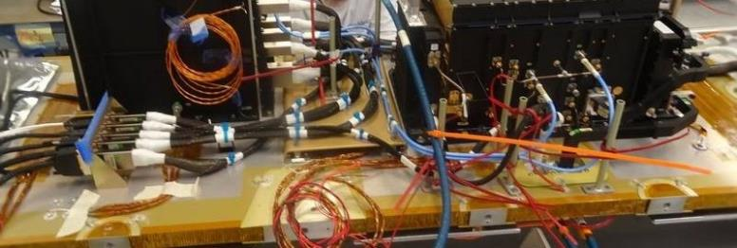
Poseidon-3C – nadir altimeter
a classical nadir altimeter in Ku and C band
Derived from Jason-3’s
To complement and calibrate KaRIn, with measurements in the middle of the gap between the two swaths
Implementing an "open loop tracking mode", for better retrieval of inland water measurements.
Notes:
Photos © TAS
Except otherwise noted, “Swot mission” presentation by Cnes/Aviso is licensed under CC BY-SA 4.0. To view a copy of this license, visit https://creativecommons.org/licenses/by-sa/4.0

Slide 13
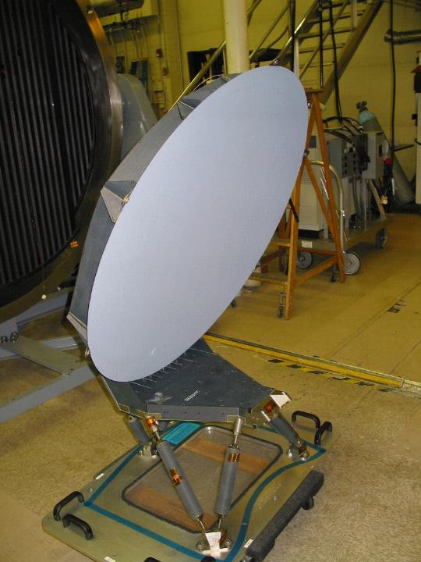
AMR – the radiometer
heritage of the Jason-3 Advanced Microwave Radiometer (AMR).
three separate frequency channels
to determine the path delay of the altimeter's radar signal due to atmospheric water vapor and liquid water in the atmosphere
© JPL
Notes:
Except otherwise noted, “Swot mission” presentation by Cnes/Aviso is licensed under CC BY-SA 4.0. To view a copy of this license, visit https://creativecommons.org/licenses/by-sa/4.0

Slide 14
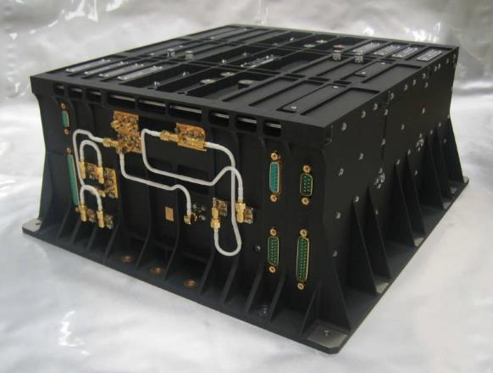
Doris – precise location by Doppler effect
Real-time location and precise orbit determination.
a network of 50 ground stations transmitting signals at two frequencies to the satellite.
The receiver onboard the satellite analyzes the received signal frequencies to calculate its velocity relative to Earth.
This velocity is fed into orbit determination models to derive the satellite's position on orbit below 1 centimeter on the radial component.
© TAS
Notes:
Except otherwise noted, “Swot mission” presentation by Cnes/Aviso is licensed under CC BY-SA 4.0. To view a copy of this license, visit https://creativecommons.org/licenses/by-sa/4.0

Slide 15
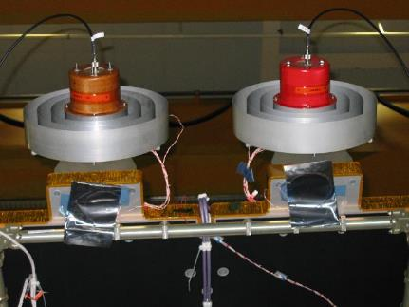
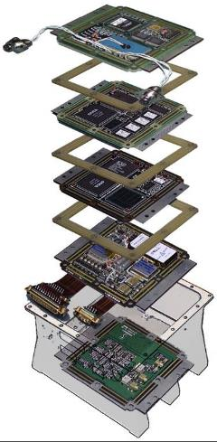
GPSP – precise location system
The Global Positioning System (GPS) Receiver is picking up tracking signals from the constellation of GPS satellites.
Its performance requirements are based on heritage Jason-3 capabilities.
Instrument development is part of a common "block buy" for SWOT and Sentinel-6.
© JPL
Notes:
Except otherwise noted, “Swot mission” presentation by Cnes/Aviso is licensed under CC BY-SA 4.0. To view a copy of this license, visit https://creativecommons.org/licenses/by-sa/4.0

Slide 16
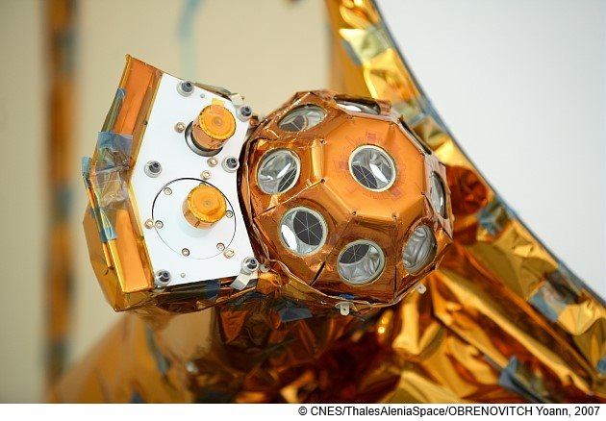
LRA – precise location system by laser
The LRA (Laser Retroflector Array) is
basically a set of mirrors, meant to reflect lasers fired from stations on Earth. The return time enable to measure the distance very precisely, if locally.
Notes:
Except otherwise noted, “Swot mission” presentation by Cnes/Aviso is licensed under CC BY-SA 4.0. To view a copy of this license, visit https://creativecommons.org/licenses/by-sa/4.0

Slide 17
Orbit
Notes:
Except otherwise noted, “Swot mission” presentation by Cnes/Aviso is licensed under CC BY-SA 4.0. To view a copy of this license, visit https://creativecommons.org/licenses/by-sa/4.0

Slide 18
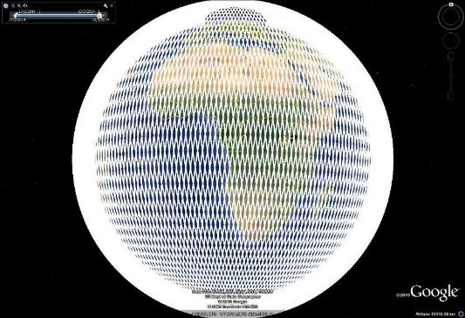
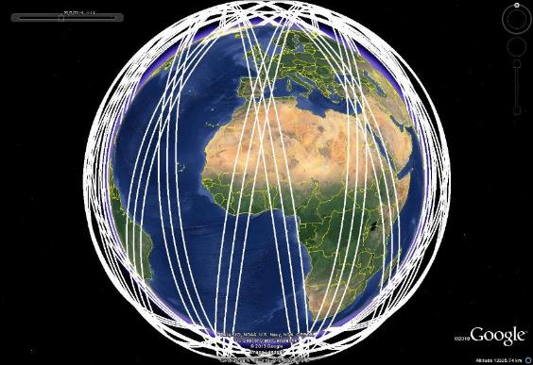
Science orbit
Swot orbit is a non sun-synchronous 21-days orbit, at 890.6 km with an inclination of 77.6°.
The wide-swath is enabling a more complete ground coverage than with previous nadir-altimeters.
Notes:
Except otherwise noted, “Swot mission” presentation by Cnes/Aviso is licensed under CC BY-SA 4.0. To view a copy of this license, visit https://creativecommons.org/licenses/by-sa/4.0

Slide 19
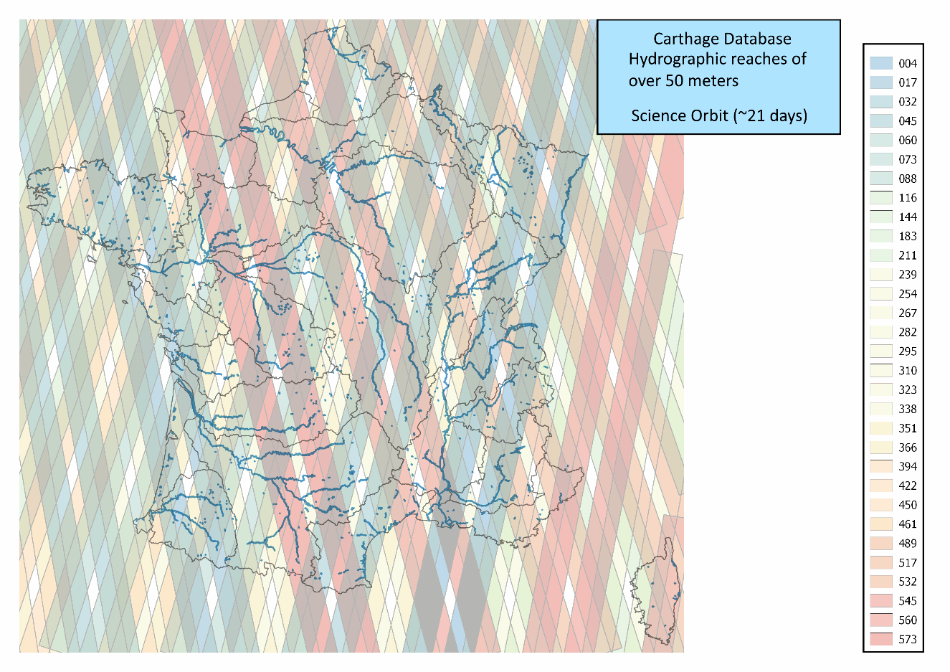
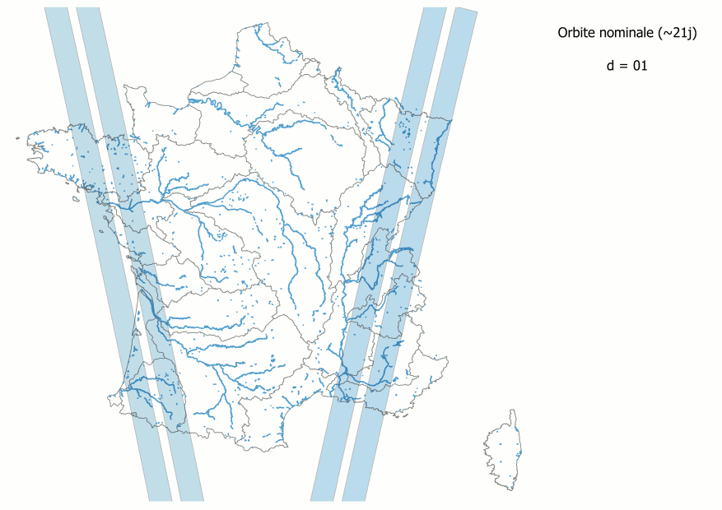
Science orbit – France coverage
© Cnes
Swot coverage over France, left with numbered tracks,
above, gif animation per day (from day 1 to 21)
© Cnes
Notes:
Except otherwise noted, “Swot mission” presentation by Cnes/Aviso is licensed under CC BY-SA 4.0. To view a copy of this license, visit https://creativecommons.org/licenses/by-sa/4.0

Slide 20
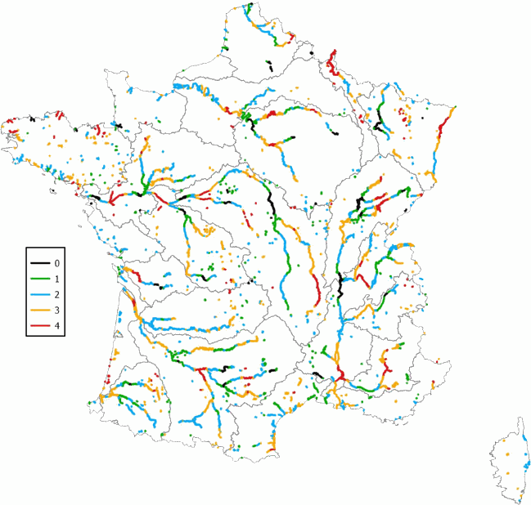
Number of observation per cycle (21 days) over France rivers & lakes
© Cnes
Notes:
Except otherwise noted, “Swot mission” presentation by Cnes/Aviso is licensed under CC BY-SA 4.0. To view a copy of this license, visit https://creativecommons.org/licenses/by-sa/4.0

Slide 21
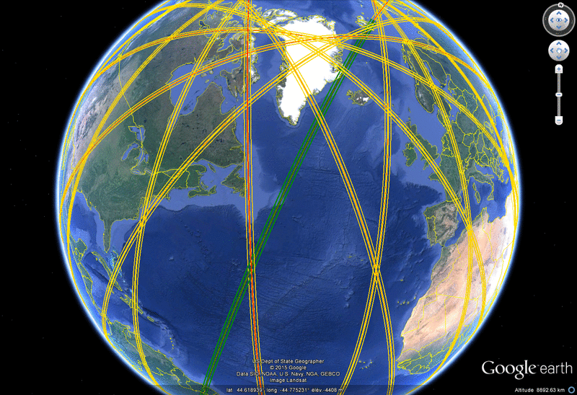
Fast-sampling orbit (1 day)
A 1-day repeat period, during the initial phase to achieve the Cal/Val objectives and study rapidly changing phenomena.
Notes:
Except otherwise noted, “Swot mission” presentation by Cnes/Aviso is licensed under CC BY-SA 4.0. To view a copy of this license, visit https://creativecommons.org/licenses/by-sa/4.0

Slide 22
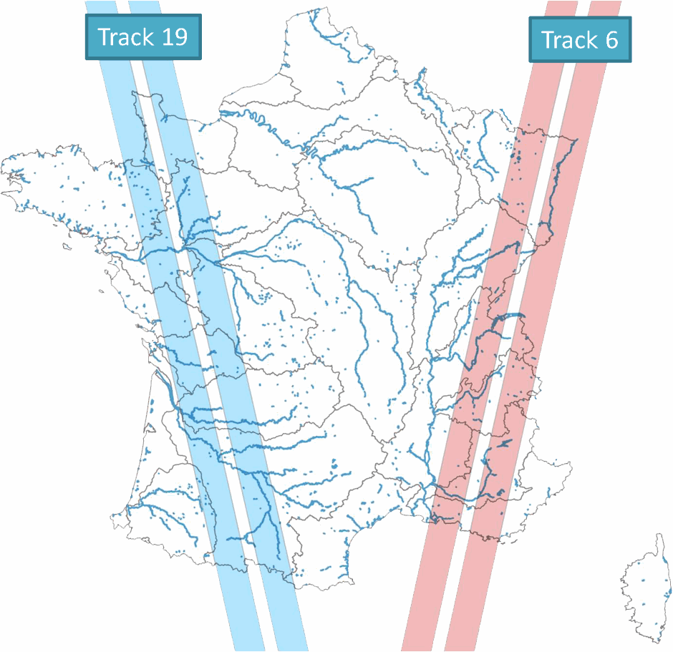
Fast-sampling orbit – France coverage
© Cnes
Notes:
Except otherwise noted, “Swot mission” presentation by Cnes/Aviso is licensed under CC BY-SA 4.0. To view a copy of this license, visit https://creativecommons.org/licenses/by-sa/4.0

Slide 23
Launch
Notes:
Except otherwise noted, “Swot mission” presentation by Cnes/Aviso is licensed under CC BY-SA 4.0. To view a copy of this license, visit https://creativecommons.org/licenses/by-sa/4.0

Slide 24
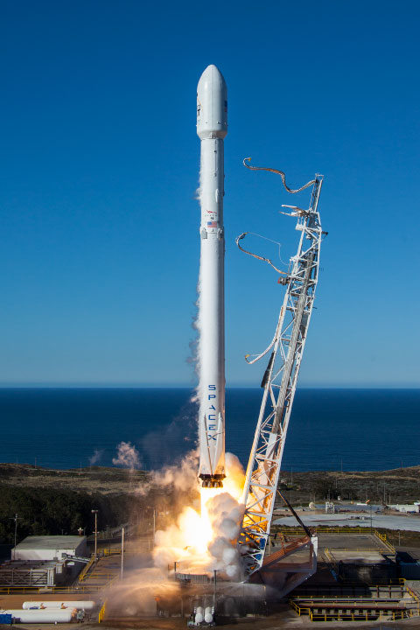
Launch
Swot was launched on December 16, 2022 on a SpaceX Falcon 9 rocket from Space Launch Complex 4E at Vandenberg Air Force Base in California.
© SpaceX
Notes:
Except otherwise noted, “Swot mission” presentation by Cnes/Aviso is licensed under CC BY-SA 4.0. To view a copy of
this license, visit https://creativecommons.org/licenses/by-sa/4.0

Slide 25
Ground segment
Notes:
Except otherwise noted, “Swot mission” presentation by Cnes/Aviso is licensed under CC BY-SA 4.0. To view a copy of this license, visit https://creativecommons.org/licenses/by-sa/4.0

Slide 26
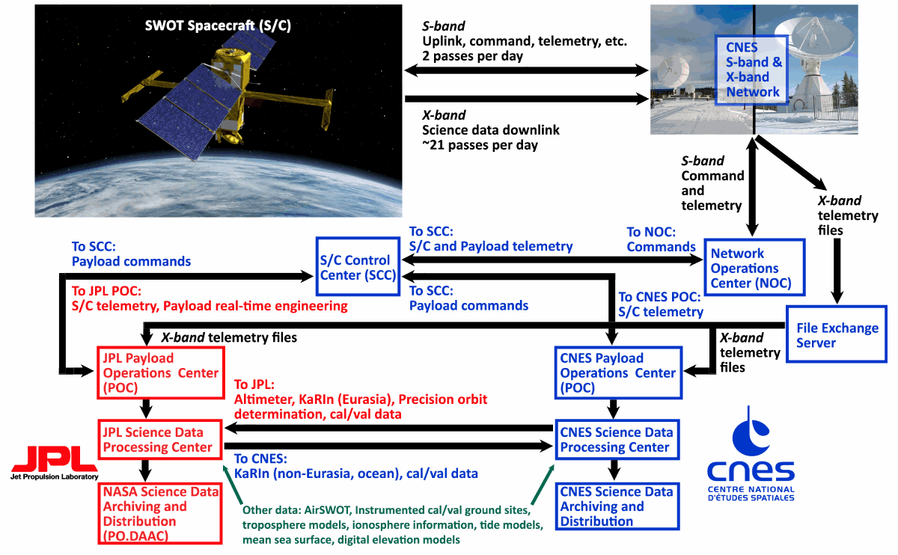
Notes:
Except otherwise noted, “Swot mission” presentation by Cnes/Aviso is licensed under CC BY-SA 4.0. To view a copy of this license, visit https://creativecommons.org/licenses/by-sa/4.0

