Slide 1
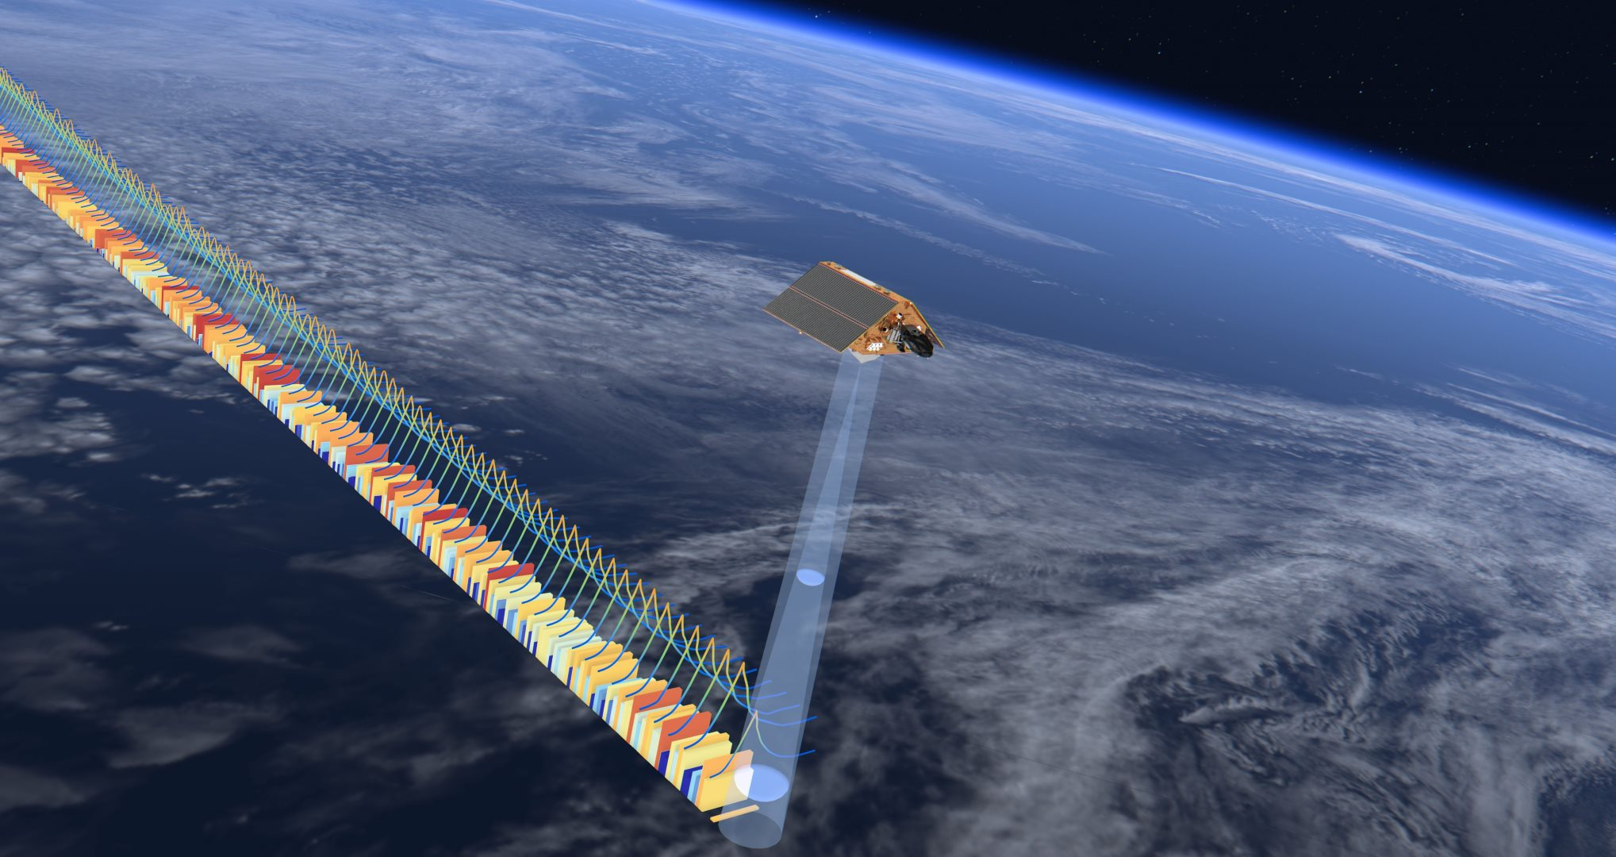
Water heights (altimetry): how does it work?
Cnes/Aviso
© Esa
Notes:
Except otherwise noted, “Water heights (altimetry): how does it work?” presentation by Cnes/Aviso is licensed under CC BY-SA 4.0. To view a copy of this license, visit https://creativecommons.org/licenses/by-sa/4.0

Slide 2
How does it work?
Notes:
Except otherwise noted, “Water heights (altimetry): how does it work?” presentation by Cnes/Aviso is licensed under CC BY-SA 4.0. To view a copy of this license, visit https://creativecommons.org/licenses/by-sa/4.0

Slide 3
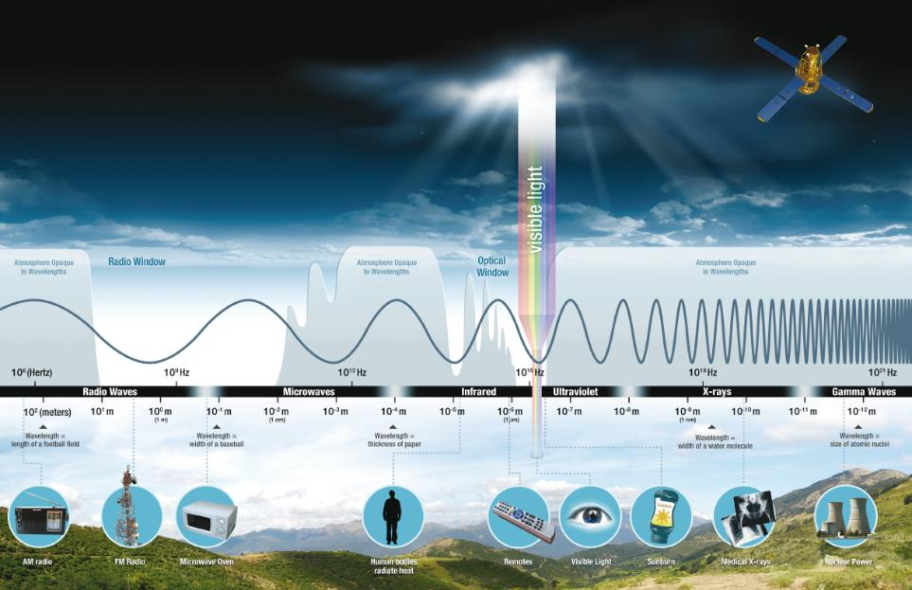
© Nasa
13 GHz to 35 GHz
Notes:
Except otherwise noted, “Water heights (altimetry): how does it work?” presentation by Cnes/Aviso is licensed under CC BY-SA 4.0. To view a copy of this license, visit https://creativecommons.org/licenses/by-sa/4.0

Slide 4
How it works? Simplified
Measure travel time 2T from emit to return of the radar pulse
Speed of the radar pulse is light’s celerity (c ≈ 3x10⁸ m/s)
The range h is deduced:
h = T×c
The altitude of the satellite is also very precisely measured; water level is the difference:
Surface height = altitude - range
orbit
h
(range)
water surface
Surface
height
altitude
geoid
Notes:
Except otherwise noted, “Water heights (altimetry): how does it work?” presentation by Cnes/Aviso is licensed under CC BY-SA 4.0. To view a copy of this license, visit https://creativecommons.org/licenses/by-sa/4.0

Slide 5
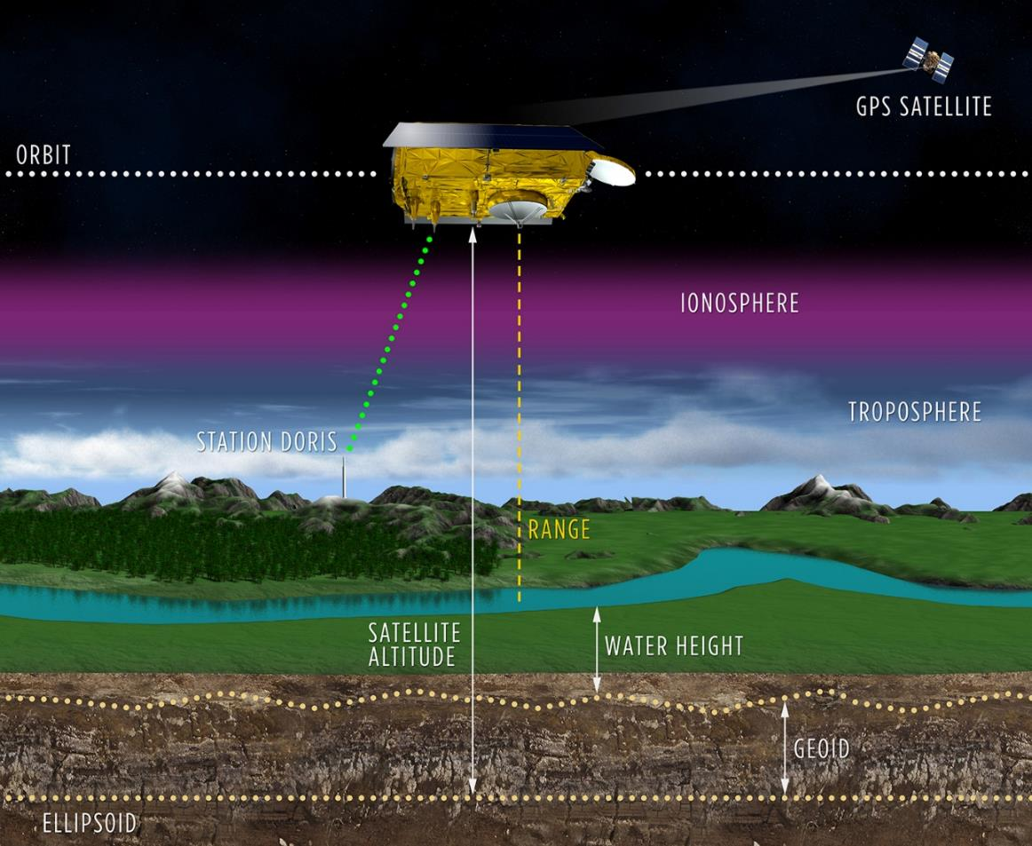
How it works (with corrections)
Instrumental Corrections
Water height = Altitude – Range – S Corr - geoid
Corrections applied:
  instrumental
  water in the troposphere
  electrons in the ionosphere
  atmosphere
  atmospheric pressure (inverse barometer)
  tides (solid Earth, pole)
Environnemental Corrections
Geophysical Corrections
© Cnes/Mira Production
Notes:
Except otherwise noted, “Water heights (altimetry): how does it work?” presentation by Cnes/Aviso is licensed under CC BY-SA 4.0. To view a copy of this license, visit https://creativecommons.org/licenses/by-sa/4.0

Slide 6
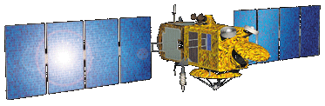
Some definitions…
  Surface Height
  in altimetry tacitly: with respect to the reference ellipsoid.
  Water height (or water level) : with respect to the geoid
  Geoid: equipotential surface of the earth that coincides with mean sea level over the oceans and extends hypothetically beneath all land surfaces.
  Reference ellipsoid: geometric shape approximating Earth surface
orbit
altitude
range
Surface Height
Water height
Geoid
Reference ellipsoid
Notes:
Except otherwise noted, “Water heights (altimetry): how does it work?” presentation by Cnes/Aviso is licensed under CC BY-SA 4.0. To view a copy of this license, visit https://creativecommons.org/licenses/by-sa/4.0

Slide 7
Limitations
Resolution: Measures only along the precise orbit repeat track
Time resolution: measures only every few days
Detects only the variable signal
➔ use data from several satellites
use data from several satellites and models
use an independent measure of geoid
Notes:
Except otherwise noted, “Water heights (altimetry): how does it work?” presentation by Cnes/Aviso is licensed under CC BY-SA 4.0. To view a copy of this license, visit https://creativecommons.org/licenses/by-sa/4.0

Slide 8
Advantages
Non sensitive to clouds or night
Measures everywhere in the world
Data available in near-real time
High precision, unremitting work on product accuracy
Continuous intercalibrated series since Oct. 1992.
Almost always at least 2 simultaneous satellites since 1992
Notes:
Except otherwise noted, “Water heights (altimetry): how does it work?” presentation by Cnes/Aviso is licensed under CC BY-SA 4.0. To view a copy of this license, visit https://creativecommons.org/licenses/by-sa/4.0

Slide 9
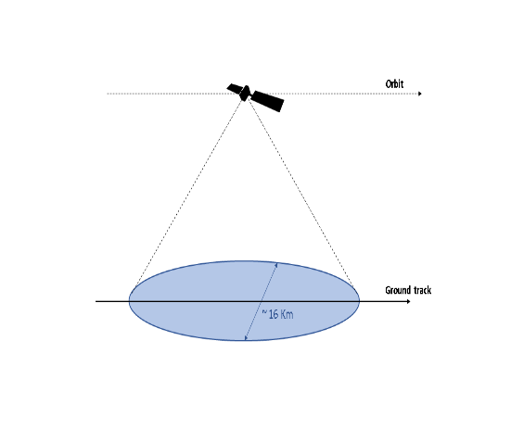
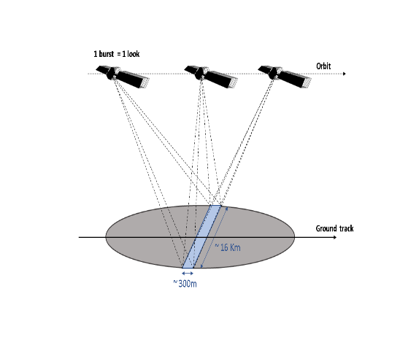
SAR altimetry vs conventional
Since 2009, a new technique is used, ‘SAR’ altimetry, also called delay-Doppler altimetry.
Onboard Cryosat-2 and Sentinel-3 (A & B), and in the future Sentinel-3 (C & D) and Jason-CS/Sentinel-6.
© CLS
© CLS
“Conventional” (classical) altimetry takes into account the reflection of the emitted beam as a whole – or at least, the part that returns to the satellite antenna.
SAR altimetry uses the Doppler effect to determine where the beam reflected, between reflections from behind and in front of the transmitted beam. This enable to split the beam in “slices” ➔ Better along-track resolution
Notes:
Except otherwise noted, “Water heights (altimetry): how does it work?” presentation by Cnes/Aviso is licensed under CC BY-SA 4.0. To view a copy of this license, visit https://creativecommons.org/licenses/by-sa/4.0

Slide 10


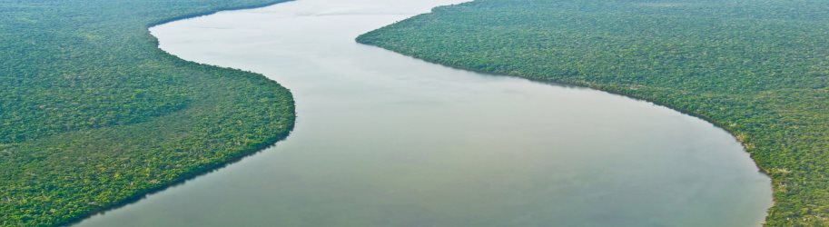
Conventional altimetry (“Low Resolution Mode”, LRM)
Conventional Altimetry
16 km of diameter (Ku; 11 km in Ka band of frequencies)
No coherent processing
(Phase not exploited)
Ku
Ka
Ground track
~11 km
© CLS
© CLS
Notes:
Except otherwise noted, “Water heights (altimetry): how does it work?” presentation by Cnes/Aviso is licensed under CC BY-SA 4.0. To view a copy of this license, visit https://creativecommons.org/licenses/by-sa/4.0

Slide 11
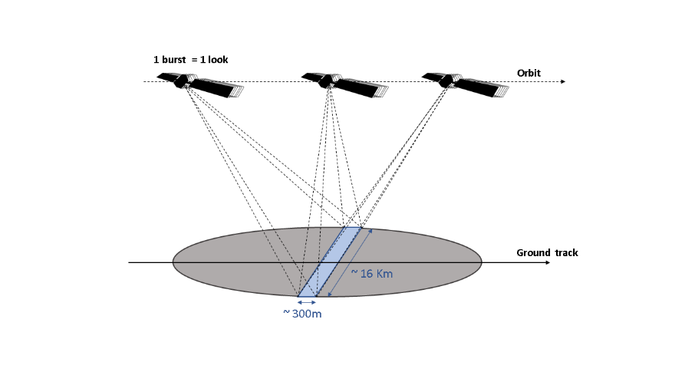
SAR- or delay-Doppler- altimetry (unfocused)
Conventional Altimetry
16 km of diameter
Unfocused SAR
~300 m in along-track direction (450 m with Hamming window)
16 km in across-track direction
Ground track
© CLS
© CLS
Coherent processing on one burst (~ 3.5 ms)
Notes:
Except otherwise noted, “Water heights (altimetry): how does it work?” presentation by Cnes/Aviso is licensed under CC BY-SA 4.0. To view a copy of this license, visit https://creativecommons.org/licenses/by-sa/4.0

Slide 12
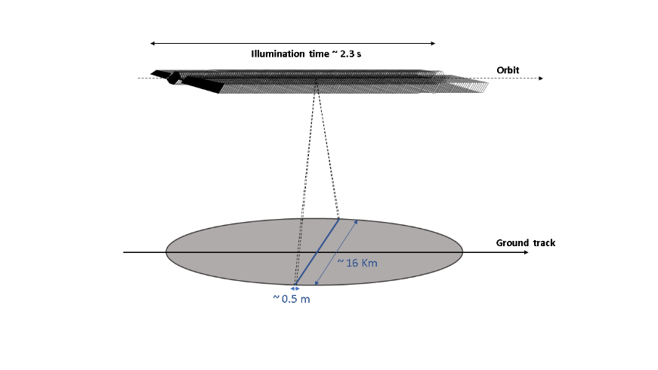
“Fully-focused” SAR altimetry (FF-SAR)
An ongoing development
Taking into account the whole time the phase stays coherent in the radar beam (~ 2.3 s, about 500 times longer than the current time used).
Higher resolution can be reached (up to the theoretical 50 cm)
Heavy in processing time
Ejido A., Smith W., “Fully Focused SAR Altimetry: Theory and Applications”, IEEE Trans. Geosci. Remote Sens., vol 55, n°1, January 2017.
© CLS
Notes:
Except otherwise noted, “Water heights (altimetry): how does it work?” presentation by Cnes/Aviso is licensed under CC BY-SA 4.0. To view a copy of this license, visit https://creativecommons.org/licenses/by-sa/4.0

Slide 13
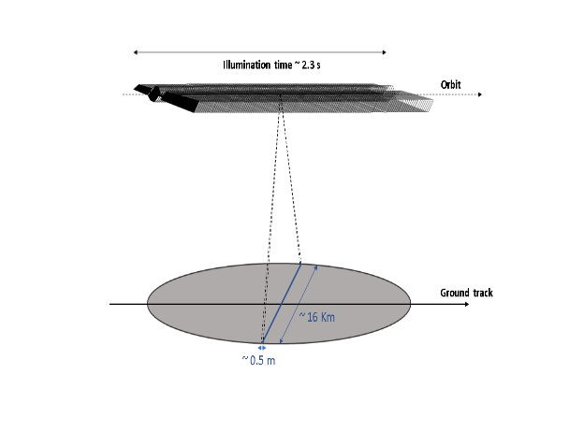
From Conventional to FF-SAR Altimeter processing
Conventional Altimetry
(LRM/PLRM mode)
Unfocused SAR (SAR mode)
[Raney, 1998]
Fully-Focused SAR (FF-SAR)
[Egido & Smith, 2017]
No coherent processing
(Phase not exploited)
➔ Footprint diameter = 16 km
Coherent processing on a burst (3.5 ms)
➔ Along-track resolution ~ 300 m
Multi-looking (sum of independent looks)
➔ Noise level reduction
Coherent processing on the entire scatterer illumination time (2.3 s)
➔ Along-track resolution = 50 cm
T/P, ERS, Jason, Envisat, Saral
Cryosat-2 and Sentinel-3
Jason-CS/Sentinel-6
Notes:
Except otherwise noted, “Water heights (altimetry): how does it work?” presentation by Cnes/Aviso is licensed under CC BY-SA 4.0. To view a copy of this license, visit https://creativecommons.org/licenses/by-sa/4.0

Slide 14
“Fully-focused” SAR altimetry (FF-SAR)
Conventional Altimetry
16 km of diameter
Unfocused SAR
~300 m in along-track direction (450 m with Hamming window)
16 km in across-track direction
FF-SAR
~50 cm in along-track direction 16 km in across-track direction
Ground track
© CLS
Notes:
Except otherwise noted, “Water heights (altimetry): how does it work?” presentation by Cnes/Aviso is licensed under CC BY-SA 4.0. To view a copy of this license, visit https://creativecommons.org/licenses/by-sa/4.0

Slide 15
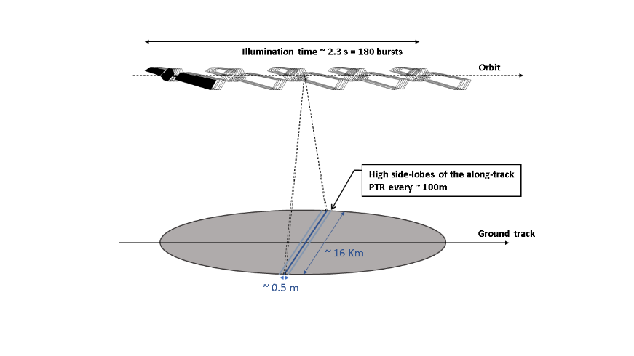
“Fully-focused” SAR altimetry (FF-SAR)
The current SAR altimeters (CryoSat-2, Sentinel-3) are emitting the radar beam by bursts of 64 pulses. This induces ghost replicas in FF-SAR in the received echoes
On Jason-CS / Sentinel-6 (to be launched in 2020) the altimeter will emit pulses continuously, which will remove this problem.
© CLS
Notes:
Except otherwise noted, “Water heights (altimetry): how does it work?” presentation by Cnes/Aviso is licensed under CC BY-SA 4.0. To view a copy of this license, visit https://creativecommons.org/licenses/by-sa/4.0

Slide 16
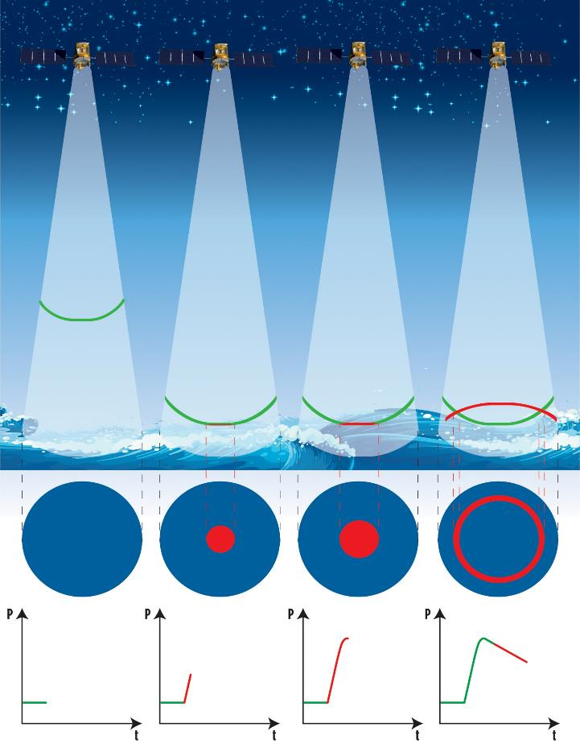
Radar echo over ocean / large lakes (classical alti)
The averaged radar echoes, also called waveforms, are the basic measurements analyzed to compute the range.
Their shape is analyzed and fitted with analytical models (ocean) or empirical ones to retrieve all the measurements.
Satellite
Radar beam
Beam front and water surface
Water surface from above, red
is the radar beam interaction with it
NB. The surfaces of the red disk
and of the red ring are equal in idealized case.
Averaged radar echo (‘waveform’)
power reflected and received back by the satellite vs time
© Cnes/Mira Production
Notes:
Except otherwise noted, “Water heights (altimetry): how does it work?” presentation by Cnes/Aviso is licensed under CC BY-SA 4.0. To view a copy of this license, visit https://creativecommons.org/licenses/by-sa/4.0

Slide 17
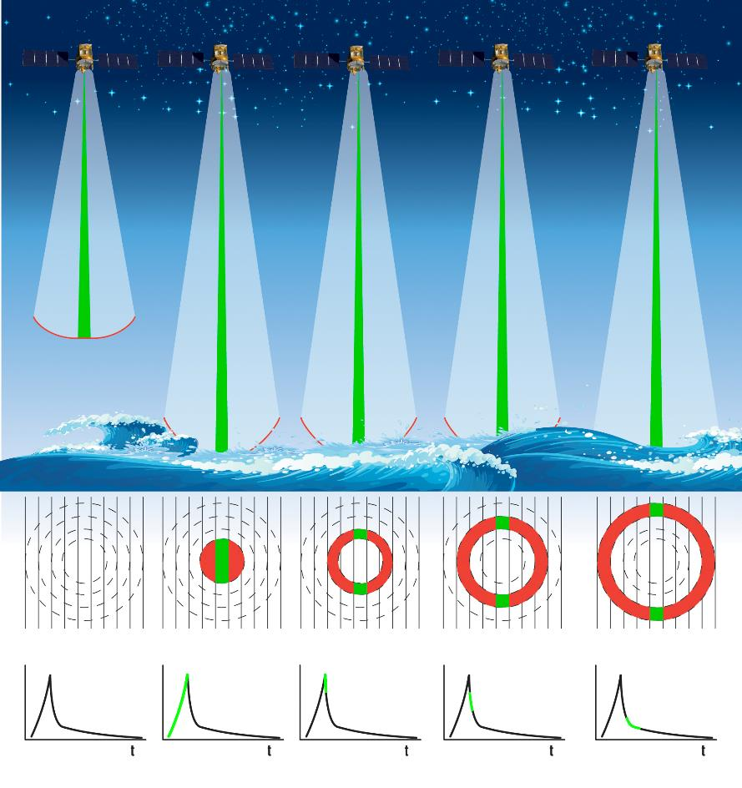
Radar echo over ocean / large lakes (SAR alti)
The averaged radar echoes, also called waveforms, are the basic measurements analyzed to compute the range.
Satellite
Radar beam
Beam front and water surface
Water surface from above, red is the radar beam interaction with it; green the part analyzed using the Doppler shift
NB. The surfaces of the red disk
and of the red ring are equal in idealized case.
Averaged radar echo (‘waveform’)
power reflected and received back by the satellite vs time
© Cnes/Mira Production
Notes:
Except otherwise noted, “Water heights (altimetry): how does it work?” presentation by Cnes/Aviso is licensed under CC BY-SA 4.0. To view a copy of this license, visit https://creativecommons.org/licenses/by-sa/4.0

Slide 18
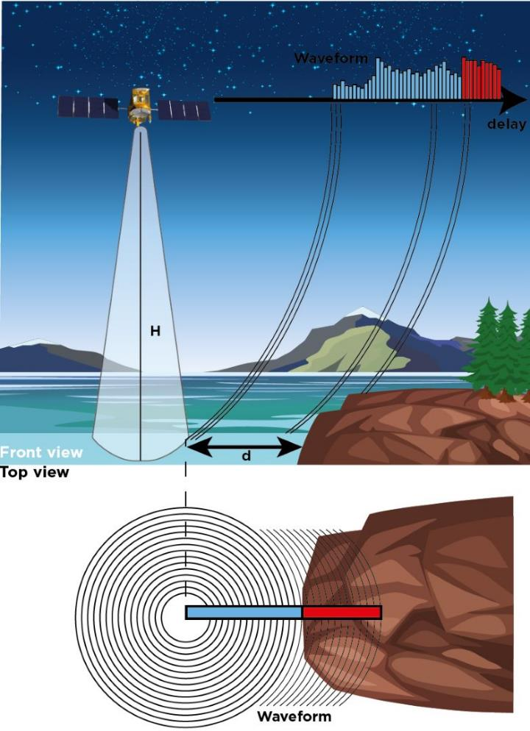
Radar echo over rivers / small water bodies
Riverbanks have an impact on the reflection (also the coasts):
reflections are not usually the same on the two types of surfaces (can be similar if the land is reflecting well – light-colored or wet sand, rocks…)
Cnes/Mira Production, From P. Thibaut, in Gommenginger et al., 2011
Notes:
Except otherwise noted, “Water heights (altimetry): how does it work?” presentation by Cnes/Aviso is licensed under CC BY-SA 4.0. To view a copy of this license, visit https://creativecommons.org/licenses/by-sa/4.0

Slide 19
Over rivers (classical alti) (non-reflecting banks)
Notes:
Except otherwise noted, “Water heights (altimetry): how does it work?” presentation by Cnes/Aviso is licensed under CC BY-SA 4.0. To view a copy of this license, visit https://creativecommons.org/licenses/by-sa/4.0

Slide 20
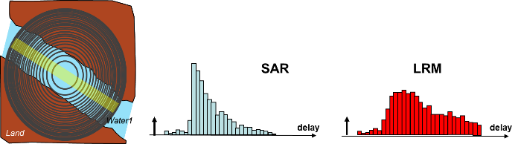
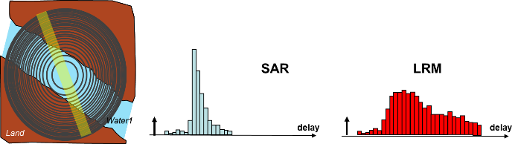
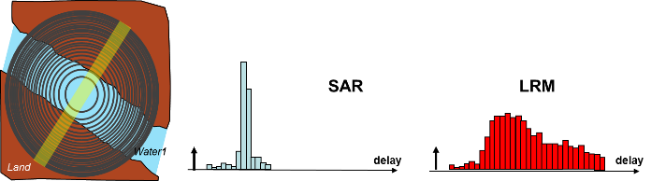
Observation wrt river-crossing geometry
© CLS/P. Thibaut
For SAR altimetry, the orientation of the measurements with respect to the river contours matters
Depending if it is a perpendicular crossing (top), side-way (middle) or along-track (bottom), the waveform will be different.
Notes:
Except otherwise noted, “Water heights (altimetry): how does it work?” presentation by Cnes/Aviso is licensed under CC BY-SA 4.0. To view a copy of this license, visit https://creativecommons.org/licenses/by-sa/4.0

Slide 21
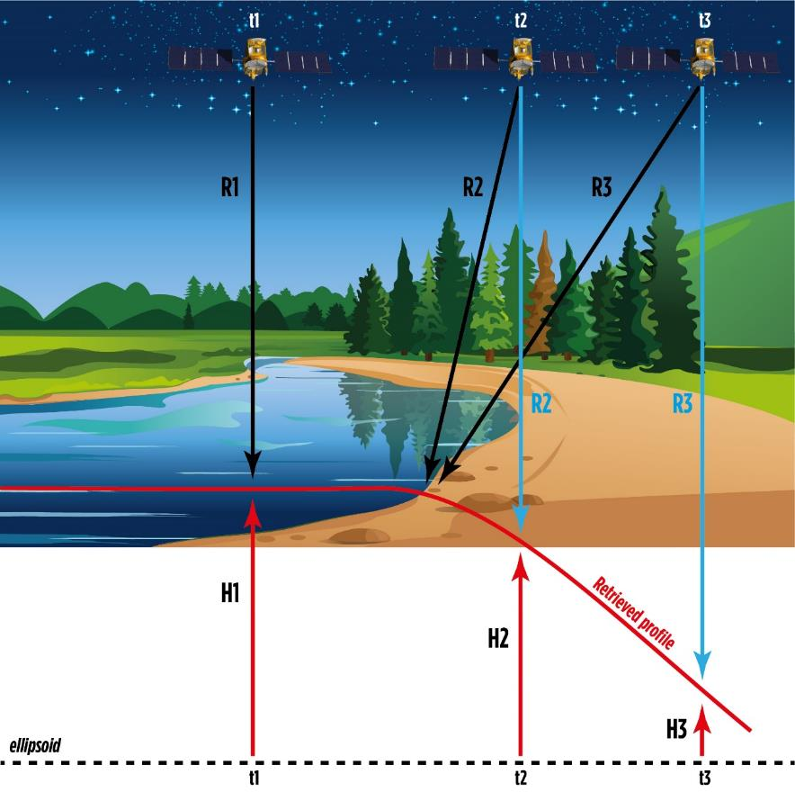
Reflections on the surrounding
when the altimeter continues to measure a reflective surface it has just flown over, despite no longer being above it, this results in a longer round-trip time for the wave, leading to an underestimation of the surface height measured by the altimeter (overestimation of the satellite-to-surface distance) (hooking)
Riverbanks & other surfaces in the footprint can be good reflectors, leading to several peaks in the waveform (also braided rivers)
© Cnes/Mira Production
Notes:
Except otherwise noted, “Water heights (altimetry): how does it work?” presentation by Cnes/Aviso is licensed under CC BY-SA 4.0. To view a copy of this license, visit https://creativecommons.org/licenses/by-sa/4.0

Slide 22
What are we observing?
Notes:
Except otherwise noted, “Water heights (altimetry): how does it work?” presentation by Cnes/Aviso is licensed under CC BY-SA 4.0. To view a copy of this license, visit https://creativecommons.org/licenses/by-sa/4.0

Slide 23
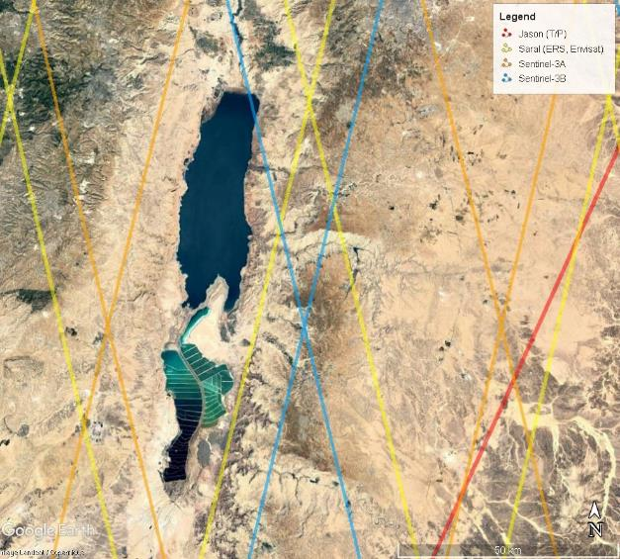
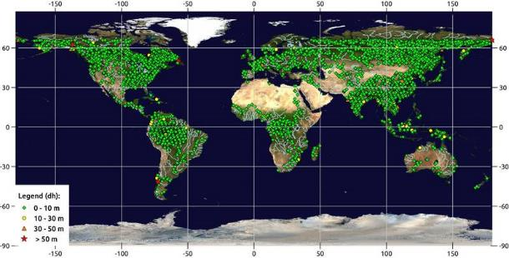
Spatial scales
Not all the points on Earth are measured.
Depending on the satellite, the measurement mesh is more or less tight. Using several satellites densifies the mesh.
Some rivers or lakes may never be measured
Dead Sea “coverage” by Jason, Saral, Sentinel-3 A & B right: this rather large water body is almost not seen by any repetitive altimeters
© Cnes
Potential measurements over inland waters by Jason-3
Notes:
Except otherwise noted, “Water heights (altimetry): how does it work?” presentation by Cnes/Aviso is licensed under CC BY-SA 4.0. To view a copy of this license, visit https://creativecommons.org/licenses/by-sa/4.0

Slide 24
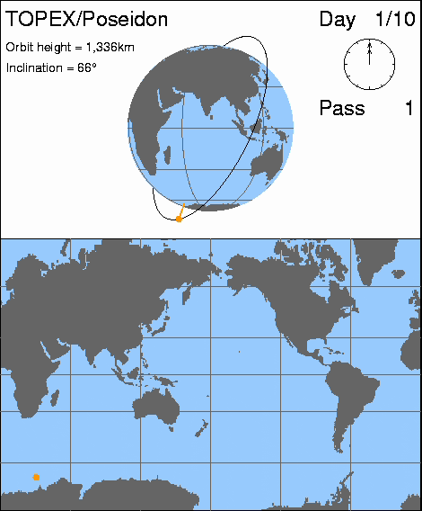
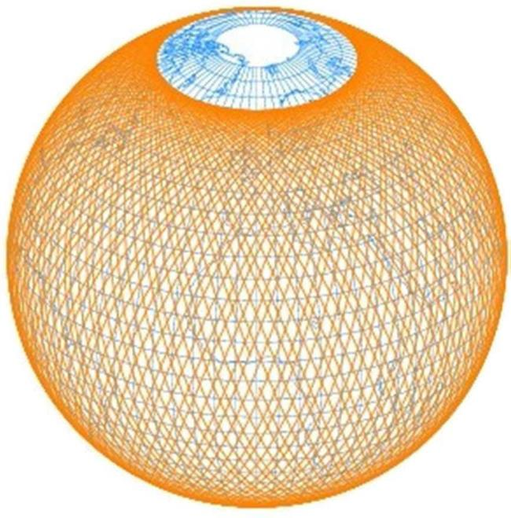
Why? Because classical altimetry is not imagery…
basically altimetry data are “along-track”, i.e. a narrow thread of measurements just beneath the satellite.
Courtesy CSIRO
Notes:
Except otherwise noted, “Water heights (altimetry): how does it work?” presentation by Cnes/Aviso is licensed under CC BY-SA 4.0. To view a copy of this license, visit https://creativecommons.org/licenses/by-sa/4.0

Slide 25
Time scales
Measurements made every few days (depending on the satellite and the location on Earth)
Continuously since 1991-92
Thus we observe:
  Transient phenomena only haphazardly
  One week to one month’s variations (depending on the satellite)
  Seasonal variations
  Interannual variations
  Climatological variations: soon (30 yrs; i.e. in 2022)
Notes:
Except otherwise noted, “Water heights (altimetry): how does it work?” presentation by Cnes/Aviso is licensed under CC BY-SA 4.0. To view a copy of this license, visit https://creativecommons.org/licenses/by-sa/4.0

Slide 26
Higher-level data available
Raw data can be used. However, different high-level processing provide with easier-to-use data, pre-computed for a given use:
Rivers: “virtual station”
Lakes: integrated surface height
Notes:
Except otherwise noted, “Water heights (altimetry): how does it work?” presentation by Cnes/Aviso is licensed under CC BY-SA 4.0. To view a copy of this license, visit https://creativecommons.org/licenses/by-sa/4.0

Slide 27
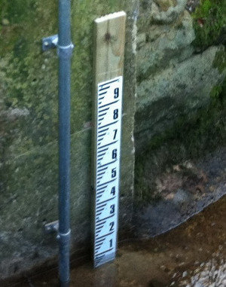
Rivers: “virtual station”
Each time the satellite ground track crosses the river, it is “as if” you had an in situ station in the middle, measuring the surface height
ground track
Only one satellite, and one of its track, used in a given time series.
The water height is given with respect to a reference (geoid)
© CLS
Notes:
Except otherwise noted, “Water heights (altimetry): how does it work?” presentation by Cnes/Aviso is licensed under CC BY-SA 4.0. To view a copy of this license, visit https://creativecommons.org/licenses/by-sa/4.0

Slide 28
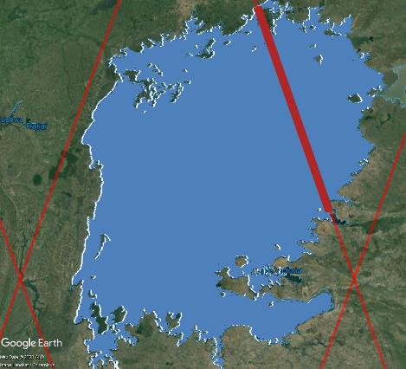
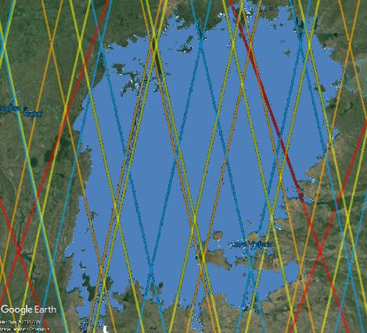
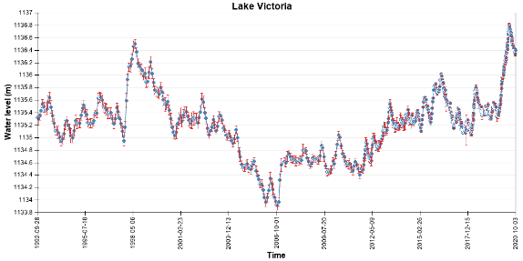
Lakes: integrated surface height
All measurements done over a lake by one given satellite along one of its ground track are averaged dated at a mean hour (before Nov. 2011: per month).
Several tracks and several satellites can be used to build a time series.
The water height is given with respect to a reference (geoid).
1 satellite track
→ 1 averaged height
at 1 date/time
N satellite tracks
→ N averaged heights
at N date/time (or /month)
Notes:
Except otherwise noted, “Water heights (altimetry): how does it work?” presentation by Cnes/Aviso is licensed under CC BY-SA 4.0. To view a copy of this license, visit https://creativecommons.org/licenses/by-sa/4.0

