Slide 1
Water Heights (altimetry): the satellites / sensors
Notes:
Except otherwise noted, “Water heights (altimetry): the satellites / sensors” presentation by Cnes/Aviso is licensed under CC BY-SA 4.0. To view a copy of this license, visit https://creativecommons.org/licenses/by-sa/4.0

Slide 2
Altimetry missions used in hydrology
ERS-1 (Esa)
7/17/1991 - 3/31/2000
Topex/Poseidon (Nasa/Cnes)
8/10/1992 - 1/18/2006
ERS-2 (Esa)
4/21/1995 - 7/6/2011
Envisat (Esa)
3/1/2002 - 4/8/2012
Jason-2 (Cnes/Eumetsat/Nasa/Noaa)
6/20/2008 - 10/10/2019
Cryosat-2 (Esa)
4/8/2010 - 12/31/2021
Saral (Cnes/Isro)
2/25/2013 - 12/31/2021
Jason-3 (Eumetsat/Noaa/Cnes/Nasa)
1/17/2016 - 1/18/2023
Sentinel-3A (EU)
2/16/2016 - 2/16/2023
Sentinel-3B (EU)
3/31/2018 - 1/31/2025
3181 jours
Jason-CS/Sentinel-6A (Esa/Eumetsat/Nasa)
11/15/2020 - 11/15/2027
4910 jours
Swot (Nasa/Cnes)
2/15/2022 - 2/15/2025
5921 jours
Sentinel-3C (EU)
7/1/2023 - 7/1/2030
3692 jours
Sentinel-3D (EU)
7/1/2025 - 7/1/2032
4130 jours
Jason-CS/Sentinel-6B (EU/Eumetsat/Nasa)
11/15/2025 - 11/15/2032
4286 jours
3232 jours
1991
1991
1997
2003
2009
2015
2021
2027
2032
2559 jours
2558 jours
Today
2499 jours
2557 jours
1097 jours
2558 jours
2558 jours
2558 jours
Notes:
Except otherwise noted, “Water heights (altimetry): the satellites / sensors” presentation by Cnes/Aviso is licensed under CC BY-SA 4.0. To view a copy of this license, visit https://creativecommons.org/licenses/by-sa/4.0

Slide 3
Altimetry satellites, from open ocean to rivers
A technique born to measure the ocean (first in 1969).
First satellites (1970s) had a 1-m accuracy
1990s: ERS-1, Topex/Poseidon used over lakes, large rivers
Envisat & Saral, then Sentinel-3, Jason-2 & follow-on continues on these measurements
Saral: higher spatial resolution (smaller beam)
Cryosat-2, Sentinel-3A&B: use of synthetic aperture techniques (« division » of the beam in smaller units by processing the radar echo)
2022: Swot, an interferometric wide-swath imager
Notes:
Except otherwise noted, “Water heights (altimetry): the satellites / sensors” presentation by Cnes/Aviso is licensed under CC BY-SA 4.0. To view a copy of this license, visit https://creativecommons.org/licenses/by-sa/4.0

Slide 4
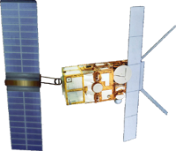
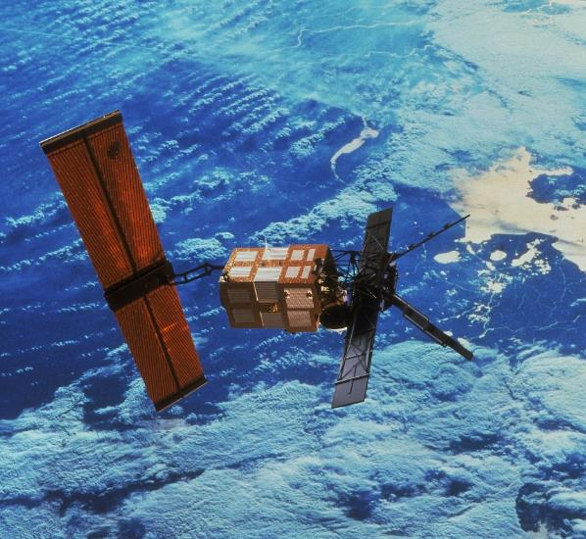
ERS-1 & 2
Esa
Launched: 17 July 1991 (ERS-1)
21 April 1995 (ERS-2)
End of mission: June 1996 (ERS-1)
June 2011 (end of global coverage in June 2003 for ERS-2)
Mission: To observe the Earth and its environment
Altitude: 782 to 785 km
Payload instruments:
  Single-frequency radar altimeter (RA)
  Dual-frequency radiometer (MWR)
  Laser for orbit determination
Orbit:
  Inclination: 98.52°
  Revisit frequency: 35 days
  3 days (ERS-1 ice phase)
  168 days (ERS-1 geodetic phase)
  Inter-track distance at the equator: 80 km (35-day cycle)
© ESA
© ESA
Notes:
Except otherwise noted, “Water heights (altimetry): the satellites / sensors” presentation by Cnes/Aviso is licensed under CC BY-SA 4.0. To view a copy of this license, visit https://creativecommons.org/licenses/by-sa/4.0

Slide 5
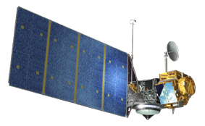
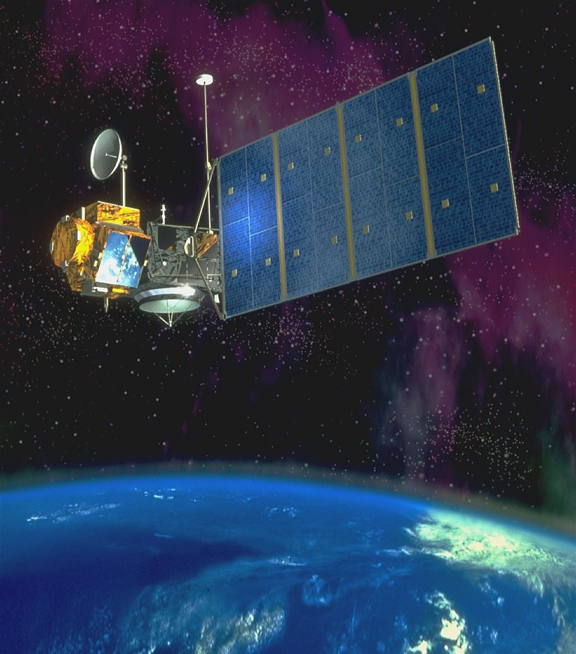
Topex/Poseidon
Nasa/Cnes
Launched: 10 August 1992
End of mission: 5 January 2006
Mission: To measure the height of the oceans
Altitude: 1,336 km
Payload instruments:
  Dual-frequency altimeter (Topex)
  Experimental single-frequency altimeter (Poseidon-1)
  3-frequency radiometer (TMR)
  Orbit determination: laser (LRA), Doris, GPS (GPSDR)
Orbit:
  Inclination: 66° (non sun-synchronous)
  Revisit frequency: 10 days
  Inter-track distance at the equator: 315 km
© Cnes/D. Ducros
Notes:
Except otherwise noted, “Water heights (altimetry): the satellites / sensors” presentation by Cnes/Aviso is licensed under CC BY-SA 4.0. To view a copy of this license, visit https://creativecommons.org/licenses/by-sa/4.0

Slide 6
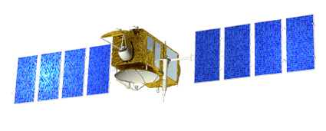
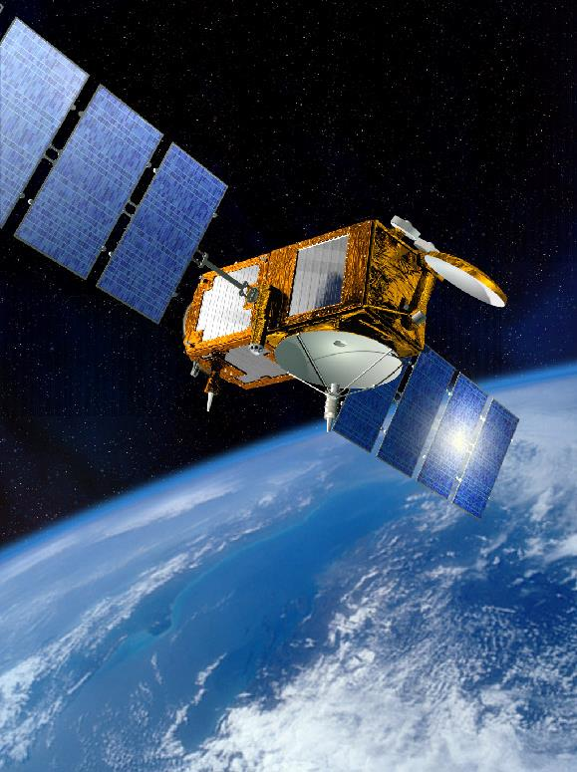
Jason-1
Cnes/Nasa
Launched: 7 December 2001
End of mission: 1st July 2013
Mission: To measure the height of the oceans
Altitude: 1,336 km
Payload instruments:
  Dual-frequency altimeter (Poseidon-2)
  3-frequency radiometer (JMR)
  Orbit determination: Laser (LRA), GPS (TRSR), Doris
Orbit:
  Inclination: 66° (non sun-synchronous)
  Revisit frequency: 10 days
  Inter-track distance at the equator: 315 km
© Cnes/D. Ducros
© Cnes/D. Ducros
Satellite emission/reception scheme was not optimized for inland water, so few data available over lands
Notes:
Except otherwise noted, “Water heights (altimetry): the satellites / sensors” presentation by Cnes/Aviso is licensed under CC BY-SA 4.0. To view a copy of this license, visit https://creativecommons.org/licenses/by-sa/4.0

Slide 7
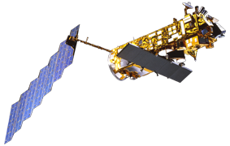
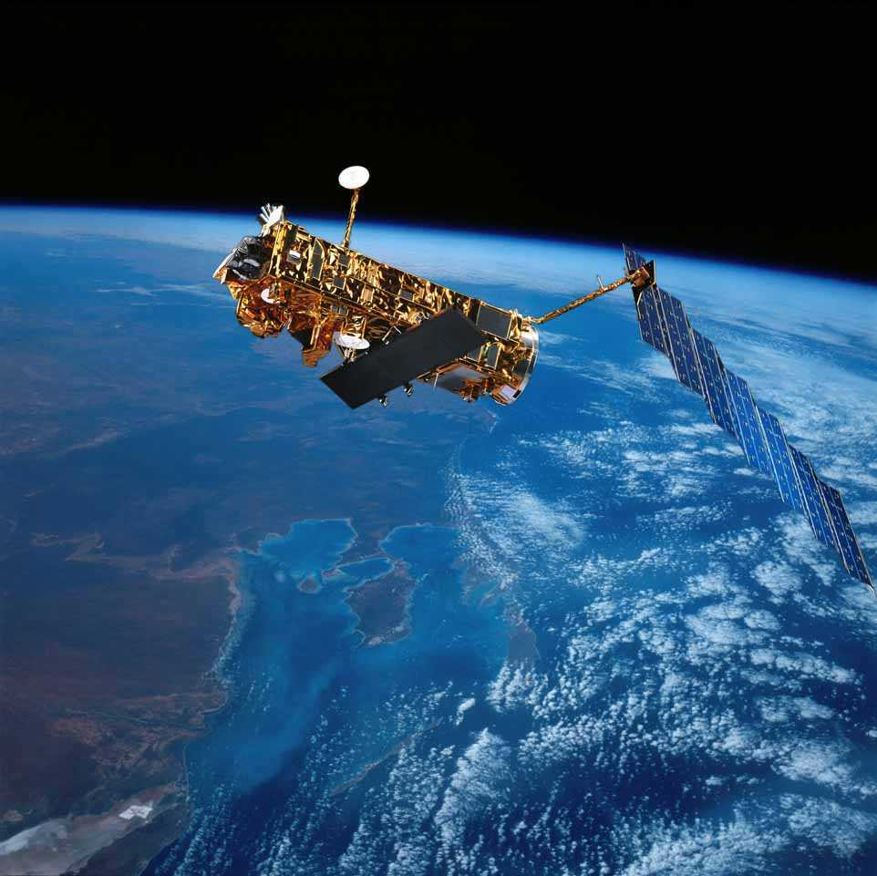
Envisat
Esa
Launched: 1 March 2002
End of mission: 9 May 2012
Mission: To observe the Earth and its
environment
Altitude: 800 km
Payload instruments:
10 different instruments including:
  Radar altimeter (RA2)
  Radiometer (MWR)
  Orbit determination: laser (LRR), Doris
Orbit:
  Inclination: 98.5° (sun-synchronous)
  Revisit frequency: 35 days
  Inter-track distance at the equator: 80 km
© Esa
© Esa
Notes:
Except otherwise noted, “Water heights (altimetry): the satellites / sensors” presentation by Cnes/Aviso is licensed under CC BY-SA 4.0. To view a copy of this license, visit https://creativecommons.org/licenses/by-sa/4.0

Slide 8
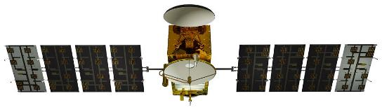
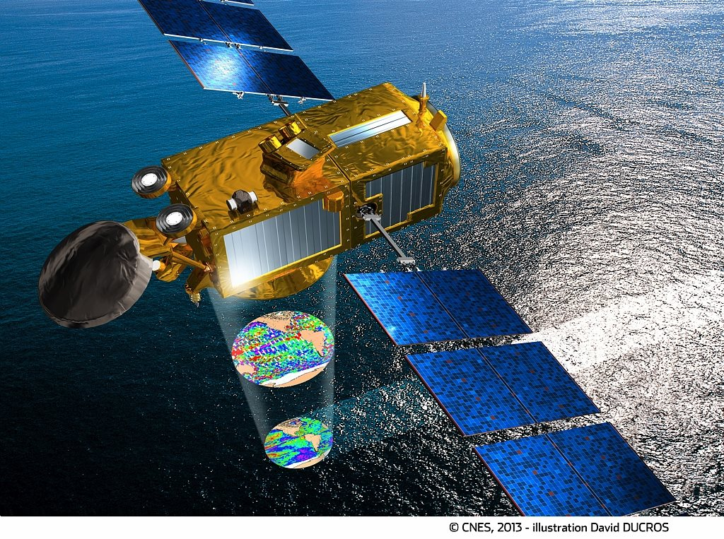
Jason-2
© Cnes/D. Ducros
Eumetsat/Noaa/Cnes/Nasa
Launched: 20 June 2008
End of mission: Oct. 2019
Mission: To measure the height
of the oceans
Altitude: 1,336 km
Payload instruments:
  Dual-frequency altimeter (Poseidon-3)
  3-frequency radiometer (AMR)
  Orbit determination:
  laser (LRA), Doris, GPS (TRSR)
Orbit:
  Inclination: 66° (non sun-synchronous)
  Revisit frequency: 10 days
  Inter-track distance at the equator: 315 km
Notes:
Except otherwise noted, “Water heights (altimetry): the satellites / sensors” presentation by Cnes/Aviso is licensed under CC BY-SA 4.0. To view a copy of this license, visit https://creativecommons.org/licenses/by-sa/4.0

Slide 9
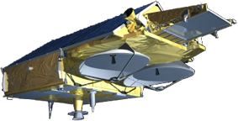
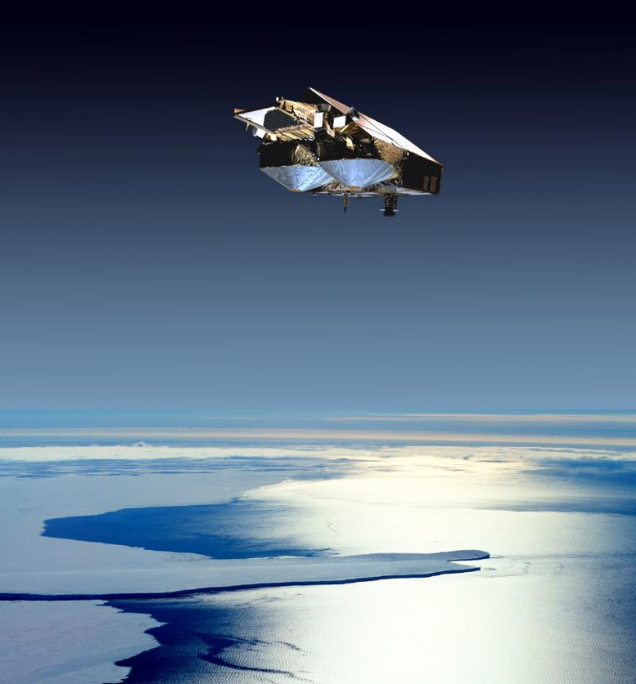
Cryosat-2
Esa
Launched: 8 April 2010
Mission: To observe the polar regions
Altitude: 717 km
Payload instruments:
  Interferometric altimeter (Siral)
  (delay-Doppler instrument (SAR-mode))
  Orbit determination: Doris, laser (LRR)
Orbit:
  Inclination: 92° (non sun-synchronous)
  Revisit frequency: 369 days (although every point on the globe observed in 30 days)
© Esa
© Esa
Notes:
Except otherwise noted, “Water heights (altimetry): the satellites / sensors” presentation by Cnes/Aviso is licensed under CC BY-SA 4.0. To view a copy of this license, visit https://creativecommons.org/licenses/by-sa/4.0

Slide 10
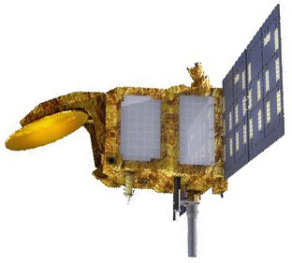
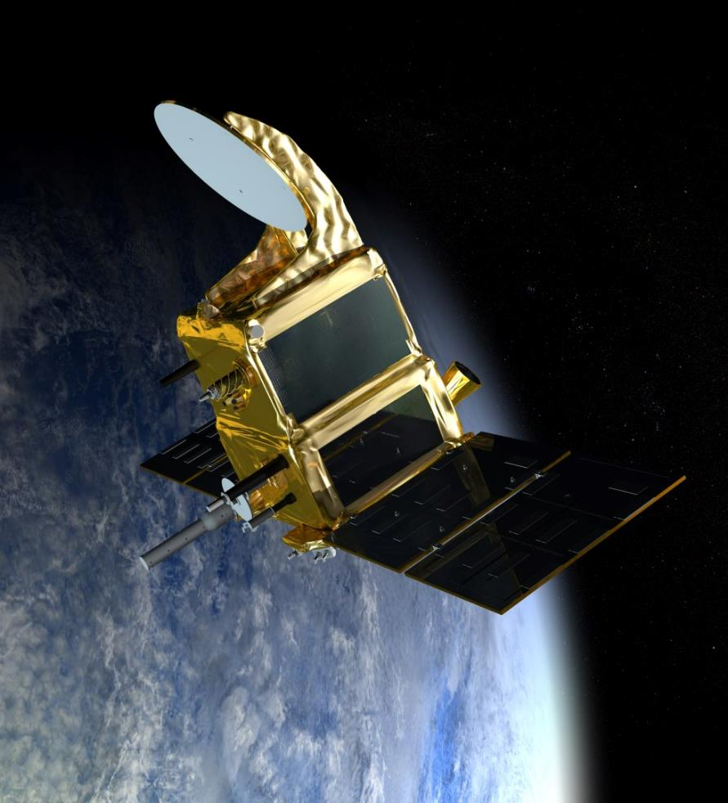
Saral
Cnes/Isro
Launch: 25 February 2013
Mission: To observe the oceans
Altitude: 800 km
Payload instruments:
  Altimeter-radiometer AltiKa
  Orbit determination: laser (LRA), Doris
  (+ Argos3 instrument)
Orbit:
  Inclination : 98.5 ° (sun-synchronous)
  Revisit frequency: 35 days
  Inter-track distance at the equator: 80 km
© Cnes
© Cnes/Mira Production
Notes:
Except otherwise noted, “Water heights (altimetry): the satellites / sensors” presentation by Cnes/Aviso is licensed under CC BY-SA 4.0. To view a copy of this license, visit https://creativecommons.org/licenses/by-sa/4.0

Slide 11
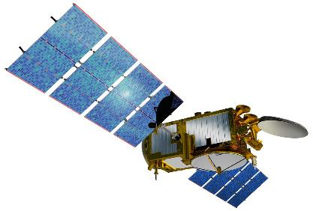
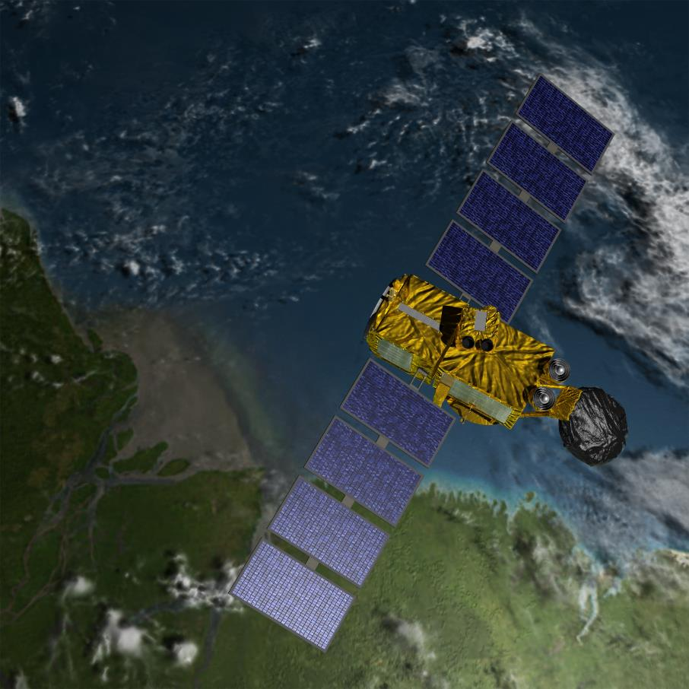
Jason-3
© Cnes/D. Ducros
Eumetsat/Noaa/Cnes/Nasa
Launch: 17 January 2016
Mission: To measure the height of the oceans
Altitude: 1,336 km
Payload instruments:
  Dual-frequency altimeter (Poseidon-3B)
  3-frequency radiometer
  Orbit determination: laser , Doris, GPS
Orbit:
  Inclination: 66° (non sun-synchronous)
  Revisit frequency: 10 days
  Inter-track distance at the equator: 315 km
© Nasa/JPL
Notes:
Except otherwise noted, “Water heights (altimetry): the satellites / sensors” presentation by Cnes/Aviso is licensed under CC BY-SA 4.0. To view a copy of this license, visit https://creativecommons.org/licenses/by-sa/4.0

Slide 12
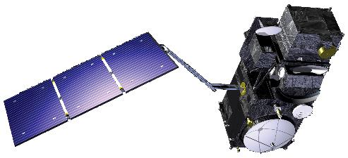
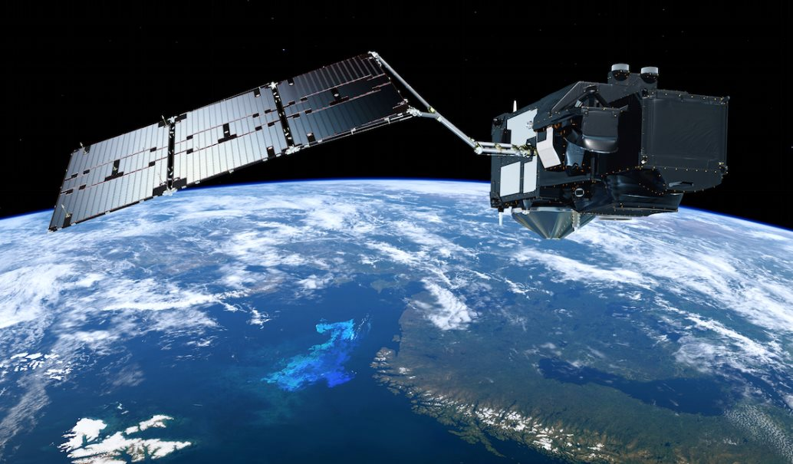
Sentinel-3
European Union
Launch: Sentinel-3A 18 February 2016;
Sentinel-3B 25 April 2018
(coming: C&D)
Mission: deliver routine operational services to policy-makers
and marine and land service users
Altitude: 814.5 km
Payload instruments:
  Altimeter (Sral) C/Ku band follow-on Cryosat
  Siral (delay-Doppler instrument)
  Radiometer (dual-frequency)
  Orbit determination :
  laser (LRR) , Doris, GNSS
Orbit:
  Inclination: 98.65° (sun-synchronous)
  Revisit frequency: 27 days
© Esa
© Esa
Notes:
Except otherwise noted, “Water heights (altimetry): the satellites / sensors” presentation by Cnes/Aviso is licensed under CC BY-SA 4.0. To view a copy of this license, visit https://creativecommons.org/licenses/by-sa/4.0

Slide 13
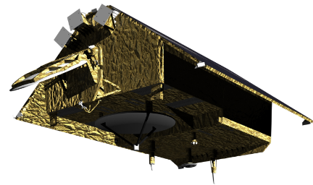
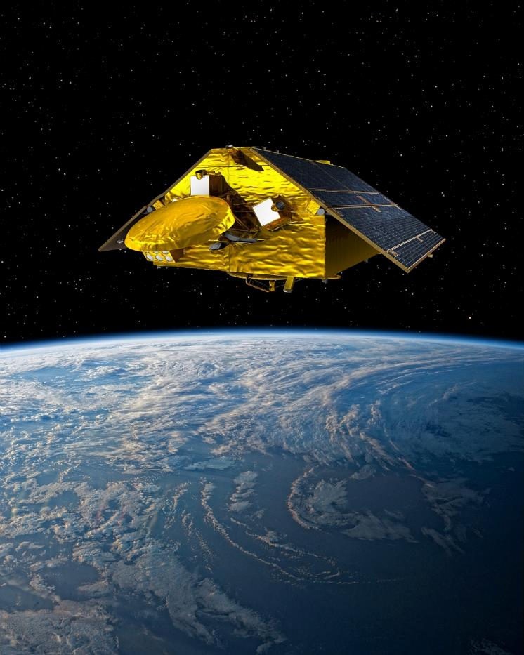
Sentinel-6 (Jason-CS)
Esa/Eumetsat/EU/Noaa/Cnes/Nasa
Launch: Nov. 2020 (A / Michael Freilich) & 2025 (B)
Mission: To measure the height of the oceans, continuing the T/P-Jason series
Altitude: 1,336 km
Payload instruments:
  SRAL-based “Poseidon-4” altimeter
  (delay-Doppler instrument)
  radiometer
  Orbit determination: Doris, laser, GNSS
Orbit:
  Inclination: 66° (non sun-synchronous)
  Revisit frequency: 10 days
  Inter-track distance at the equator: 315 km
© Cnes/D. Ducros
Notes:
Except otherwise noted, “Water heights (altimetry): the satellites / sensors” presentation by Cnes/Aviso is licensed under CC BY-SA 4.0. To view a copy of this license, visit https://creativecommons.org/licenses/by-sa/4.0

Slide 14
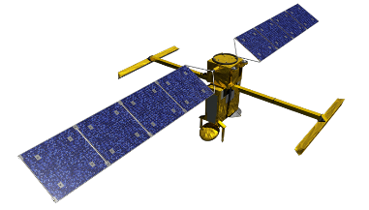
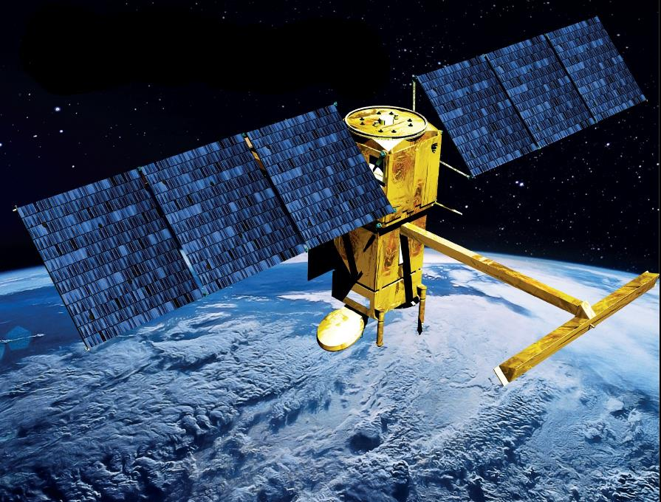
Swot
Nasa/Cnes/CSA/UKSA
Launch: December 16, 2022
Mission: better understanding of the world's oceans
and its terrestrial surface waters.
Altitude: 890 km
Payload instruments:
  Interferometric altimeter (KaRIN)
  Nadir dual-frequency altimeter (Poseidon-3)
  3-frequency radiometer
  Orbit determination: Doris, laser, GPS
Orbit:
  Inclination: 77.6 °(non sun-synchronous)
  Revisit frequency: ~21 days (20.86455 days)
© Cnes/Mira Production
© TAS
Notes:
Except otherwise noted, “Water heights (altimetry): the satellites / sensors” presentation by Cnes/Aviso is licensed under CC BY-SA 4.0. To view a copy of this license, visit https://creativecommons.org/licenses/by-sa/4.0

Slide 15
Data access
Hydroweb
http://hydroweb.theia-land.fr/?lang=en&
Copernicus Global Land
https://land.copernicus.eu/global/products/wl
Database for Hydrological Time Series of Inland Waters (DAHITI)
https://dahiti.dgfi.tum.de/en/
Global Reservoirs and Lakes Monitor (G-REALM)
https://ipad.fas.usda.gov/cropexplorer/global_reservoir/
Rivers & Lakes (no longer updated) :
http://altimetry.esa.int/riverlake/shared/main.html
FDR4Alt: new processing being fine-tuned
https://www.fdr4alt.org/
Notes:
Except otherwise noted, “Water heights (altimetry): the satellites / sensors” presentation by Cnes/Aviso is licensed under CC BY-SA 4.0. To view a copy of this license, visit https://creativecommons.org/licenses/by-sa/4.0

