Slide 1
Water heights (altimetry):
How are they used?
Notes:
Except otherwise noted, “Water heights (altimetry): how are they used?” presentation by Cnes/Aviso is licensed under CC BY-SA 4.0. To view a copy of this license, visit https://creativecommons.org/licenses/by-sa/4.0

Slide 2
At stakes
The water height provided by altimetry, enables to follow the seasonal or long term water level variations of rivers and lakes, or those from one passage of the satellite to the next.
The analysis of the return radar wave also allows to detect areas under water (or not) , and thus to monitor wetlands.
Notes:
Except otherwise noted, “Water heights (altimetry): how are they used?” presentation by Cnes/Aviso is licensed under CC BY-SA 4.0. To view a copy of this license, visit https://creativecommons.org/licenses/by-sa/4.0

Slide 3
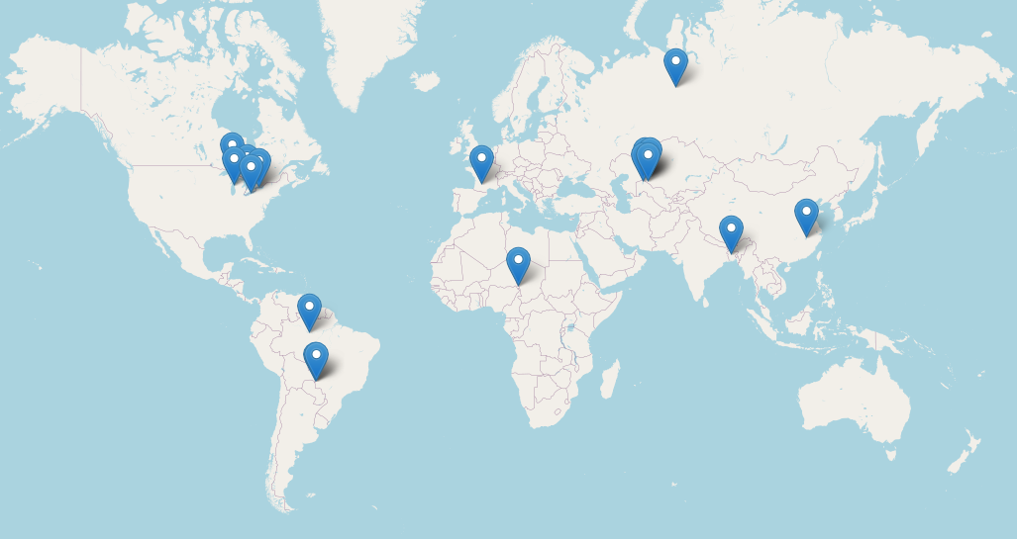
Notes:
Except otherwise noted, “Water heights (altimetry): how are they used?” presentation by Cnes/Aviso is licensed under CC BY-SA 4.0. To view a copy of this license, visit https://creativecommons.org/licenses/by-sa/4.0

Slide 4
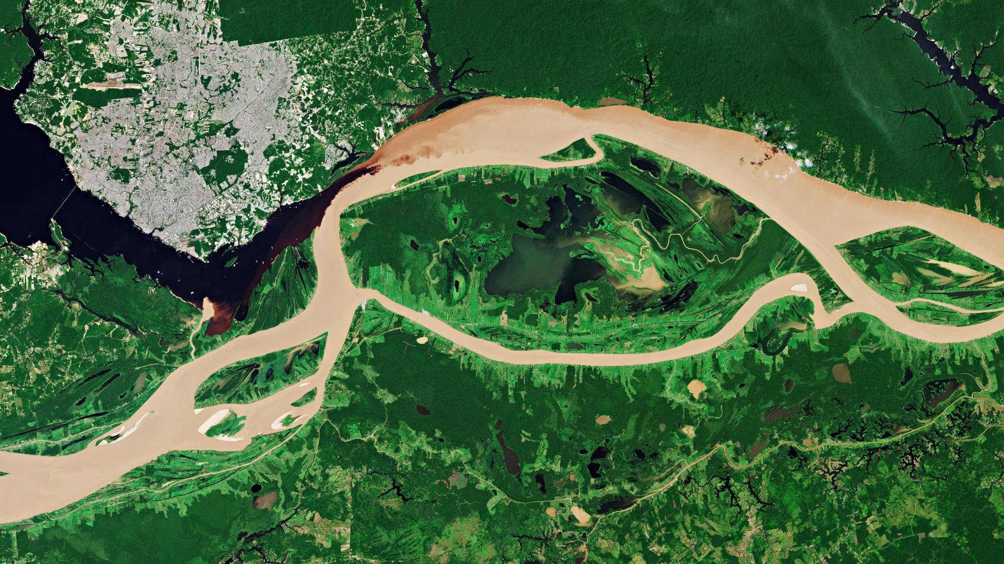
Rivers
Rio Negro and the Solimões River meeting to form the Amazon River © Esa
Notes:
Except otherwise noted, “Water heights (altimetry): how are they used?” presentation by Cnes/Aviso is licensed under CC BY-SA 4.0. To view a copy of this license, visit https://creativecommons.org/licenses/by-sa/4.0

Slide 5
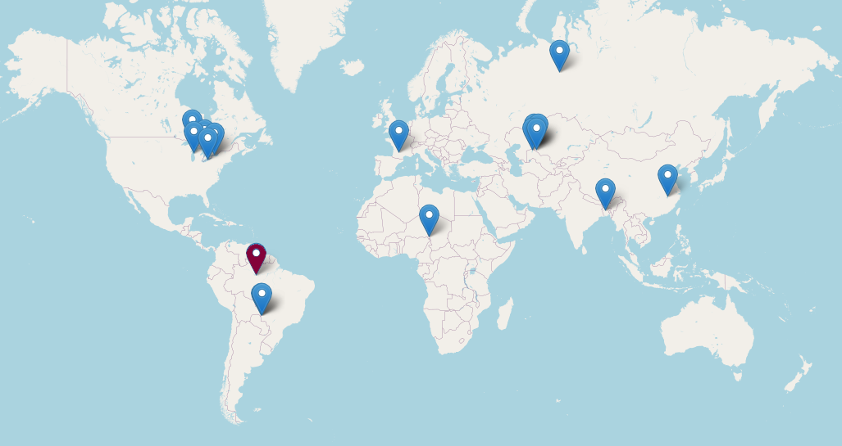
Notes:
Except otherwise noted, “Water heights (altimetry): how are they used?” presentation by Cnes/Aviso is licensed under CC BY-SA 4.0. To view a copy of this license, visit https://creativecommons.org/licenses/by-sa/4.0

Slide 6
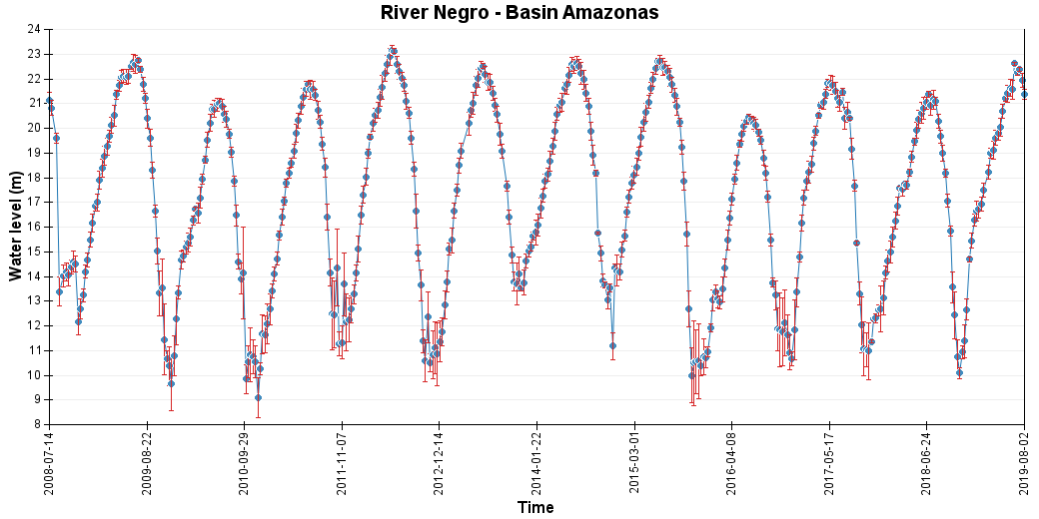
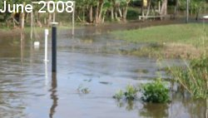
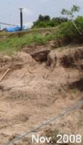
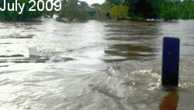
Seasonal variations monitoring – the Amazon
The Amazon shows impressive variations between seasons (up to 16 m).
This very high amplitude is one of the problems of in situ measurements in the Amazon basin, since it requires not one but a series of gauges cross to the shores to be able to monitor it
Hydroweb
©D. Medeiros Moreira (CPRM, Brazil)
©D. Medeiros Moreira
(CPRM, Brazil)
©D. Medeiros Moreira (CPRM, Brazil)
Notes:
http://hydroweb.theia-land.fr/hydroweb/view/R_AMAZONAS_NEGRO_KM1295?lang=en
Except otherwise noted, “Water heights (altimetry): how are they used?” presentation by Cnes/Aviso is licensed under CC BY-SA 4.0. To view a copy of this license, visit https://creativecommons.org/licenses/by-sa/4.0

Slide 7

Notes:
Except otherwise noted, “Water heights (altimetry): how are they used?” presentation by Cnes/Aviso is licensed under CC BY-SA 4.0. To view a copy of this license, visit https://creativecommons.org/licenses/by-sa/4.0

Slide 8
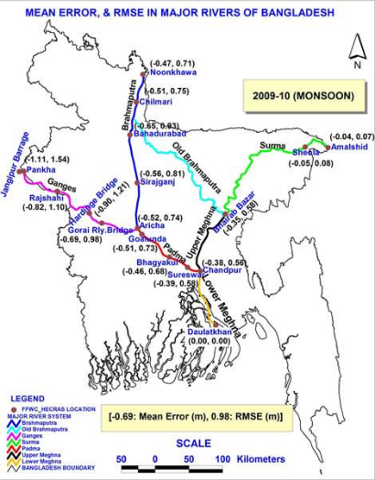
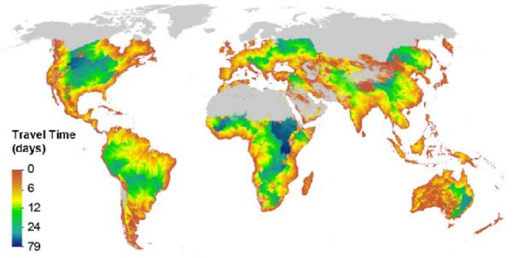
Forecasting rivers
Altimetry observations can be used in forecasting downstream events like flood.
(Credits Nasa/JPL)
Minimum time it takes flood waves to exit the global river network.
Combining Jason-2 Ganges-Brahmaputra levels with a model enable to forecast water level 5 days in advance. A 20-day Jason-2 based forecasting of flooding during Aug 1, 2012 to Aug 20, 2012 was demonstrated in a real-time operational environment.
Flood Forecasting and Warning Center (FFWC)
Notes:
Except otherwise noted, “Water heights (altimetry): how are they used?” presentation by Cnes/Aviso is licensed under CC BY-SA 4.0. To view a copy of this license, visit https://creativecommons.org/licenses/by-sa/4.0

Slide 9
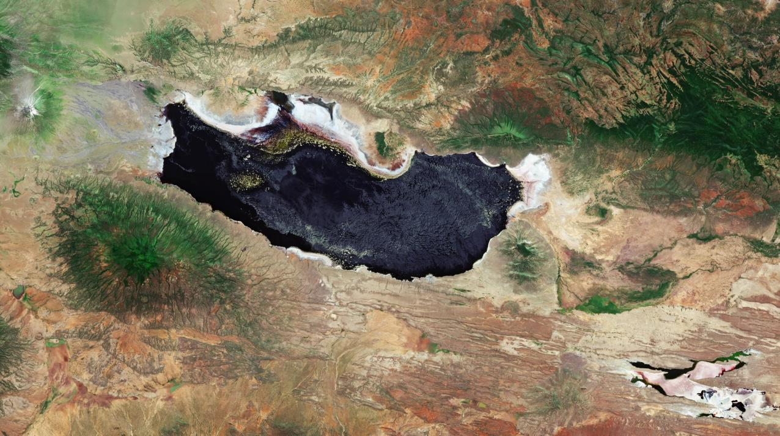
Lakes
Lake Natron Tanzania © Esa
Notes:
Except otherwise noted, “Water heights (altimetry): how are they used?” presentation by Cnes/Aviso is licensed under CC BY-SA 4.0. To view a copy of this license, visit https://creativecommons.org/licenses/by-sa/4.0

Slide 10

Notes:
Except otherwise noted, “Water heights (altimetry): how are they used?” presentation by Cnes/Aviso is licensed under CC BY-SA 4.0. To view a copy of this license, visit https://creativecommons.org/licenses/by-sa/4.0

Slide 11
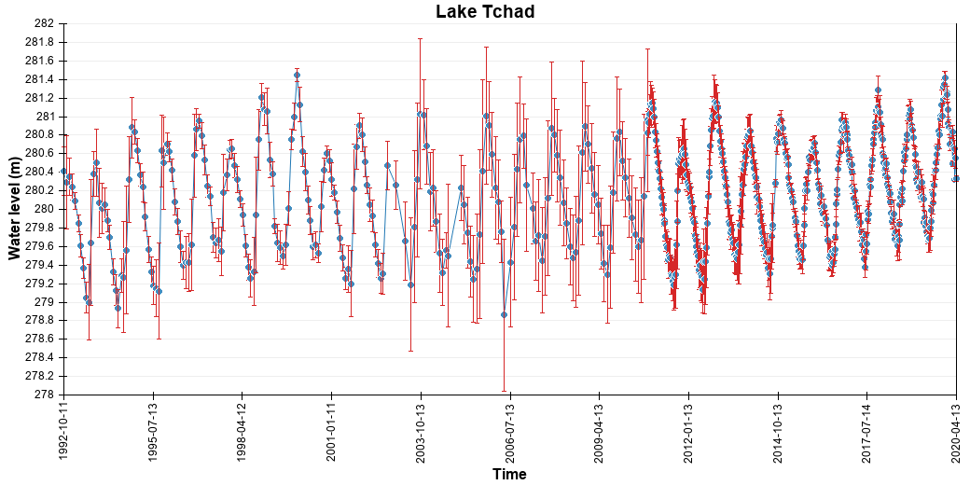
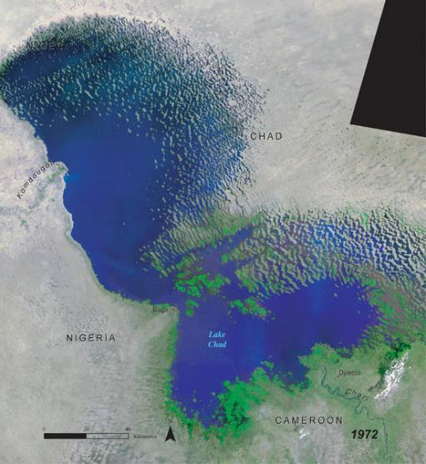
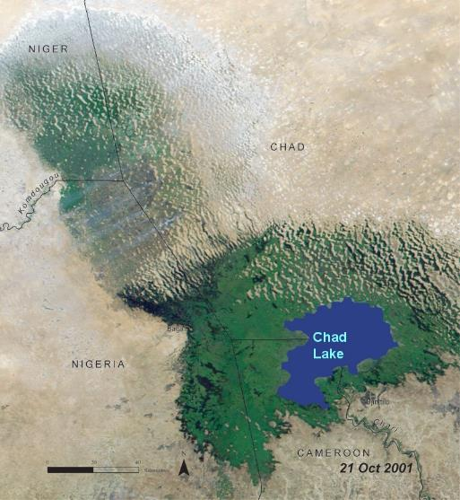
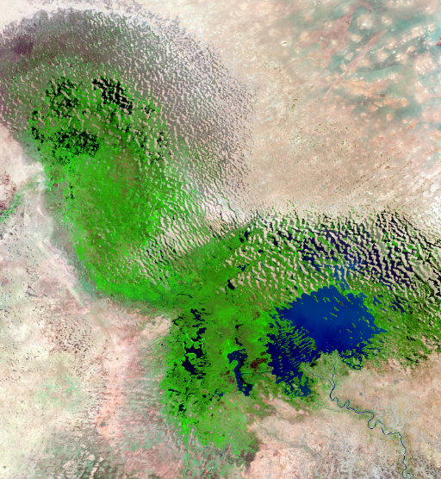
Lake Chad
Lake Chad decrease had started from the 1960s. When altimetry began, the lake was already down to 1/10th of its initial surface. Its variations are monitored, seasonal or interannual, with stabilization or even a slight increase between 2000-2020.
Hydroweb
Credit UNEP/GRID-Sioux Falls
Credit UNEP/GRID-Sioux Falls
Credit UNEP/GRID-Sioux Falls
May 2018
Notes:
hydroweb.theia-land.fr/hydroweb/view/L_tchad?lang=en
Except otherwise noted, “Water heights (altimetry): how are they used?” presentation by Cnes/Aviso is licensed under CC BY-SA 4.0. To view a copy of this license, visit https://creativecommons.org/licenses/by-sa/4.0

Slide 12
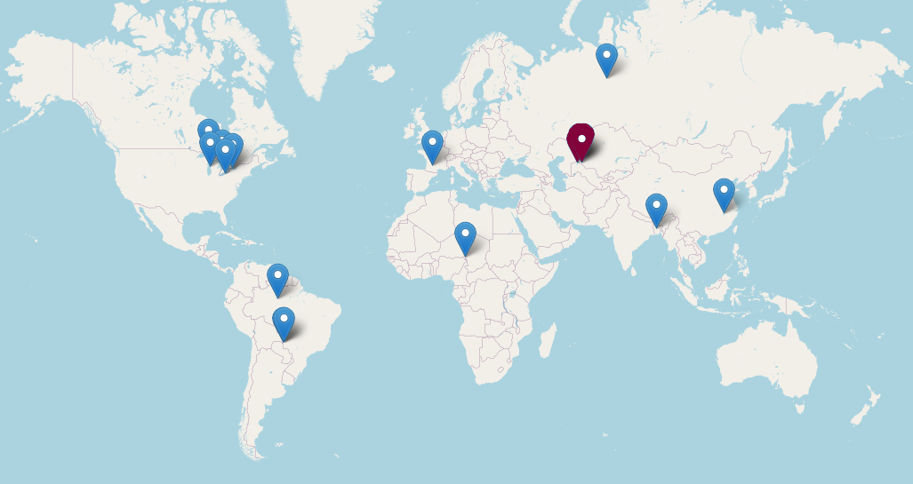
Notes:
Except otherwise noted, “Water heights (altimetry): how are they used?” presentation by Cnes/Aviso is licensed under CC BY-SA 4.0. To view a copy of this license, visit https://creativecommons.org/licenses/by-sa/4.0

Slide 13
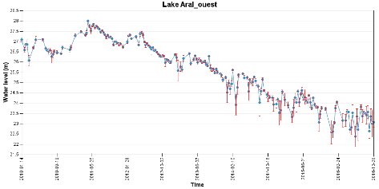
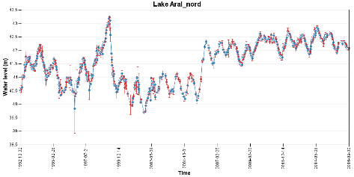
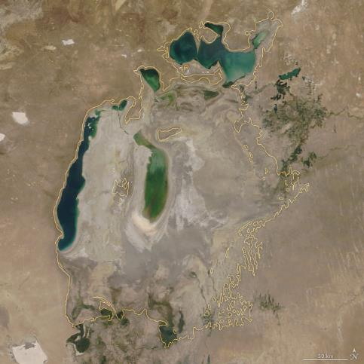
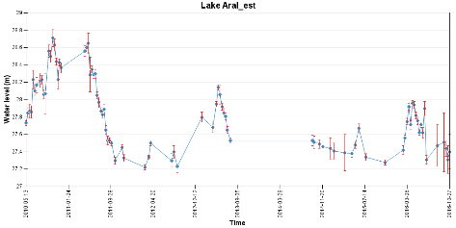
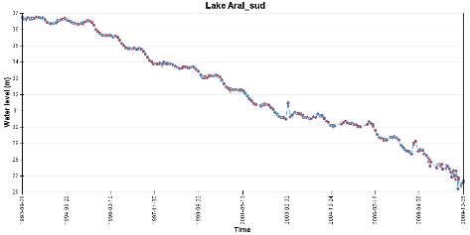
Aral Sea
Hydroweb
Hydroweb
Hydroweb
Hydroweb
(Credits Nasa/JPL)
Aral sea on August 21, 2018.
In yellow, 1960 approximate shorelines
Notes:
Image : https://earthobservatory.nasa.gov/world-of-change/AralSea
hydroweb.theia-land.fr/hydroweb/view/L_aral_sud?lang=en
hydroweb.theia-land.fr/hydroweb/view/L_aral_nord?lang=en
hydroweb.theia-land.fr/hydroweb/view/L_aral_ouest?lang=en
hydroweb.theia-land.fr/hydroweb/view/L_aral_est?lang=en
Except otherwise noted, “Water heights (altimetry): how are they used?” presentation by Cnes/Aviso is licensed under CC BY-SA 4.0. To view a copy of this license, visit https://creativecommons.org/licenses/by-sa/4.0

Slide 14

Notes:
Except otherwise noted, “Water heights (altimetry): how are they used?” presentation by Cnes/Aviso is licensed under CC BY-SA 4.0. To view a copy of this license, visit https://creativecommons.org/licenses/by-sa/4.0

Slide 15
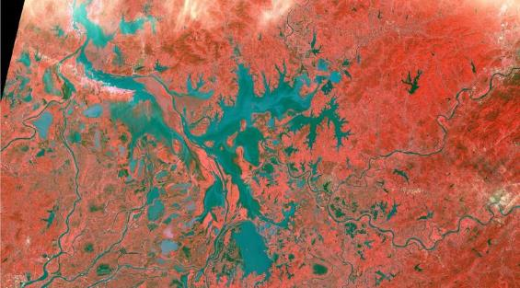
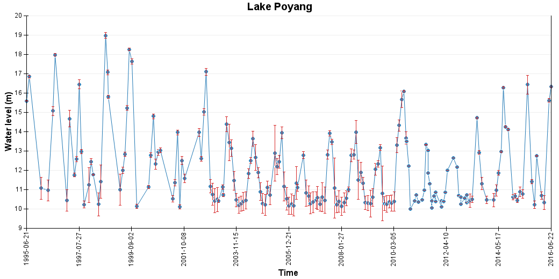
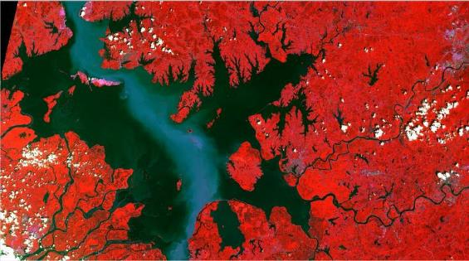
Lake Poyang (China)
Hydroweb
ICube-Sertit / European Union, contains modified Copernicus Sentinel data
Poyang water level as measured by altimetry (Hydroweb)
Sentinel-2 optical image over the Poyang for 2016-02-17 (top): the lake is then at its lowest and presenting a myriad of small water bodies and sub lakes, and for 2016-08-15 (bottom), at its highes, forming a single “continental sea”; in the central part the clearer corridor highlights the suspended sediments, mostly linked with sand extraction activities. Both images cover a 75x130 km area (Credits Sertit/Icube, contains modified Copernicus Sentinel data)
ICube-Sertit / European Union, contains modified Copernicus Sentinel data
Notes:
http://hydroweb.theia-land.fr/hydroweb/view/L_poyang?lang=en pour la courbe alti.
Except otherwise noted, “Water heights (altimetry): how are they used?” presentation by Cnes/Aviso is licensed under CC BY-SA 4.0. To view a copy of this license, visit https://creativecommons.org/licenses/by-sa/4.0

Slide 16
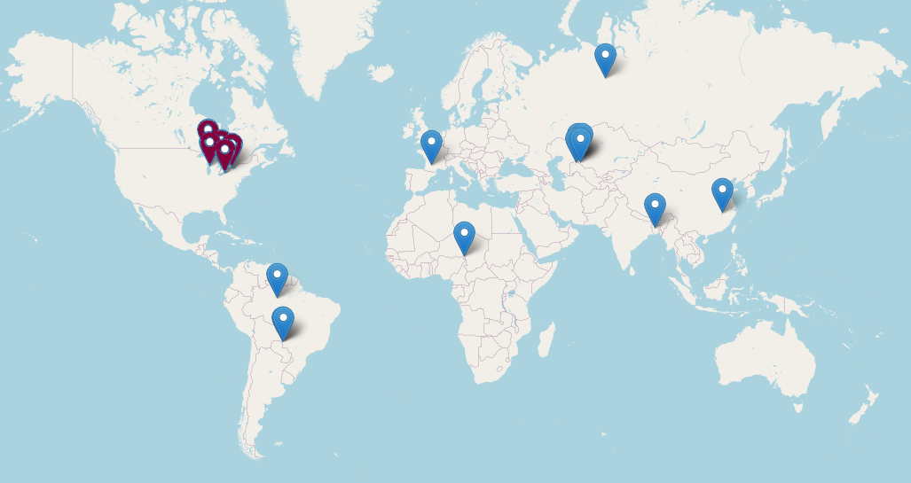
Notes:
Except otherwise noted, “Water heights (altimetry): how are they used?” presentation by Cnes/Aviso is licensed under CC BY-SA 4.0. To view a copy of this license, visit https://creativecommons.org/licenses/by-sa/4.0

Slide 17
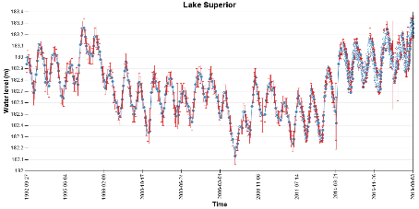
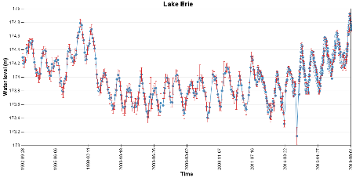
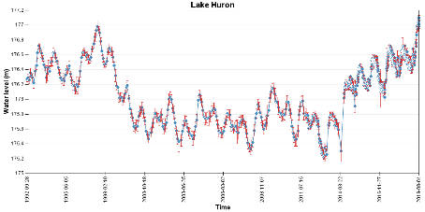
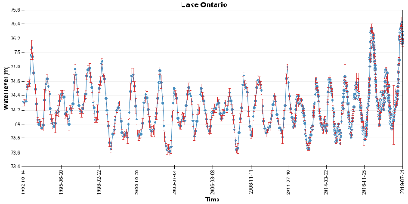
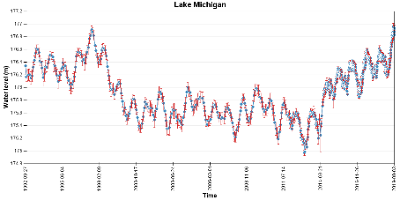
American Great Lakes
The Great Lakes, in the North-East of the United States, are among the largest freshwater lakes on Earth. Flown over by Topex/Poseidon, we have been able to monitor their surface water levels and their seasonal variations since 1992.
Hydroweb
At the end of 1998, some of the lakes (e.g. Lake Ontario) experienced lower than normal minimum levels possibly due to the El Niño/La Niña phenomenon.
In 2018 and 2019, the level was exceptionally high in all of them
Hydroweb
Hydroweb
Hydroweb
Hydroweb
Notes:
http://hydroweb.theia-land.fr/?lang=en&basin=ST.LAWRENCE
http://hydroweb.theia-land.fr/hydroweb/view/L_michigan?lang=en
hydroweb.theia-land.fr/hydroweb/view/L_superior?lang=en
hydroweb.theia-land.fr/hydroweb/view/L_huron?lang=en
hydroweb.theia-land.fr/hydroweb/view/L_erie?lang=en
hydroweb.theia-land.fr/hydroweb/view/L_ontario?lang=en
Except otherwise noted, “Water heights (altimetry): how are they used?” presentation by Cnes/Aviso is licensed under CC BY-SA 4.0. To view a copy of this license, visit https://creativecommons.org/licenses/by-sa/4.0

Slide 18
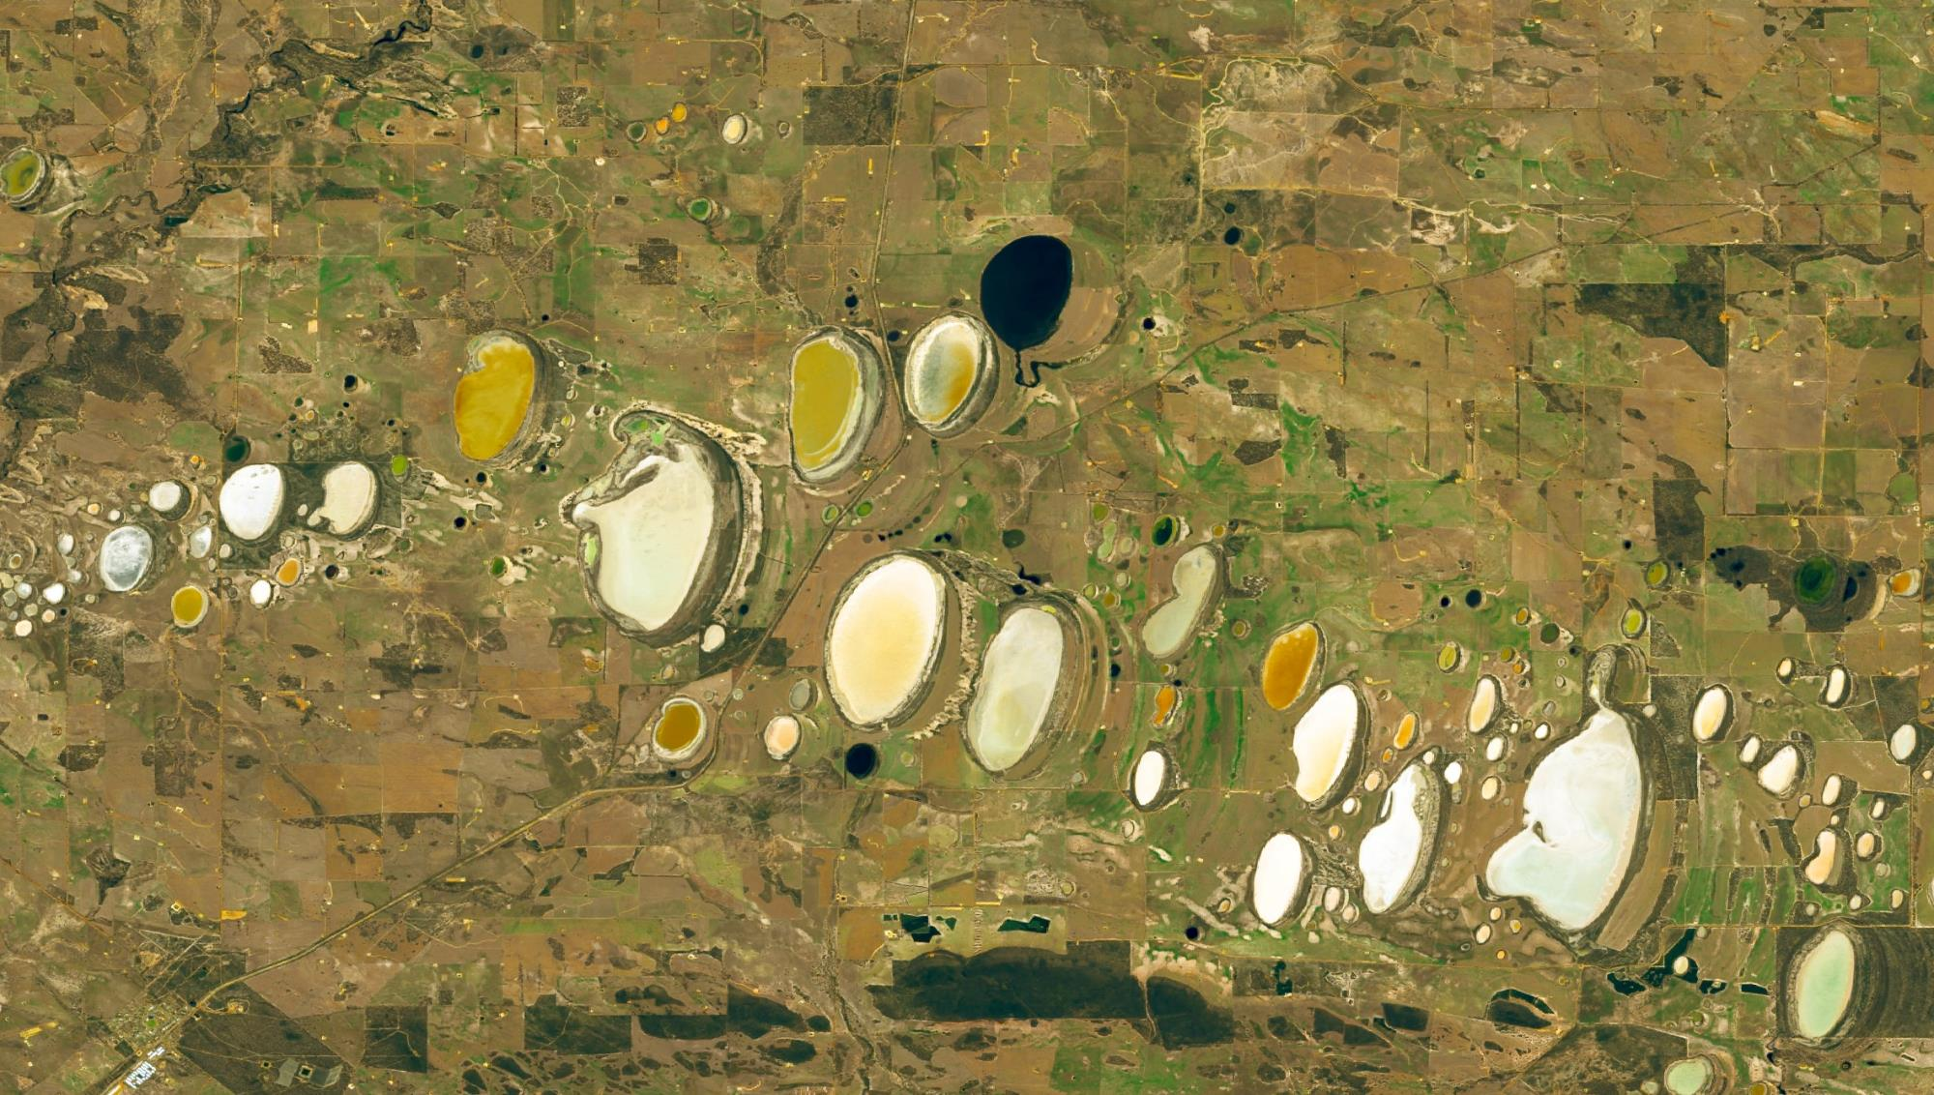
Small water bodies
Salted lakes, Western Australia © Nasa
Notes:
Except otherwise noted, “Water heights (altimetry): how are they used?” presentation by Cnes/Aviso is licensed under CC BY-SA 4.0. To view a copy of this license, visit https://creativecommons.org/licenses/by-sa/4.0

Slide 19
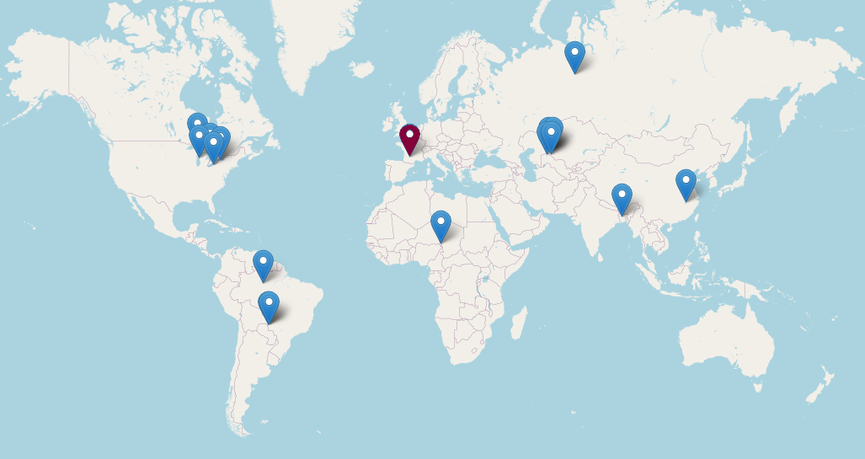
Notes:
Except otherwise noted, “Water heights (altimetry): how are they used?” presentation by Cnes/Aviso is licensed under CC BY-SA 4.0. To view a copy of this license, visit https://creativecommons.org/licenses/by-sa/4.0

Slide 20
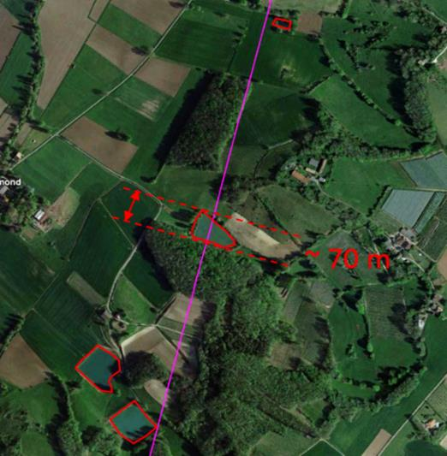
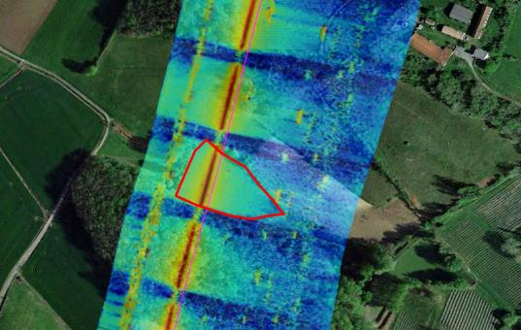
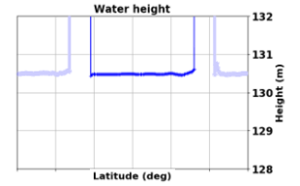
Small water bodies: SAR mode capabilities
A pond as seen by optical satellites (left); right, the fully-focused SAR measurements of it (note that the repetitions are due to the emission / reception pattern of the altimeter which leads to secondary images; Jason-CS/Sentinel-6 should remove those) (Credits CLS)
(Credit CLS)
The entire illumination time of the surface by the altimeter radar beam (almost 2.5 s) can be used for the synthetic aperture processing since it stays coherent for that entire period. This “Fully-focused SAR processing” achieves better along-track resolution, eventually reaching the theoretical limit of approximately 50 cm for current SAR (Cryosat-2, Sentinel-3A&B). Very small water bodies crossed by the satellite ground track can be accurately observed and measured.
Notes:
Except otherwise noted, “Water heights (altimetry): how are they used?” presentation by Cnes/Aviso is licensed under CC BY-SA 4.0. To view a copy of this license, visit https://creativecommons.org/licenses/by-sa/4.0

Slide 21
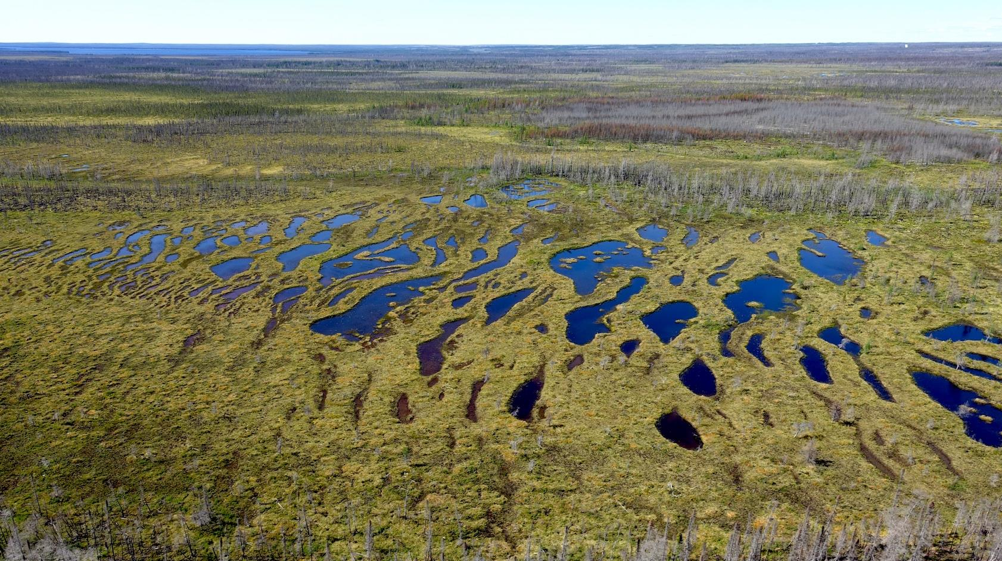
Wetlands
Peatlands, Mélina Guêné-Nanchen via Imaggeo CC-BY3,0

Slide 22

Notes:
Except otherwise noted, “Water heights (altimetry): how are they used?” presentation by Cnes/Aviso is licensed under CC BY-SA 4.0. To view a copy of this license, visit https://creativecommons.org/licenses/by-sa/4.0

Slide 23
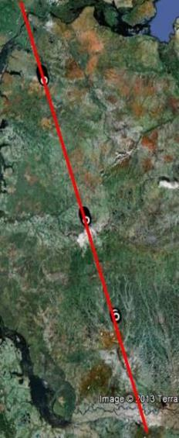
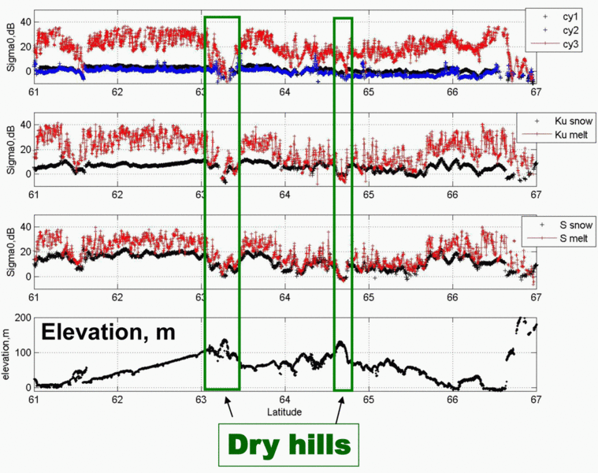
Ob’s bogs and wetlands
The backscatter coefficient (σ0) is the ratio between the power reflected from the surface and the incident power emitted by the onboard radar. Water and ice are good reflectors, while dry vegetated areas strongly attenuate the signal. Thus the backscatter coefficient can be used to discriminate surface type within the radar footprint
(Credit CNRS/Legos)
Backscatter coefficient measurements for (up) Saral first 3 cycles, (middle) Envisat in Ku and S band of the altimeter. Bottom, the topography of the area (Credit CNRS/Legos)
Saral ground track
Notes:
Except otherwise noted, “Water heights (altimetry): how are they used?” presentation by Cnes/Aviso is licensed under CC BY-SA 4.0. To view a copy of this license, visit https://creativecommons.org/licenses/by-sa/4.0

Slide 24
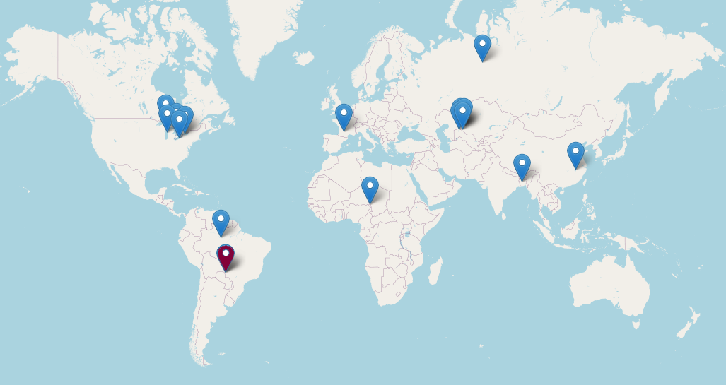
Notes:
Except otherwise noted, “Water heights (altimetry): how are they used?” presentation by Cnes/Aviso is licensed under CC BY-SA 4.0. To view a copy of this license, visit https://creativecommons.org/licenses/by-sa/4.0

Slide 25
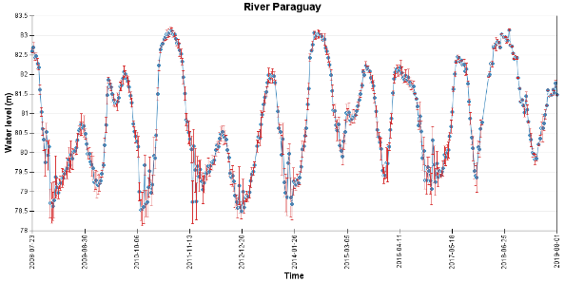
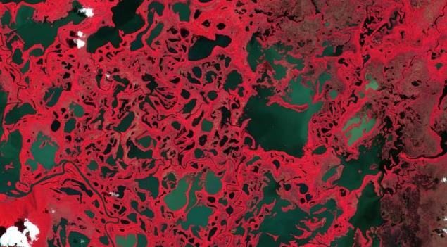
Pantanal wetlands
the largest tropical wetlands
It shows a complex mix of tropical forest, savannah, and aquatic environments
highly variable annual and interannual flood cycles
Hydroweb
Altimetry levels on the Paraguay (one of the rivers feeding these wetlands) clearly show the cycle and amplitude of the floods
Optical images show the flood extend and the complexity of the area.
ICube-Sertit / European Union, contains modified Copernicus Sentinel data
Sentinel-2 optical image over the Pantanal area for 2019-02-06: the mix of waters and vegetation (in red) is clearly shown
Notes:
http://hydroweb.theia-land.fr/hydroweb/view/R_PARANA_PARAGUAI_KM2439?lang=en
Except otherwise noted, “Water heights (altimetry): how are they used?” presentation by Cnes/Aviso is licensed under CC BY-SA 4.0. To view a copy of this license, visit https://creativecommons.org/licenses/by-sa/4.0

Slide 26
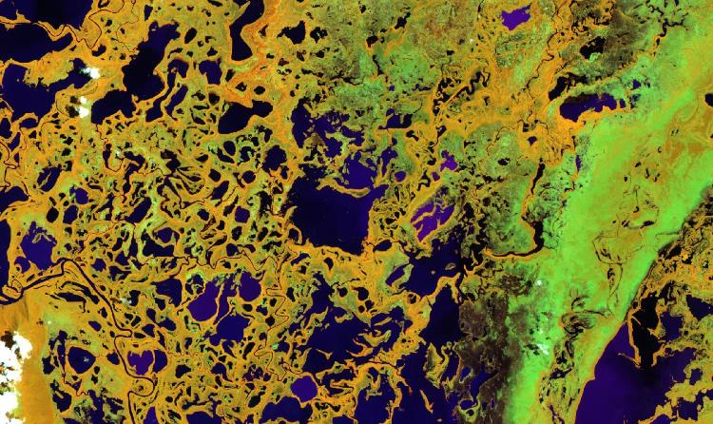
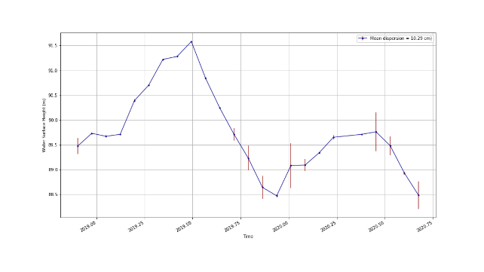
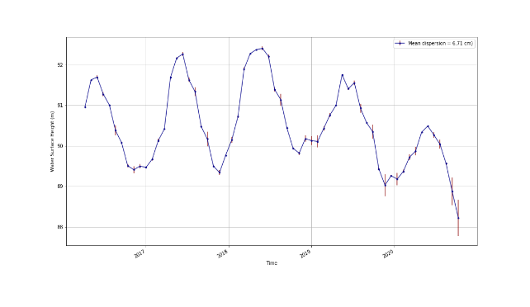
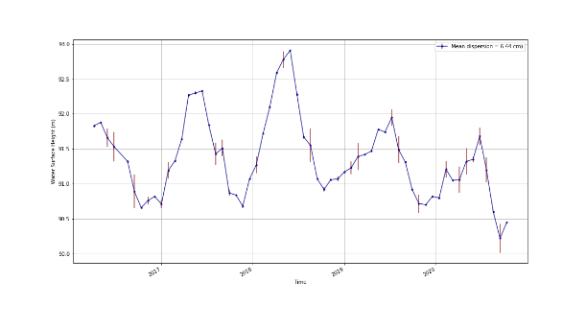
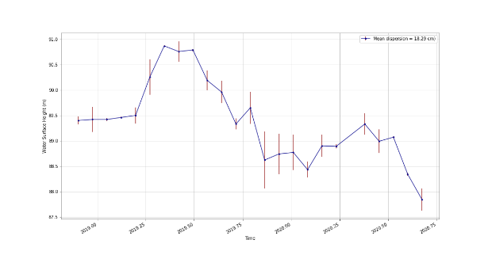
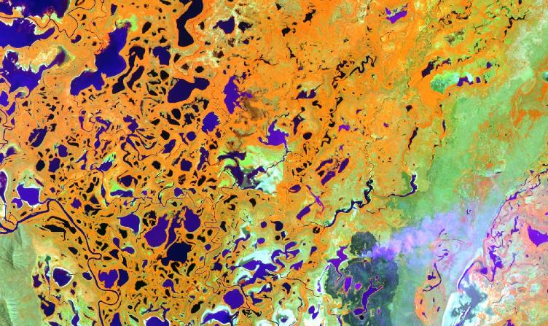
Pantanal 2020 drought
Hydroweb
Hydroweb
ICube-Sertit / European Union, contains modified Copernicus Sentinel data
2019-02-06 Sentinel-2A
Hydroweb
Hydroweb
2020 saw a major drought over the Pantanal, with almost no flood in the April-July period.
Sentinel-2 images leaving burnt areas show the catastrophic impact, with also fires
ICube-Sertit / European Union, contains modified Copernicus Sentinel data
2020-10-03 Sentinel-2A
Notes:
http://hydroweb.theia-land.fr/?lang=en&basin=Para
Except otherwise noted, “Water heights (altimetry): how are they used?” presentation by Cnes/Aviso is licensed under CC BY-SA 4.0. To view a copy of this license, visit https://creativecommons.org/licenses/by-sa/4.0
na

