Slide 1
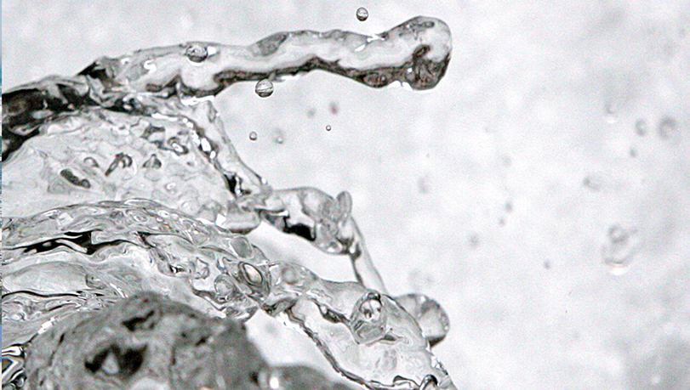
Why study water?
Cnes/Aviso
Notes:
Except otherwise noted, “Why study water on Earth” presentation by Cnes/Aviso is licensed under CC BY-SA 4.0. To view a copy of this license, visit https://creativecommons.org/licenses/by-sa/4.0

Slide 2

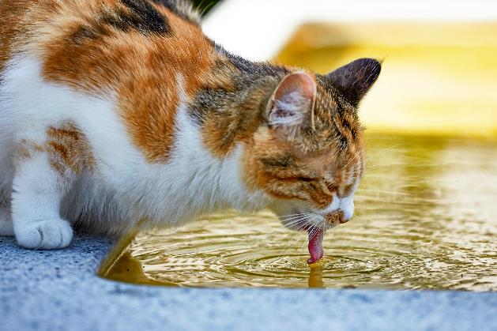
We need water to
drink
Brendan Church on Unsplash
Dorothea Oldani on Unsplash
Notes:
Except otherwise noted, “Why study water on Earth” presentation by Cnes/Aviso is licensed under CC BY-SA 4.0. To view a copy of this license, visit https://creativecommons.org/licenses/by-sa/4.0

Slide 3
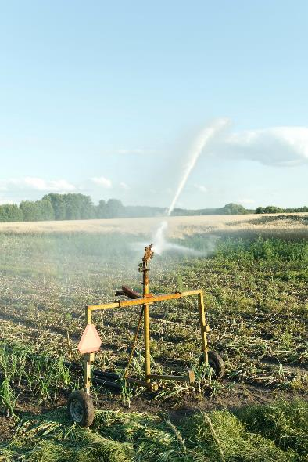
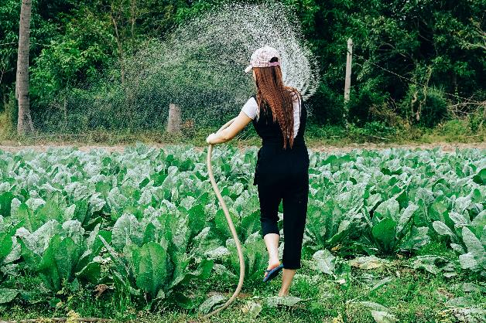
We need water to
grow plants (including those we are eating, or animals are eating)
Przemyslaw Stroinski on Unsplash
Tony Pham on Unsplash
Notes:
Except otherwise noted, “Why study water on Earth” presentation by Cnes/Aviso is licensed under CC BY-SA 4.0. To view a copy of this license, visit https://creativecommons.org/licenses/by-sa/4.0

Slide 4


We need water to
wash (ourselves / things)
Planetcare on Unsplash
Sean Horsburgh on Unsplash
Notes:
Except otherwise noted, “Why study water on Earth” presentation by Cnes/Aviso is licensed under CC BY-SA 4.0. To view a copy of this license, visit https://creativecommons.org/licenses/by-sa/4.0

Slide 5
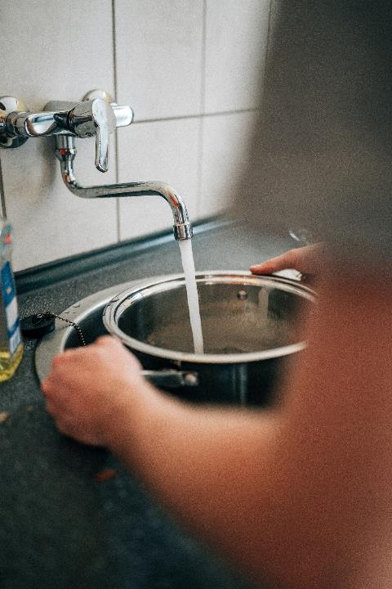
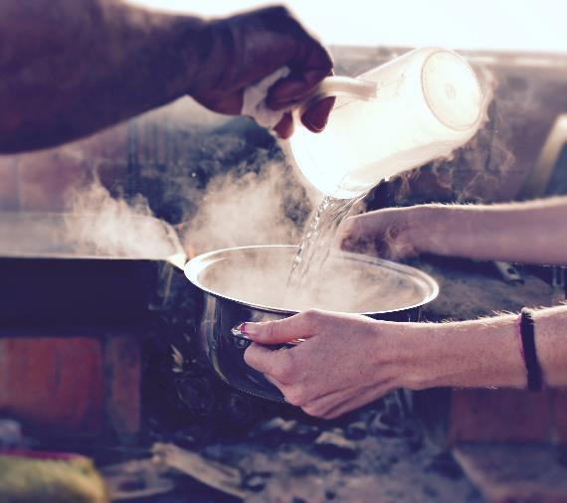
We need water to
cook
Yosef Ariel on Unsplash
Paul Meckes on Unsplash
Notes:
Except otherwise noted, “Why study water on Earth” presentation by Cnes/Aviso is licensed under CC BY-SA 4.0. To view a copy of this license, visit https://creativecommons.org/licenses/by-sa/4.0

Slide 6
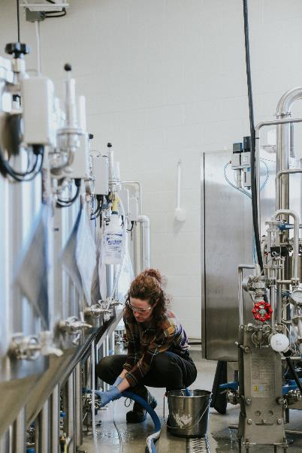
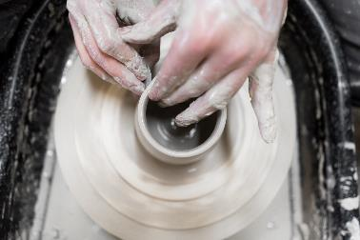
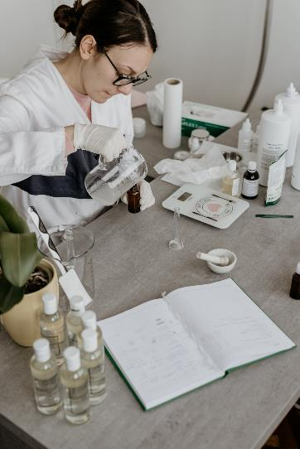
We need water to
make things
Courtney Cook on Unsplash
Amplitude Magazin on Unsplash
Kat Maryschuk on Unsplash
Notes:
Except otherwise noted, “Why study water on Earth” presentation by Cnes/Aviso is licensed under CC BY-SA 4.0. To view a copy of this license, visit https://creativecommons.org/licenses/by-sa/4.0

Slide 7
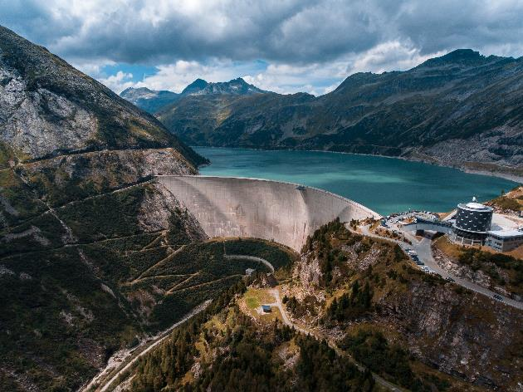
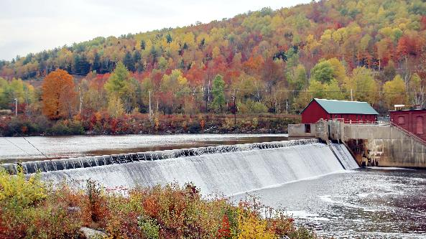
We need water to
generate electricity
Mark Konig on Unsplash
Kees Streefkerk on Unsplash
Notes:
Except otherwise noted, “Why study water on Earth” presentation by Cnes/Aviso is licensed under CC BY-SA 4.0. To view a copy of this license, visit https://creativecommons.org/licenses/by-sa/4.0

Slide 8
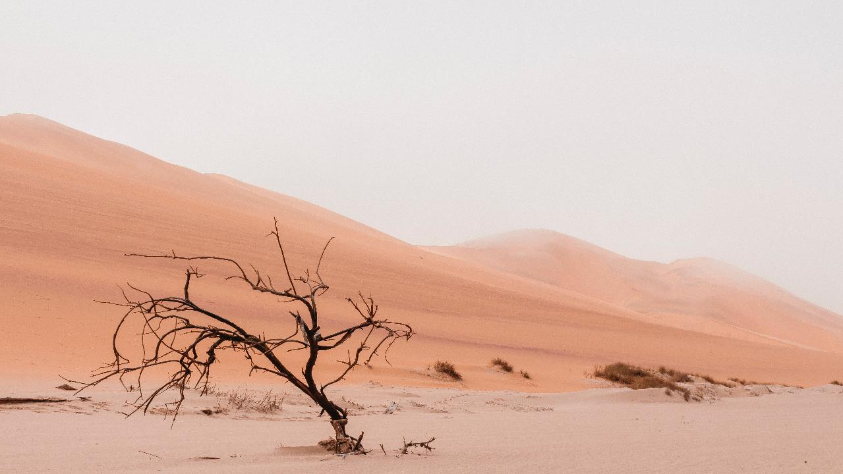
Water is vital.
It is impossible to replace.
But…
Ryan Cheng on Unsplash
Notes:
Except otherwise noted, “Why study water on Earth” presentation by Cnes/Aviso is licensed under CC BY-SA 4.0. To view a copy of this license, visit https://creativecommons.org/licenses/by-sa/4.0

Slide 9
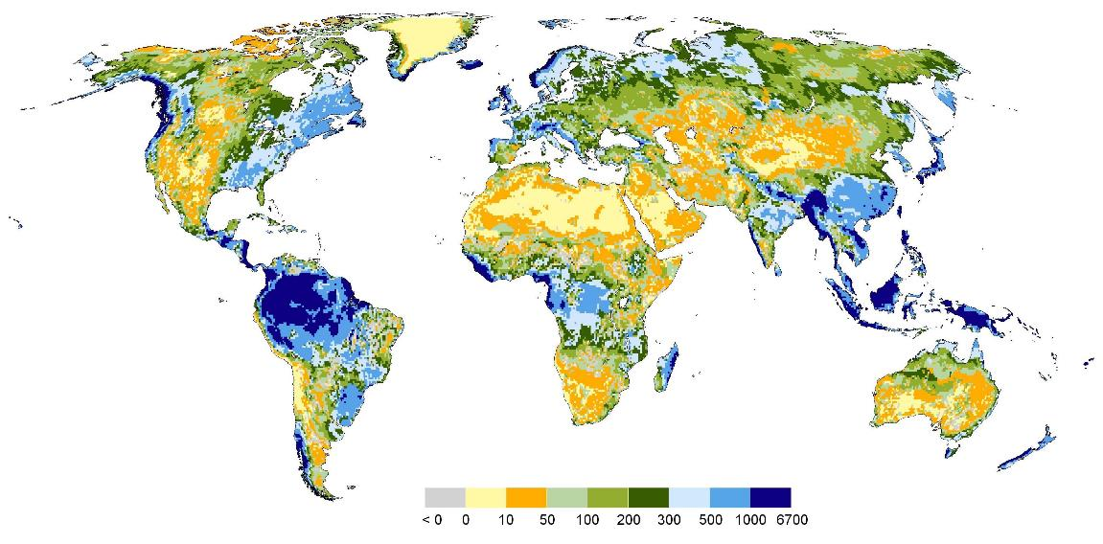
Resources are not the same everywhere
Frankfurt University
Total renewable freshwater resources, in mm/yr ( 1 mm is equivalent to 1 l of water per m²) (average for 1961-1990)
Notes:
Total renewable freshwater resources of the world, in mm/yr ( 1 mm is equivalent to 1 l of water per m²) (long-term average for the years 1961-1990). Resolution is 0.5° longitude x 0.5° latitude (equivalent to 55 km x 55 km at the equator). Computed by the global freshwater model WaterGAP.
From Döll, P., Fiedler, K. (2008): Global-scale modeling of groundwater recharge. Hydrol. Earth Syst. Sci., 12, 863-885
Except otherwise noted, “Why study water on Earth” presentation by Cnes/Aviso is licensed under CC BY-SA 4.0. To view a copy of this license, visit https://creativecommons.org/licenses/by-sa/4.0

Slide 10
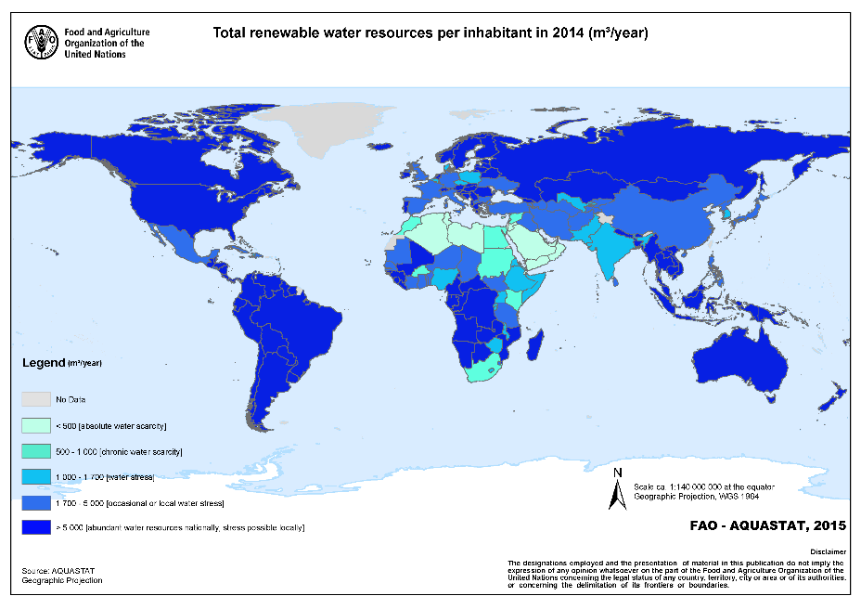
The most heavily populated areas are not the ones with the most water
Asia: 60% of the world population but 36% of the water
South America: 7% of the world population but 30% of the water
But: in Peru, more than 50% of the population lack water since they live on the desertic coast
Notes:
quantité d’eau douce renouvelable par personne en moyenne dans chaque pays (exclut les nappes phréatiques non renouvelables). Mais dans un même pays on peut avoir des zones en pénurie par rapport au nombre d’habitants
Except otherwise noted, “Why study water on Earth” presentation by Cnes/Aviso is licensed under CC BY-SA 4.0. To view a copy of this license, visit https://creativecommons.org/licenses/by-sa/4.0

Slide 11
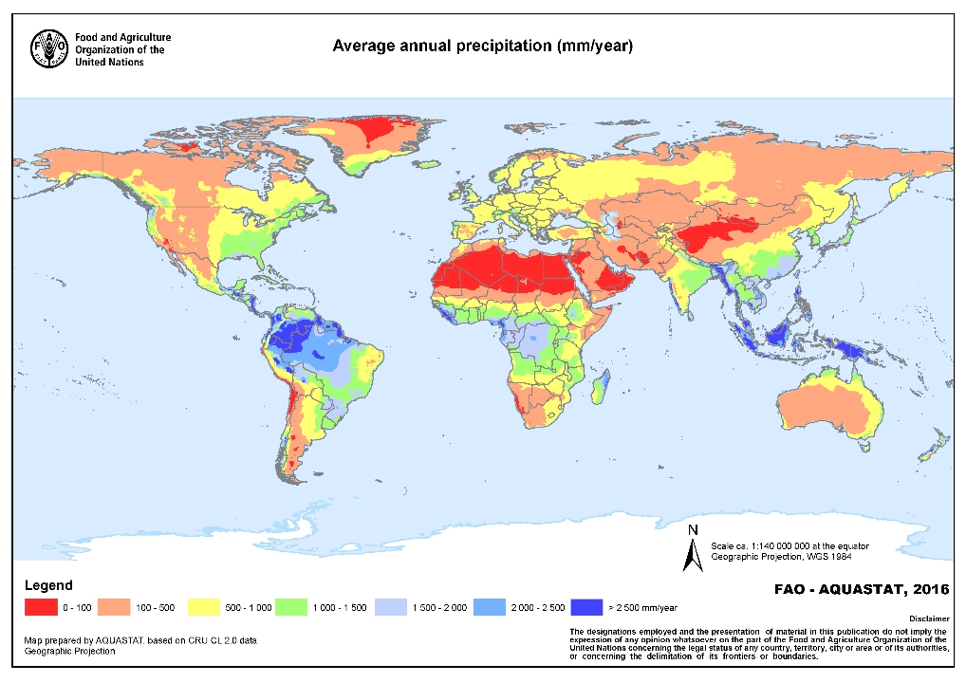
It is not raining everywhere
Cartes précipitations
Ressources / Ressources per capita
Notes:
In 2019, water scarcity currently affects 2.3 billion people. This is around 31% of the world population today. Over the next decade, this number is expected to climb to over 2.7 billion.
China, with 311 million people living under absolute water scarcity, is the country with most people living in water scarce areas. This number represents around 36% of the country's current population.
Except otherwise noted, “Why study water on Earth” presentation by Cnes/Aviso is licensed under CC BY-SA 4.0. To view a copy of this license, visit https://creativecommons.org/licenses/by-sa/4.0

Slide 12
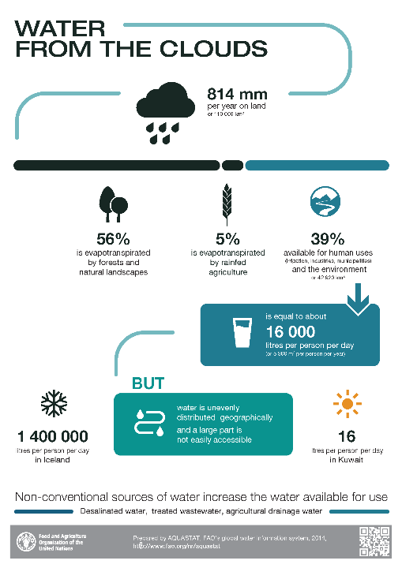
Notes:
Except otherwise noted, “Why study water on Earth” presentation by Cnes/Aviso is licensed under CC BY-SA 4.0. To view a copy of this license, visit https://creativecommons.org/licenses/by-sa/4.0

Slide 13
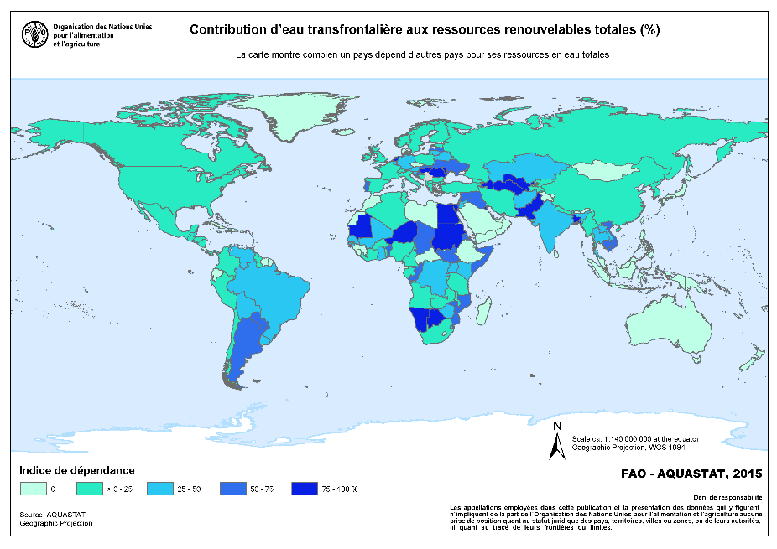
Resources can be shared between countries
Rivers crossing several countries (→ problem if a dam is built for downstream countries)
Lakes with shores in different countries
Groundwaters
(map: only renewable resources) under several countries
Notes:
The more a country is blue/dark blue, the more it depends on renewable water resources (=courses, lakes or shallow aquifers) from another country.
Examples: Egypt depends on the Nile, which has crossed Sudan, South Sudan, Uganda... and which water comes in part from the various large African lakes located in several countries; the rivers of South America have their source in the Andes, and can then flow eastward in other countries; rivers that flow into the sea in Portugal have their source in Spain.
In light green are the very few countries that do not depend on any other country, but for some of them because they have no major river on their territory and depend rather on groundwater often non-renewable (Arabian Peninsula, Libya ...). Others are islands
NB. in France: the sources of the Rhone and Rhine are in Switzerland, those of the Garonne in Spain. Lake Geneva is shared with Switzerland, the Rhine with Germany as a border (the Rhine also borders Luxembourg, and finally crosses the Netherlands).
Except otherwise noted, “Why study water on Earth” presentation by Cnes/Aviso is licensed under CC BY-SA 4.0. To view a copy of this license, visit https://creativecommons.org/licenses/by-sa/4.0

Slide 14
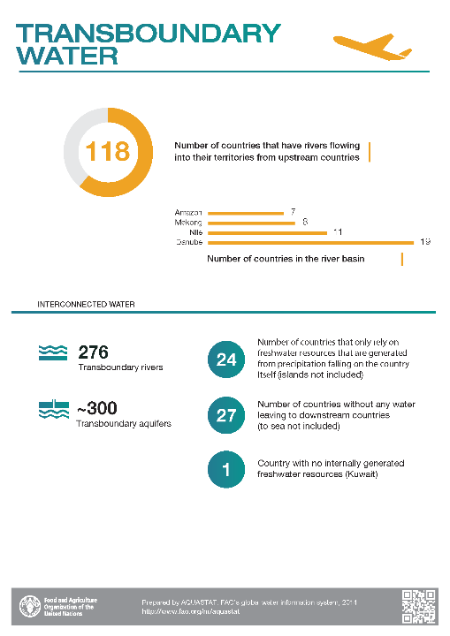
Notes:
Except otherwise noted, “Why study water on Earth” presentation by Cnes/Aviso is licensed under CC BY-SA 4.0. To view a copy of this license, visit https://creativecommons.org/licenses/by-sa/4.0

Slide 15
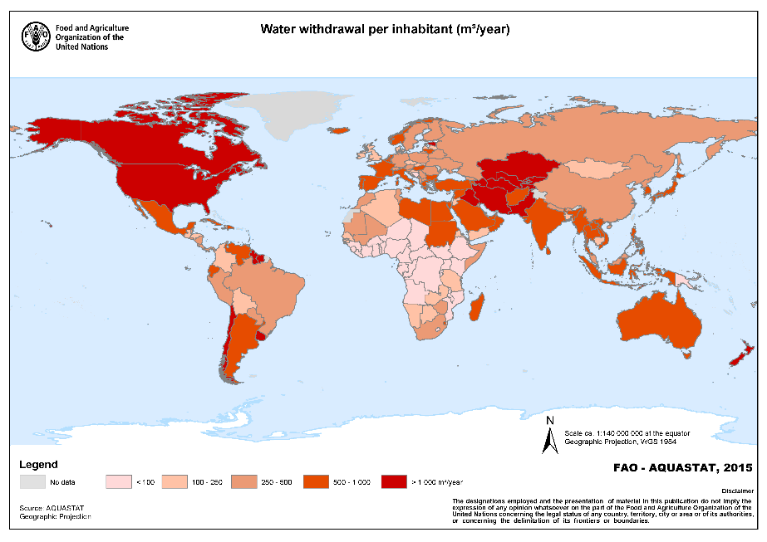
Use is not the same everywhere
Notes:
Except otherwise noted, “Why study water on Earth” presentation by Cnes/Aviso is licensed under CC BY-SA 4.0. To view a copy of this license, visit https://creativecommons.org/licenses/by-sa/4.0

Slide 16
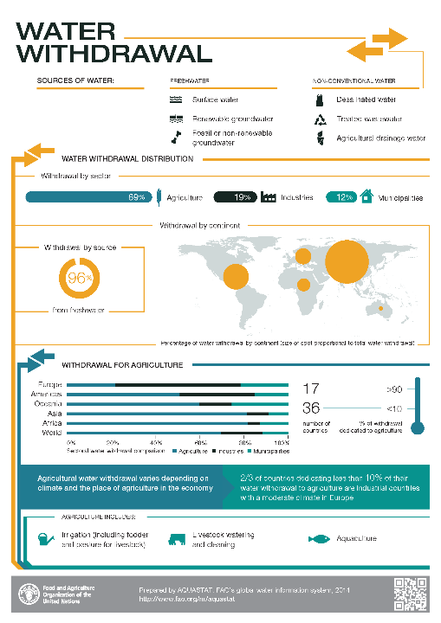
Notes:
Except otherwise noted, “Why study water on Earth” presentation by Cnes/Aviso is licensed under CC BY-SA 4.0. To view a copy of this license, visit https://creativecommons.org/licenses/by-sa/4.0

Slide 17
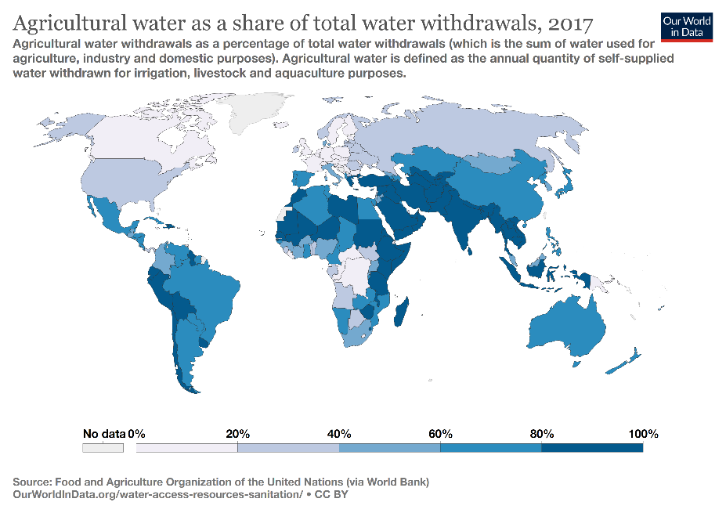
Use is not the same everywhere
Notes:
Except otherwise noted, “Why study water on Earth” presentation by Cnes/Aviso is licensed under CC BY-SA 4.0. To view a copy of this license, visit https://creativecommons.org/licenses/by-sa/4.0

Slide 18
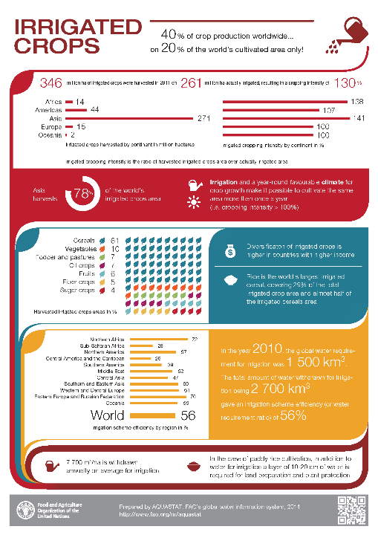
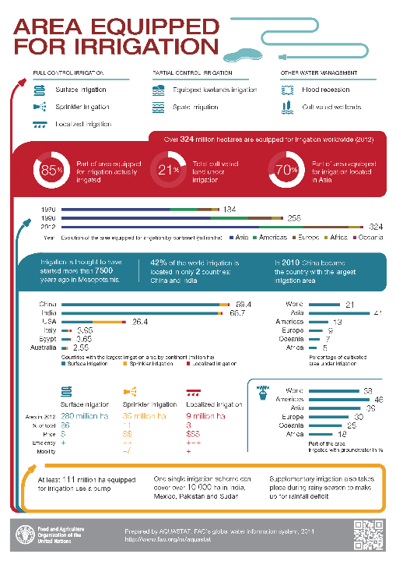
Notes:
Except otherwise noted, “Why study water on Earth” presentation by Cnes/Aviso is licensed under CC BY-SA 4.0. To view a copy of this license, visit https://creativecommons.org/licenses/by-sa/4.0

Slide 19
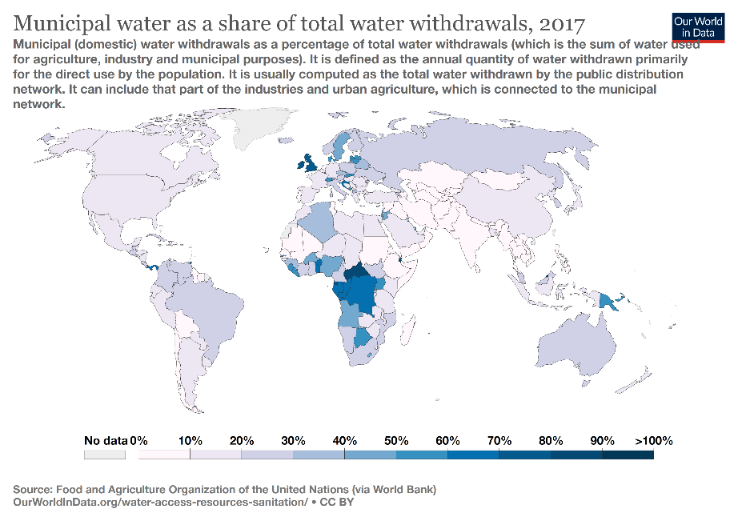
Use is not the same everywhere
Notes:
Except otherwise noted, “Why study water on Earth” presentation by Cnes/Aviso is licensed under CC BY-SA 4.0. To view a copy of this license, visit https://creativecommons.org/licenses/by-sa/4.0

Slide 20

Use is not the same everywhere
Notes:
Except otherwise noted, “Why study water on Earth” presentation by Cnes/Aviso is licensed under CC BY-SA 4.0. To view a copy of this license, visit https://creativecommons.org/licenses/by-sa/4.0

Slide 21
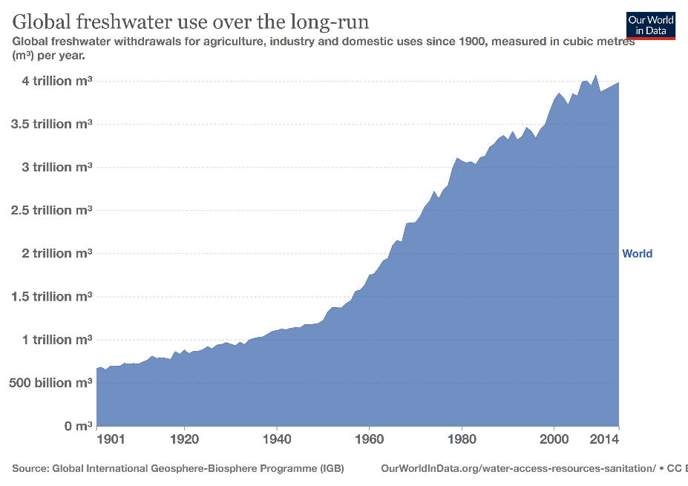
More and more water is used
Notes:
Except otherwise noted, “Why study water on Earth” presentation by Cnes/Aviso is licensed under CC BY-SA 4.0. To view a copy of this license, visit https://creativecommons.org/licenses/by-sa/4.0

Slide 22
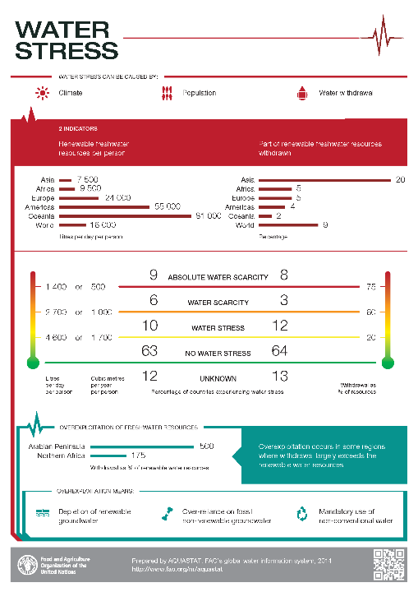
Notes:
Except otherwise noted, “Why study water on Earth” presentation by Cnes/Aviso is licensed under CC BY-SA 4.0. To view a copy of this license, visit https://creativecommons.org/licenses/by-sa/4.0

Slide 23
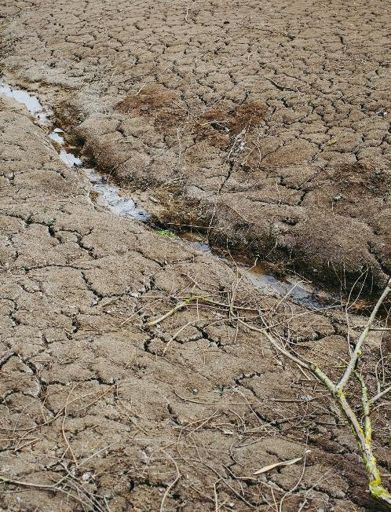
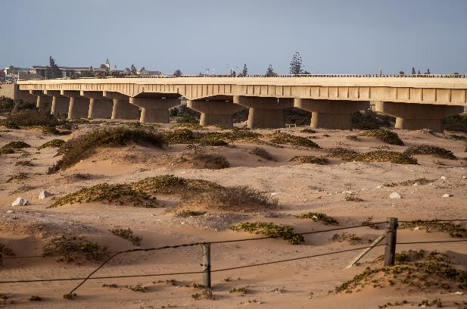
Water is not always present
Grant Durr on Unsplash
Markus Spiske on Unsplash
Notes:
Except otherwise noted, “Why study water on Earth” presentation by Cnes/Aviso is licensed under CC BY-SA 4.0. To view a copy of this license, visit https://creativecommons.org/licenses/by-sa/4.0

Slide 24
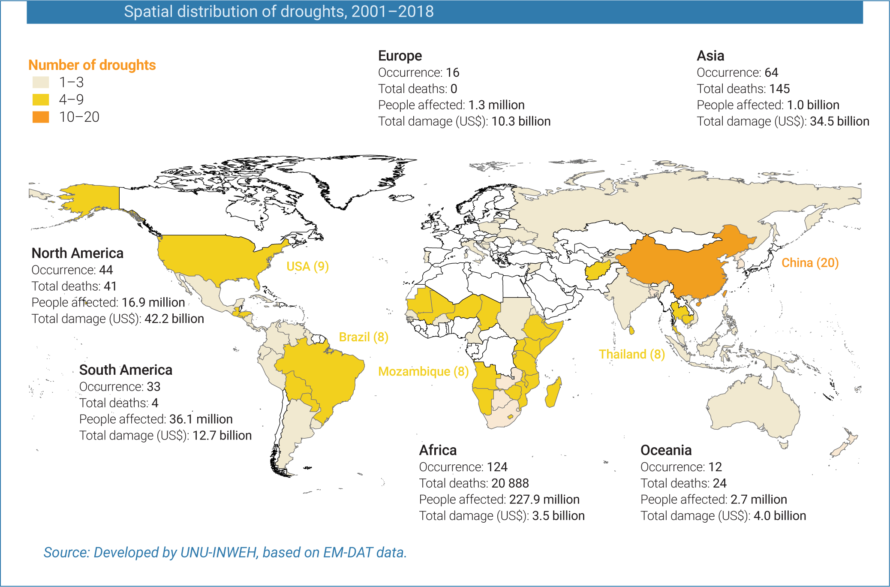
Notes:
UNESCO, UN-Water, 2020: United Nations World Water Development Report 2020:Water and Climate Change, Paris, UNESCO.
https://en.unesco.org/themes/water-security/wwap/wwdr/2020
https://creativecommons.org/licenses/by-sa/3.0/igo/deed.en
Except otherwise noted, “Why study water on Earth” presentation by Cnes/Aviso is licensed under CC BY-SA 4.0. To view a copy of this license, visit https://creativecommons.org/licenses/by-sa/4.0

Slide 25
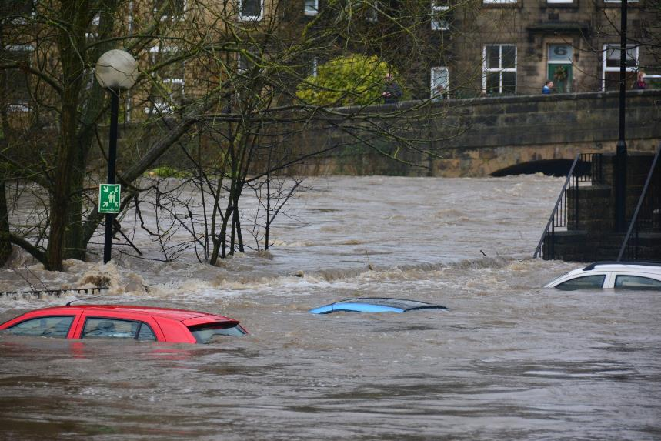
Or sometimes there’s too much of it…
Chris Gallagher on Unsplash
Notes:
Except otherwise noted, “Why study water on Earth” presentation by Cnes/Aviso is licensed under CC BY-SA 4.0. To view a copy of this license, visit https://creativecommons.org/licenses/by-sa/4.0

Slide 26
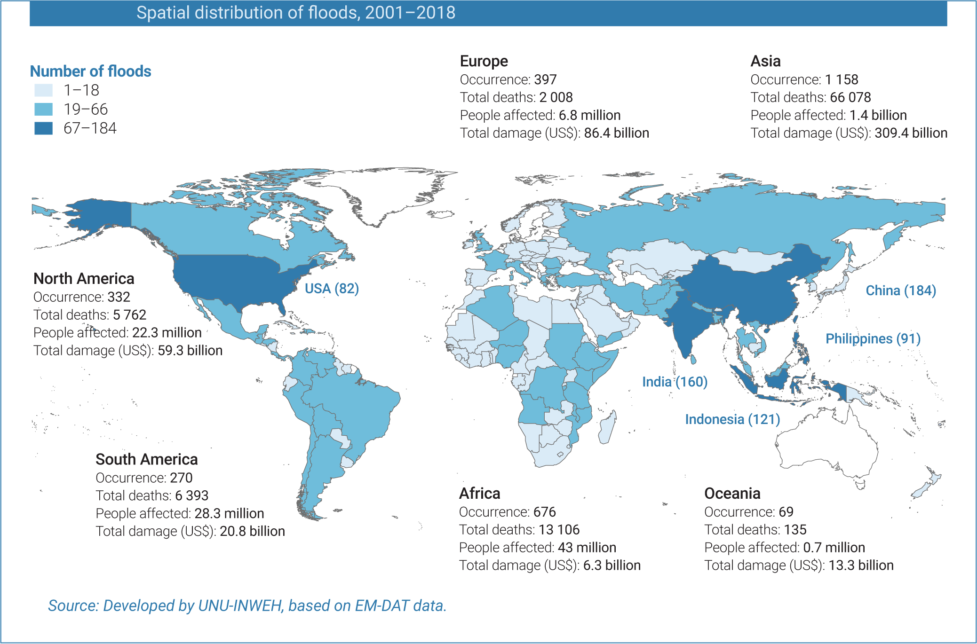
Notes:
Except otherwise noted, “Why study water on Earth” presentation by Cnes/Aviso is licensed under CC BY-SA 4.0. To view a copy of this license, visit https://creativecommons.org/licenses/by-sa/4.0

Slide 27
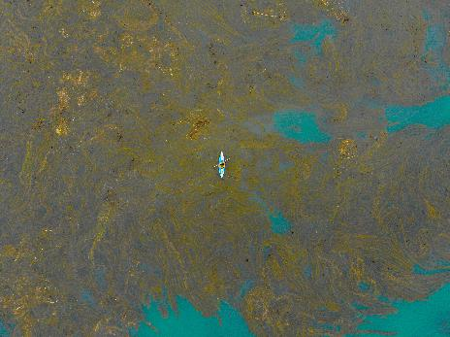
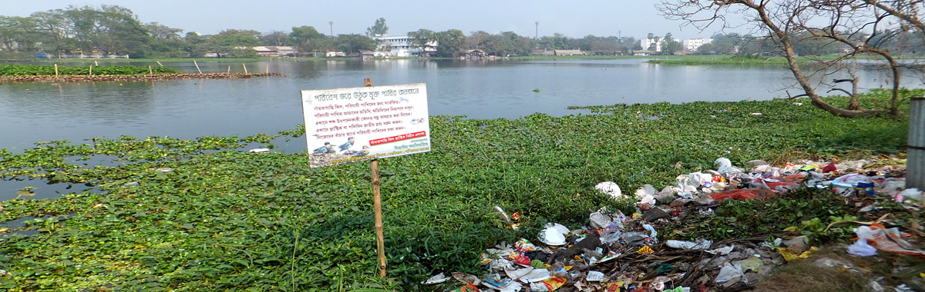
It can be polluted, or contaminated by disease vectors
Riley on Unsplash
USGS
Notes:
Except otherwise noted, “Why study water on Earth” presentation by Cnes/Aviso is licensed under CC BY-SA 4.0. To view a copy of this license, visit https://creativecommons.org/licenses/by-sa/4.0

Slide 28
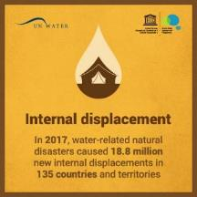
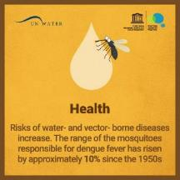
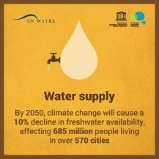
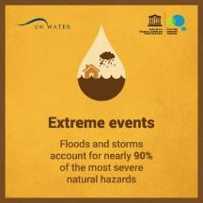
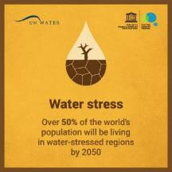
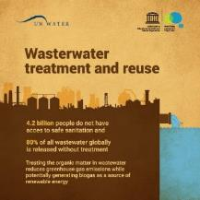
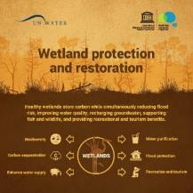

Issues
UNESCO, UN-Water, 2020: United Nations World Water Development Report 2020: Water and Climate Change, Paris, UNESCO.
Notes:
Except otherwise noted, “Why study water on Earth” presentation by Cnes/Aviso is licensed under CC BY-SA 4.0. To view a copy of this license, visit https://creativecommons.org/licenses/by-sa/4.0

Slide 29

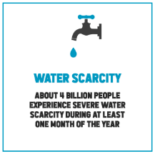
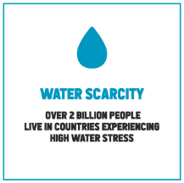
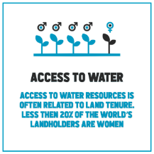
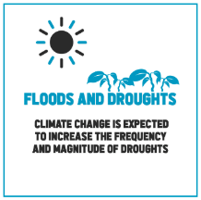
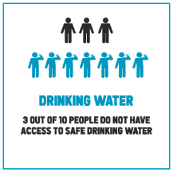
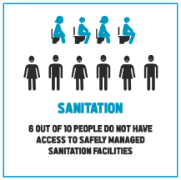
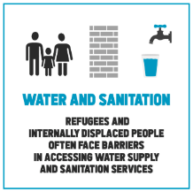
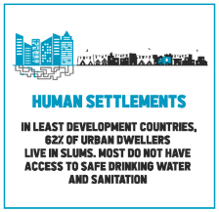

Issues
UNESCO, UN-Water, 2019: United Nations World Water Development Report 2019: Leaving No One Behind. Paris, UNESCO.
Notes:
Except otherwise noted, “Why study water on Earth” presentation by Cnes/Aviso is licensed under CC BY-SA 4.0. To view a copy of this license, visit https://creativecommons.org/licenses/by-sa/4.0

